Slide 1



Slide 2
2025 Daily Occupancy

Slide 3
2025 Daily Occupancy
53%
below 50%

Slide 4
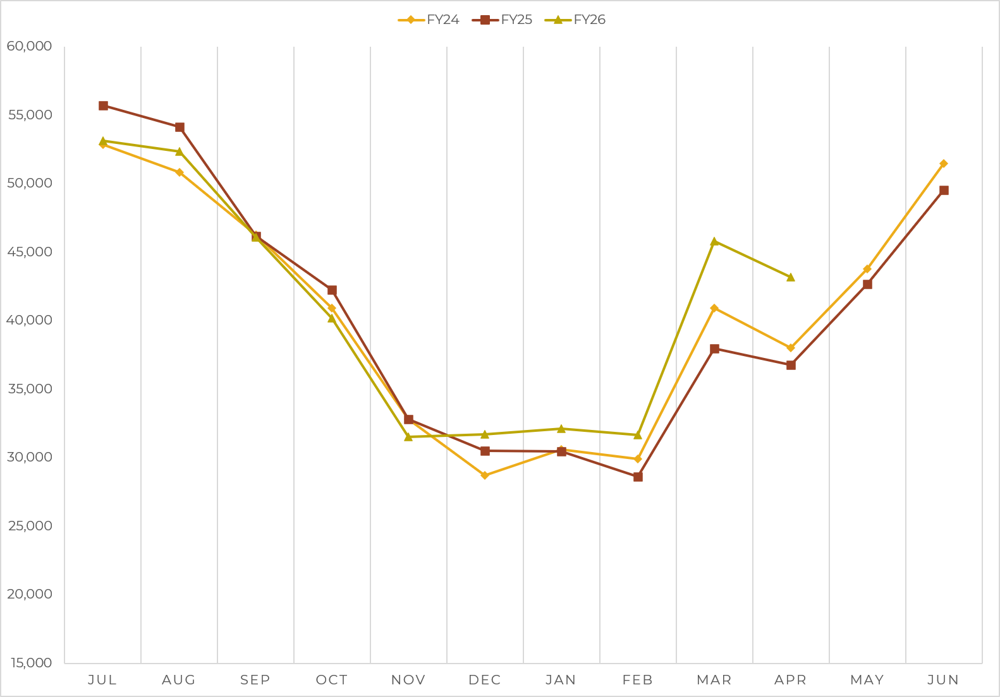
Annual Room Demand

Slide 5
Annual Room Demand
BEST April Ever!

Slide 6

PROMOTE
Outdoor Experiences, Art, Culture, Heritage, Events, Affordability, Accessibility,
Off-Peak

