Slide 1
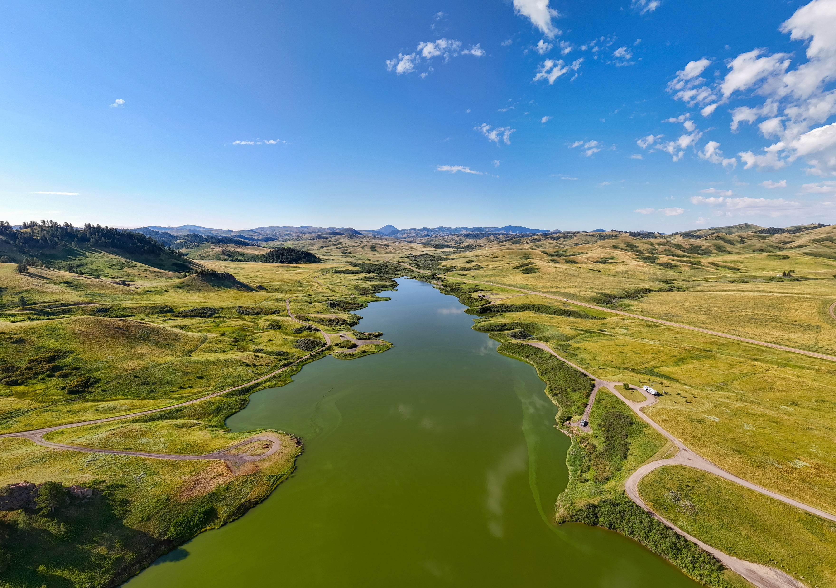

FY27 PLAN

Slide 2
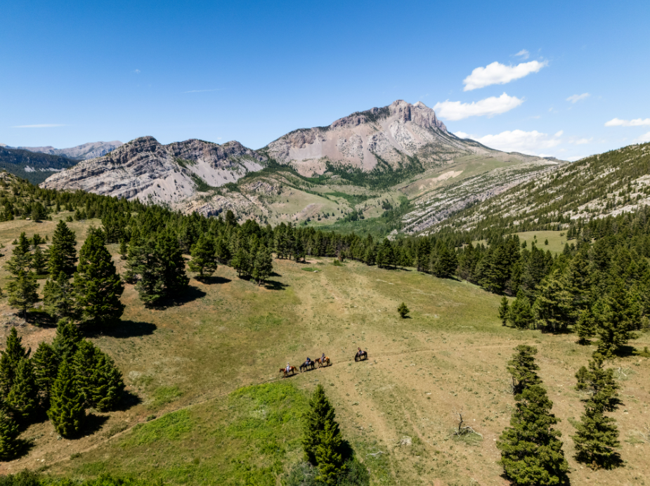
Increase visitation to and around Central Montana
Strategies: Scenic Drive Content, Earned Media/Influencers/Content Creators, Photo + Video Library

Slide 3
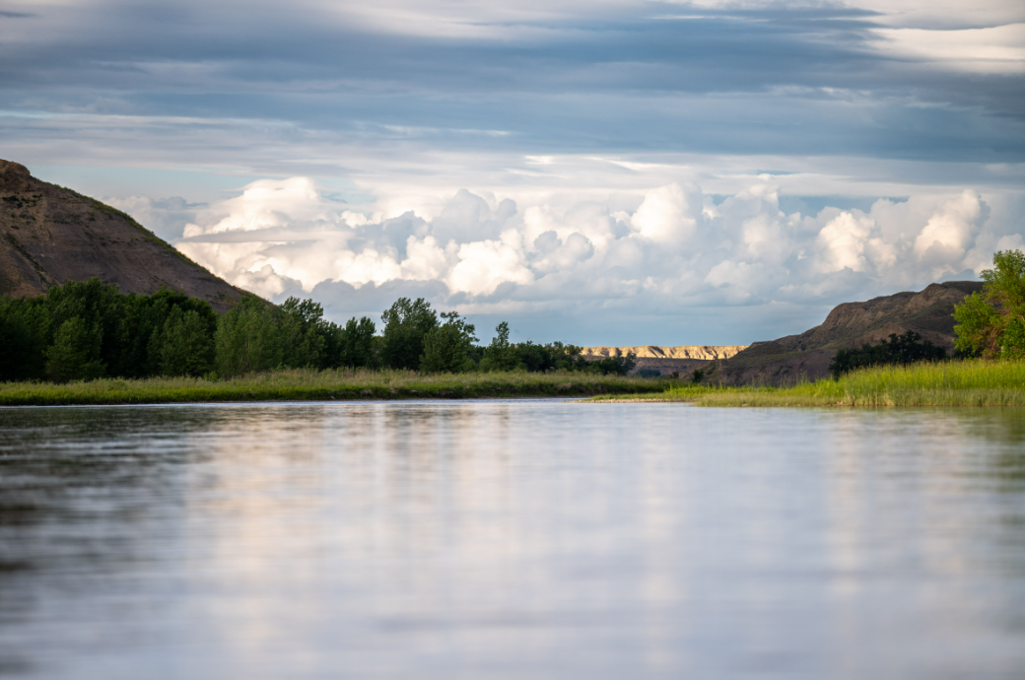
Public Outreach
73%
64%
2%
of residents say tourism has a positive impact on their community
support continued growth of tourism in their county
want tourism activity reduced
Strategies: Economic Impact, Grants, Exploration: Central Montana, Partner Communication, Crisis Communication Plan

Slide 4
Thanks!
Budget: $599,303

