Slide 1
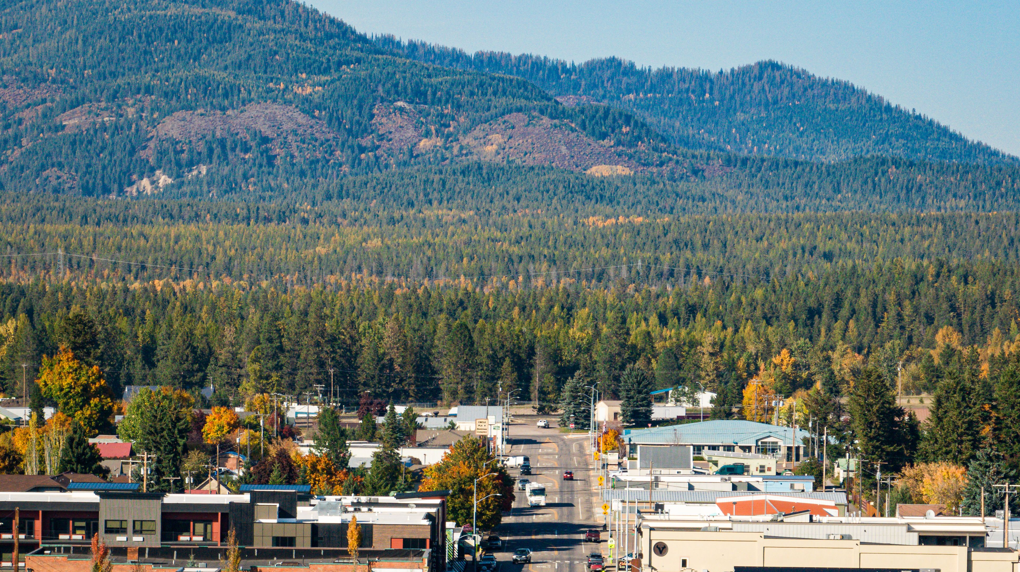

FY27 Destination Marketing Organization Presentation
Presented by:
Laura Gadwa
Executive Director, Columbia Falls Area Chamber of Commerce & Columbia Falls DMO
www.discovercolumbiafallsmt.com

Slide 2
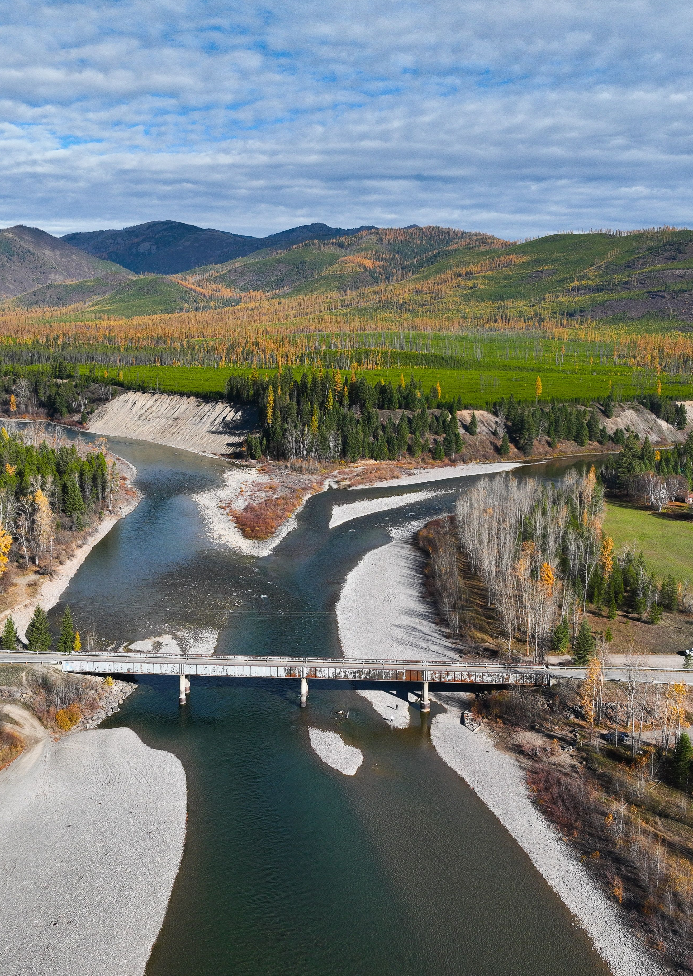
Fy27 Focus Areas
Destination
Marketing
Destination
Stewardship

Slide 3
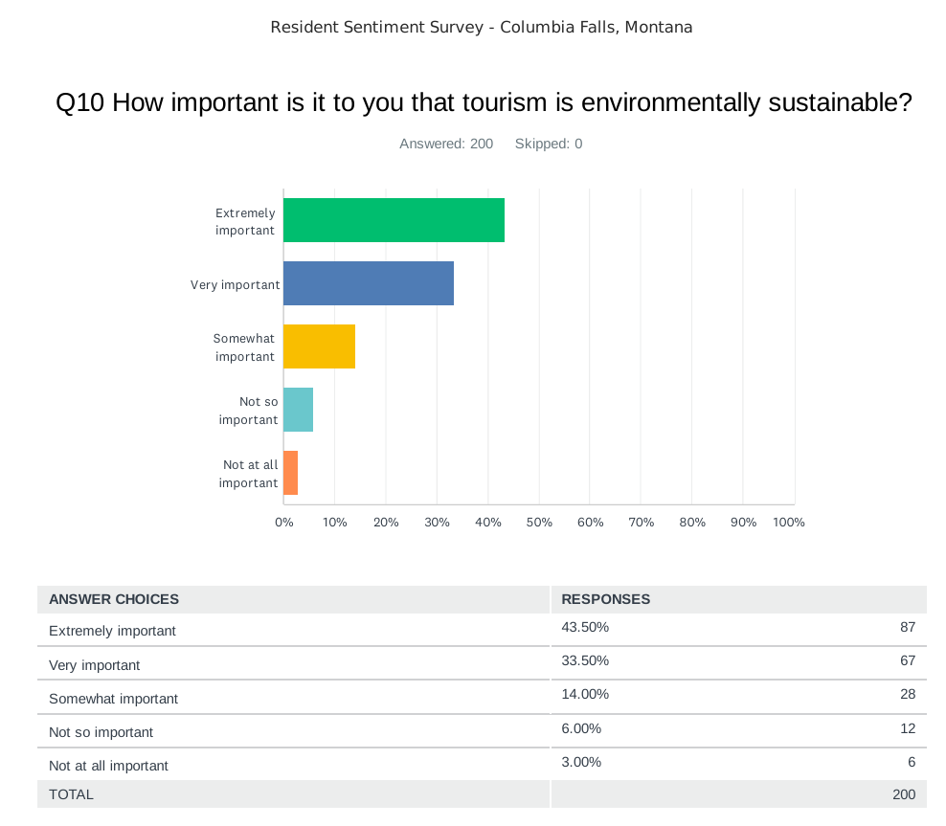
Destination Stewardship – Data Driven Focus
Resident Sentiment Survey Data & Community Meetings
Overarching Themes Identified
1. Overcrowding
  Residents report feeling the strain of peak‑season congestion.
  Concerns about quality of life during summer months.
2. Environmental Concerns and Sustainability
  Strong desire to protect rivers, forests, wildlife, and public lands.
  Emphasis on responsible recreation and stewardship education.
  Interest in long‑term planning that preserves natural resources.
  Support for strategies that reduce seasonal strain and spread visitation.

Slide 4
Destination Stewardship – Data Driven Focus
Resident Sentiment Survey Data & Community Meetings
Overarching Themes Identified
3. “Focus on Our Community First”
  Clear message: tourism should support—not overshadow—local needs.
  Desire for balanced growth that benefits resident's year‑round.
“It starts and ends with the people who live and work there. Incentivize them, make them feel as if they own a piece of the pie and the community will boom and embrace tourism.”
4. Infrastructure. Parking, Traffic & Transportation
    Pressure on roads, parking, and public facilities during peak season.
    Need for improved communication around construction, closures, and access.
    Peak‑season traffic is a top frustration.
    Need for better visitor guidance, signage, and trip‑planning resources

Slide 5
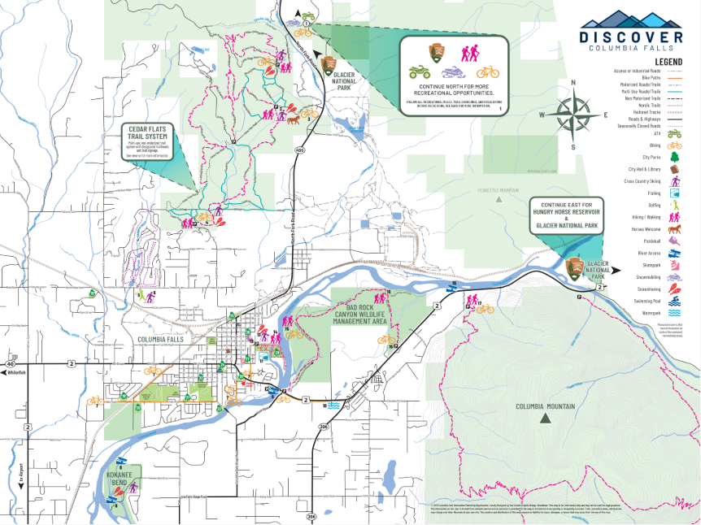
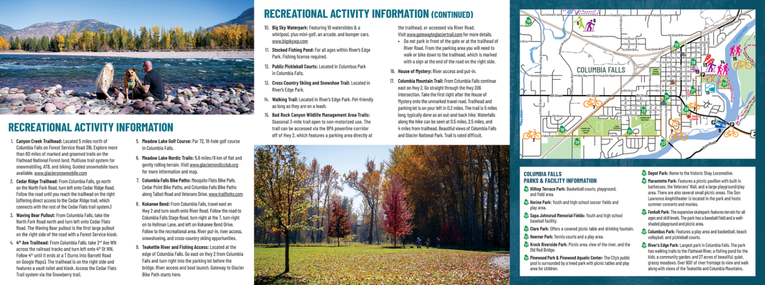
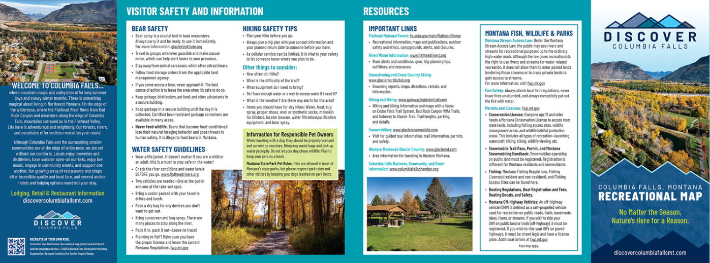
Destination Stewardship – Data Driven Focus
Resident Sentiment Survey Data & Community Meetings
Overarching Themes Identified
5. Education
  Residents want visitors to understand:
    Local rules and expectations
    Safety practices
    How to recreate responsibly
  Strong support for more visitor‑facing educational materials.
“How do we educate tourists that this is our community, not their personal playground?”

Slide 6
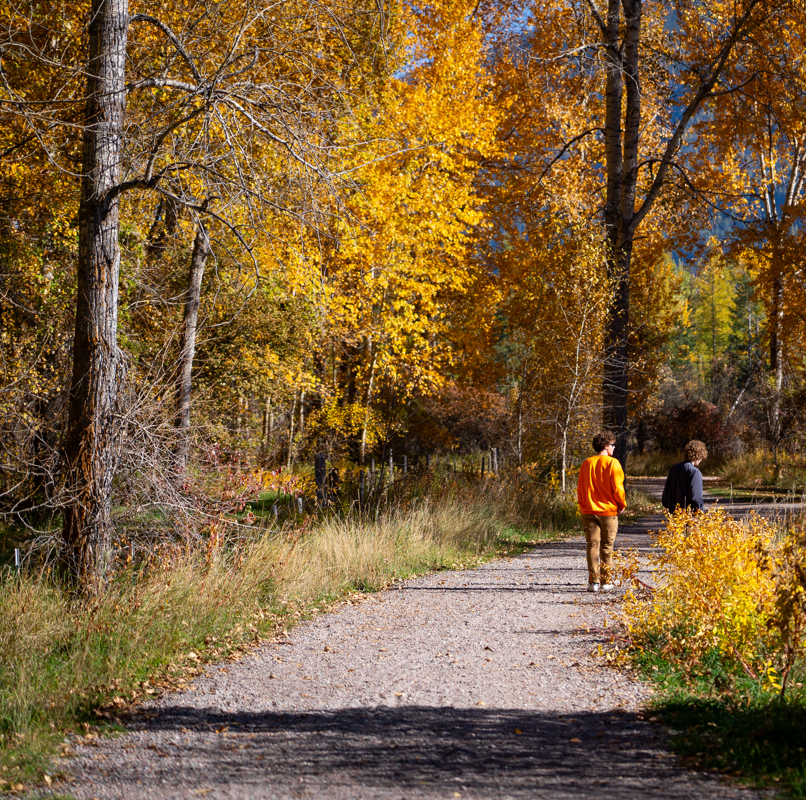
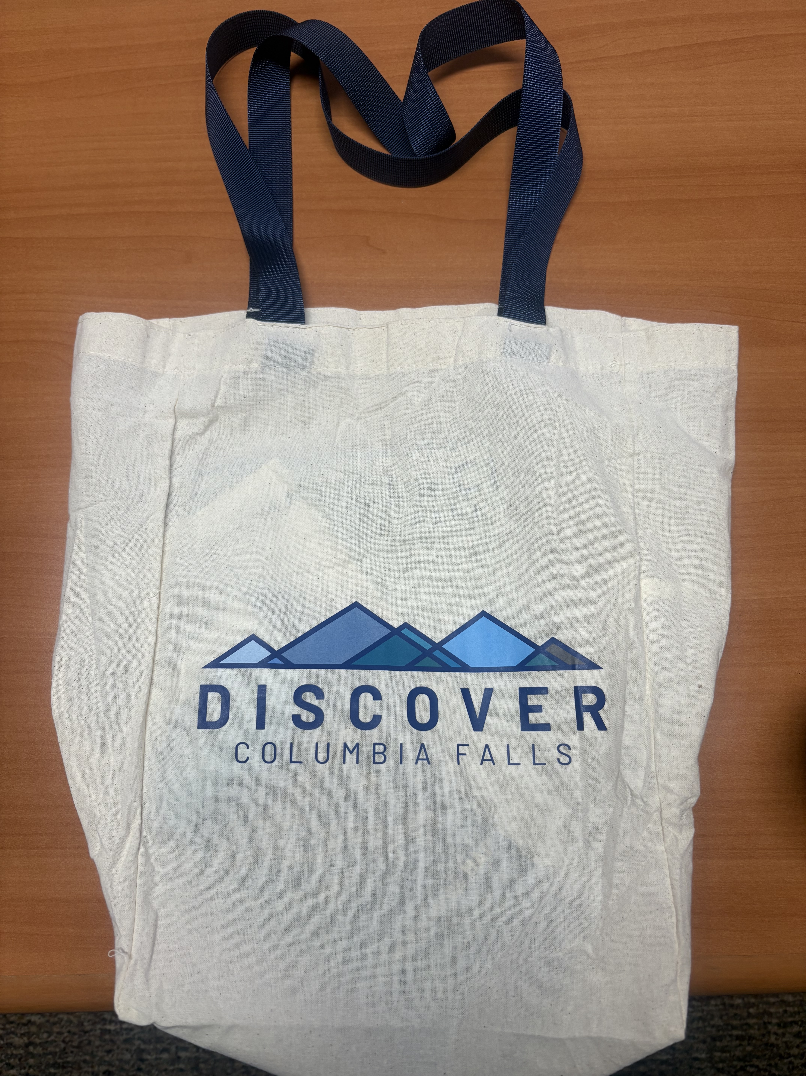
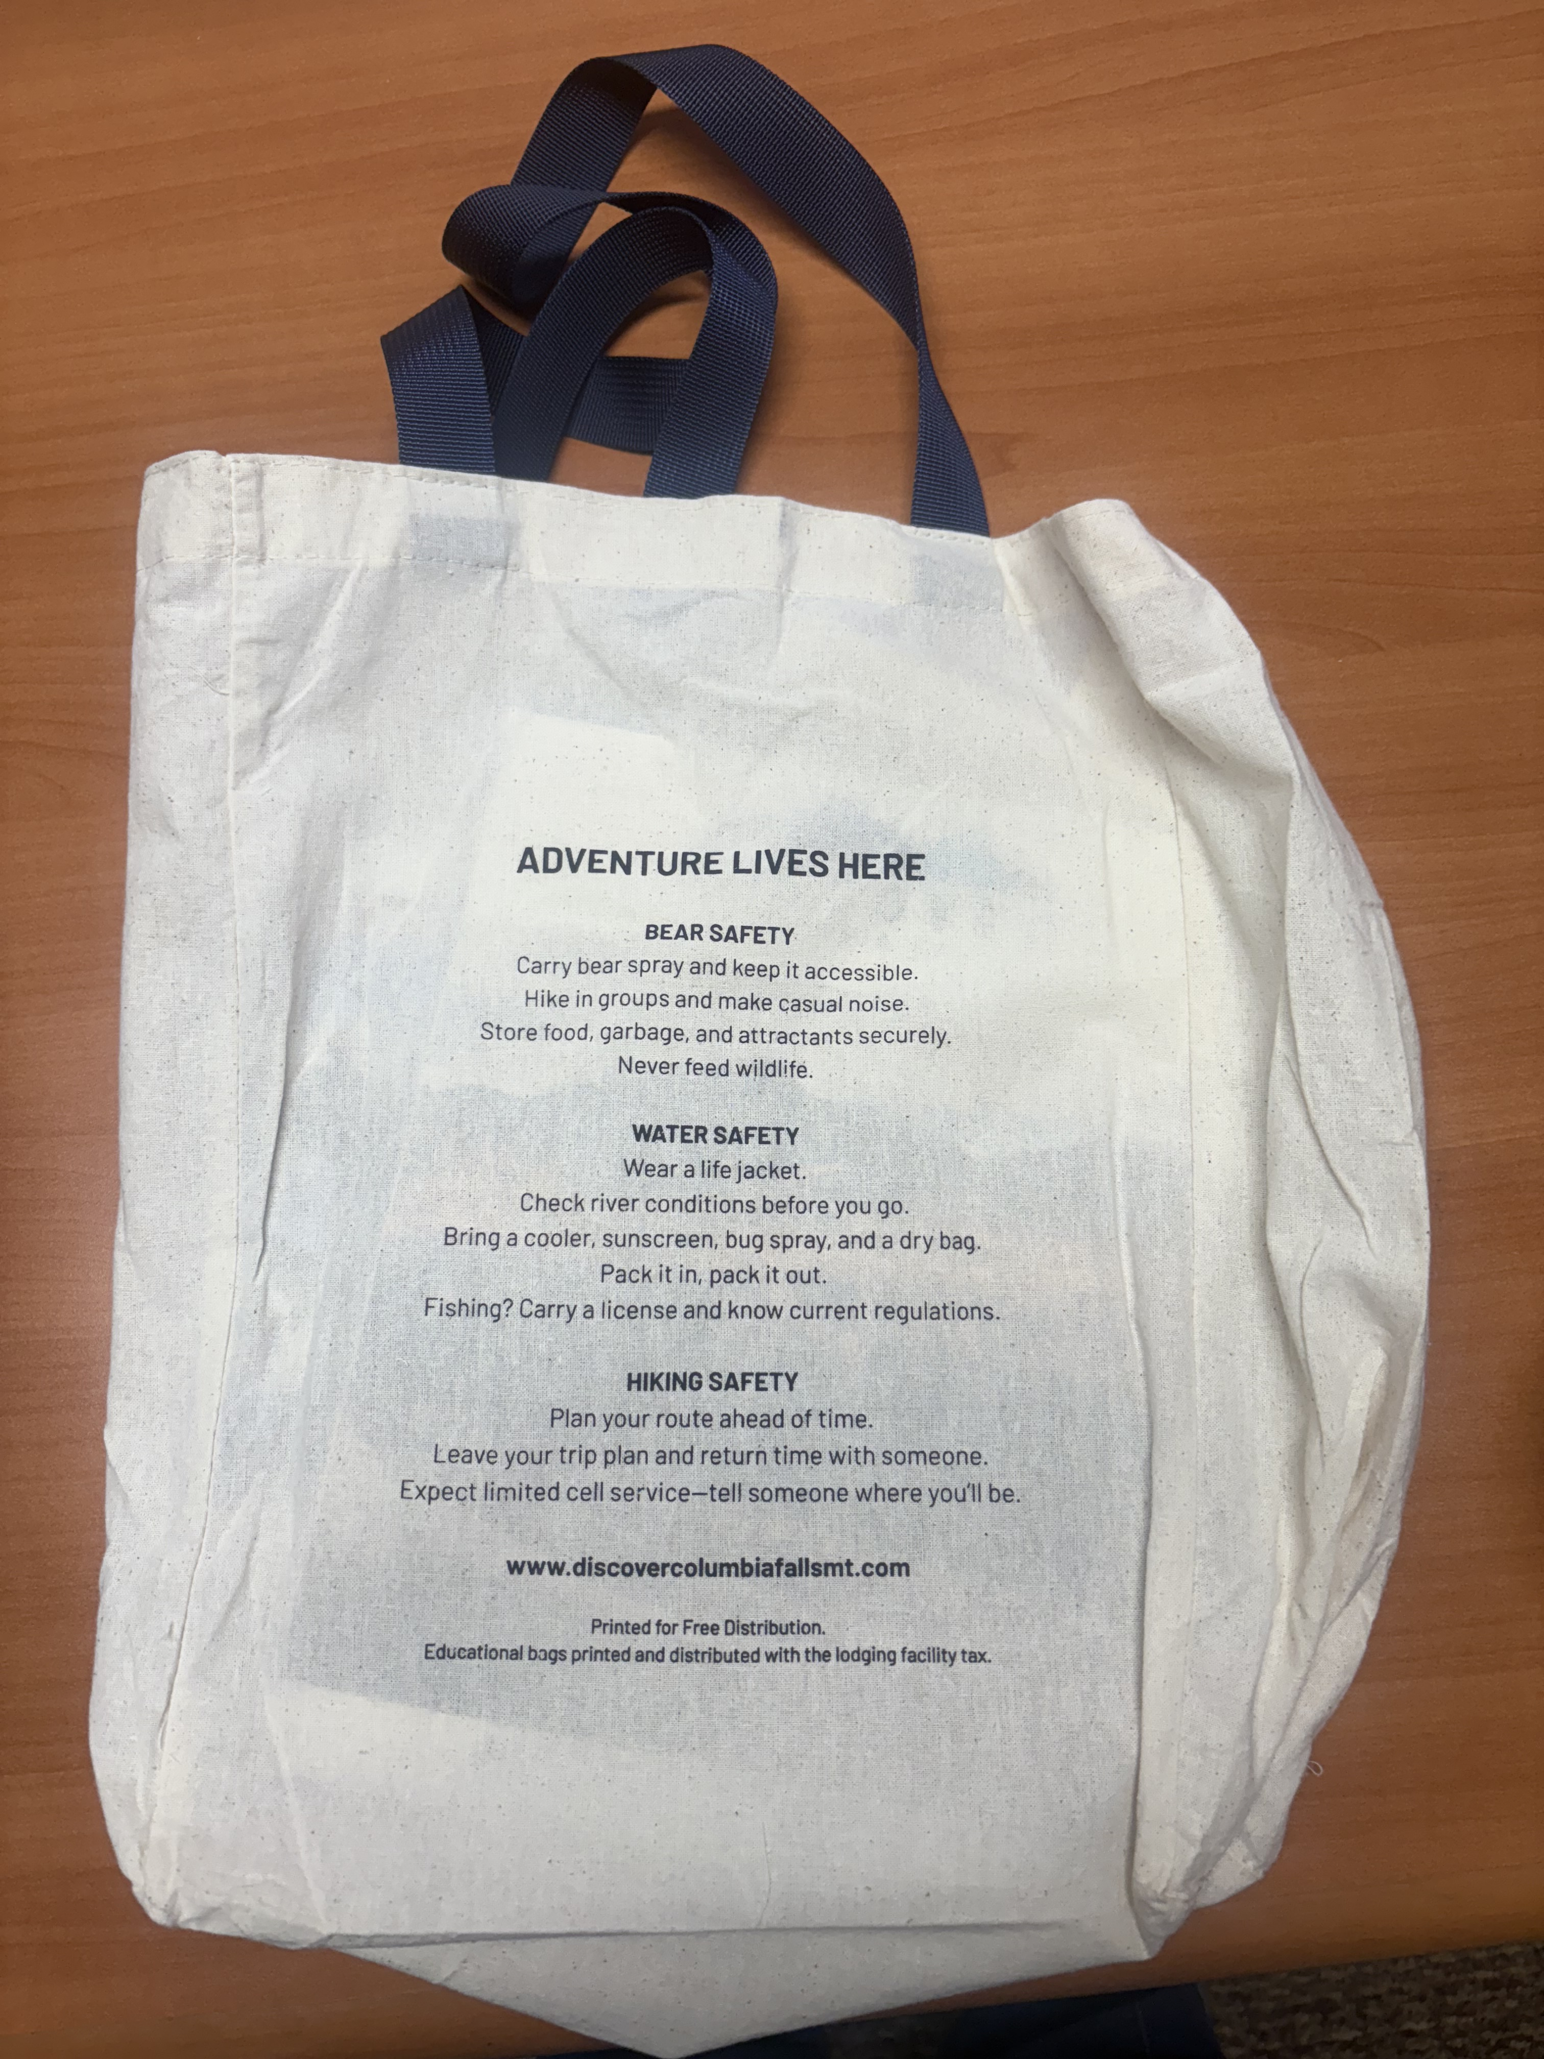
Fy27 Strategies and Goals
Rivers Edge Park
Columbia Falls, MT
Strengthening Destination Stewardship
First, we are expanding our stewardship efforts to ensure visitors have the information they need to recreate safely and responsibly.
This includes:
  Increasing distribution of our educational bags and information packets by 5% over FY26
  Developing two new educational resources for community‑wide distribution
  Enhancing signage, printed materials, and digital content
  Partnering with local organizations to share consistent messaging
  Providing clear information about public lands, river access, weather, and seasonal conditions
  Help visitors understand GNP reservation systems, construction updates, and road closures
.

Slide 7
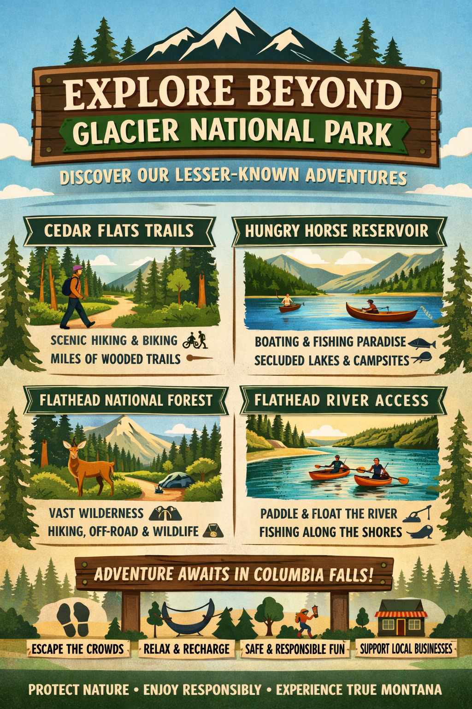
Destination Marketing – Data Driven Focus
Resident Sentiment Survey Data & Community Meetings
Overarching Themes Identified
7. Dispersed Tourism Outside Glacier National Park
  Community supports promoting:
    Cedar Flats
    Hungry Horse Reservoir
    Flathead National Forest
    Local parks and river access
  Reduce pressure on GNP and spread out the economic benefit.
.

Slide 8
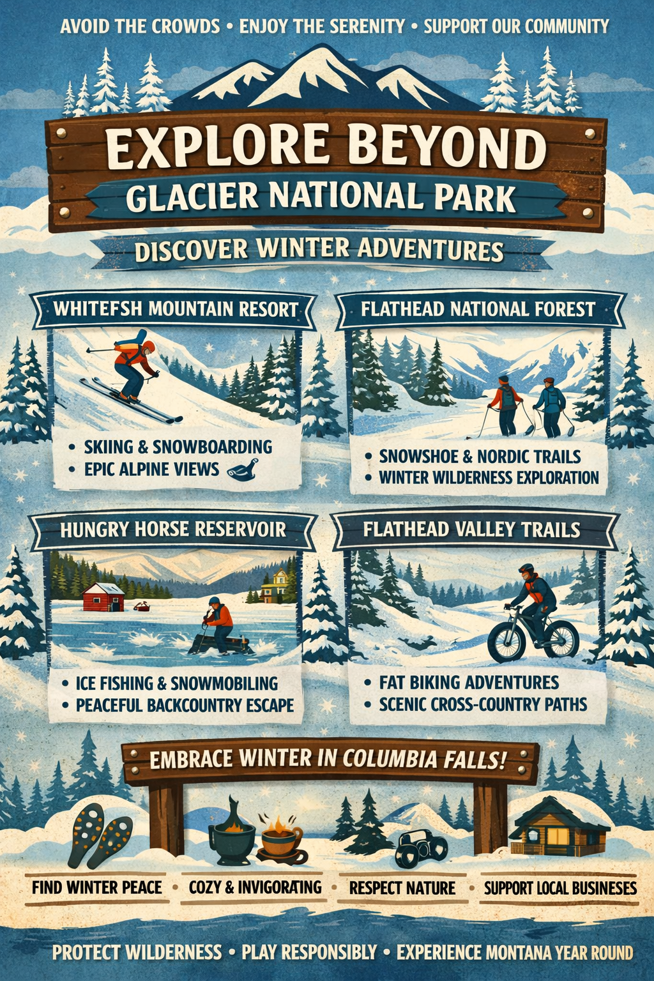
Destination Marketing – Data Driven Focus
First, the seasonality issue. Bed tax revenue for the Glacier Country region in 2025 shows a dramatic imbalance:
  Q1: $42,893
  Q2: $238,123
  Q3: $876,824
  Q4: $35,001
That means nearly 70% of annual revenue is concentrated in the summer quarter alone. This level of seasonality creates strain on infrastructure, businesses, and natural resources during peak months, while leaving significant opportunity for growth the rest of the year.
.

Slide 9
Destination Marketing – Data Driven Focus
Airport data tells the same story. Glacier Park International Airport enplanements in 2025 peak sharply in summer:
  June: 61,000
  July: 86,000
  August: 85,000
But in the shoulder and winter months, numbers drop by half or more:
  April: 26,000
  November: 26,000
  December: 31,000
.

Slide 10
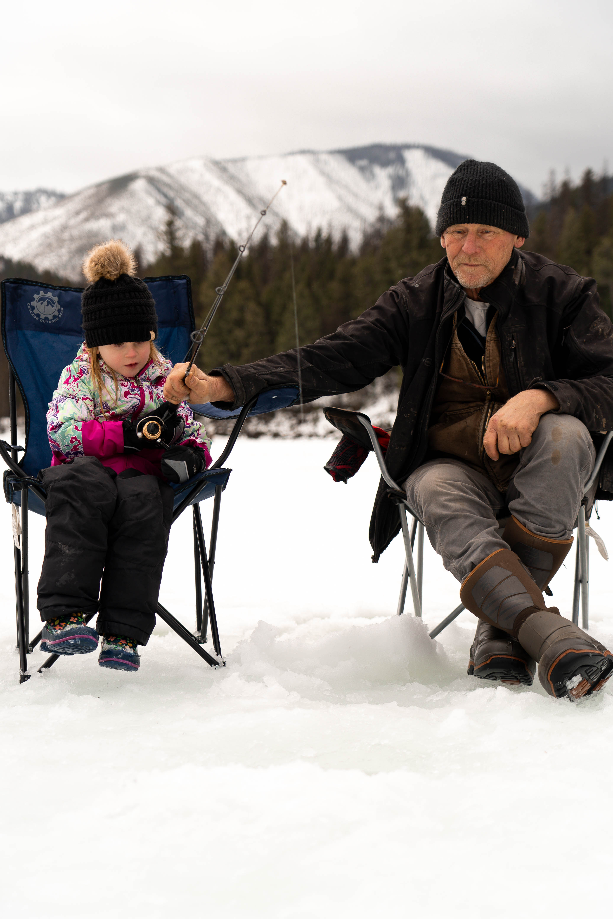
Fy27 Destination Marketing Strategies
Our second major strategy is to elevate Columbia Falls as a year‑round home base for recreation and community experiences.
We will:
  Launch targeted marketing campaigns for fall, winter, and spring
  Promote recreation outside Glacier National Park, including Cedar Flats, Hungry Horse Reservoir, Flathead National Forest, and the Flathead River
  Highlight local events, small‑town charm, and authentic community experiences
  Continue building out the Discover Columbia Falls brand to reflect who we are as a community
  Post and boost educational and promotional content at least six times per quarter on two social media platforms, ensuring consistent visibility and engagement.
.

Slide 11
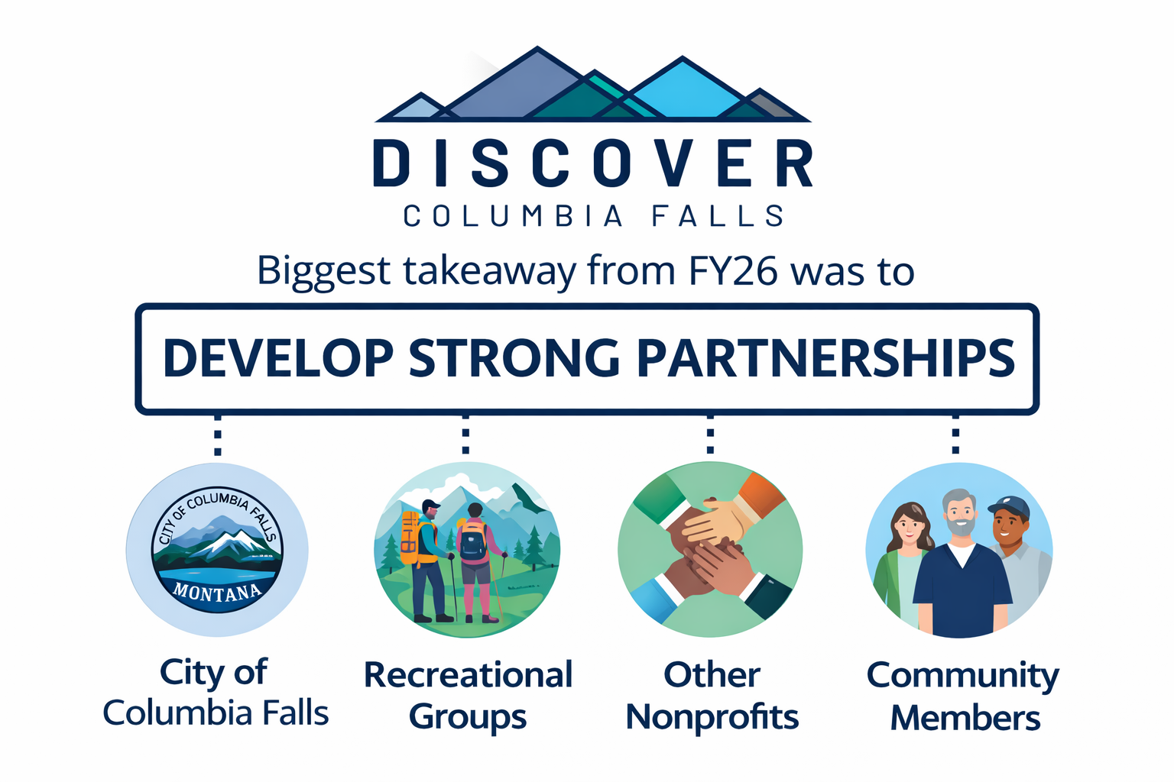

Slide 12
Thank you from the Columbia falls dMO
Any questions?
Laura Gadwa
discovercolumbiafallsmt@gmail.com
director@columbiafallschamber.org
406-892-2072
No Matter the Season.
Natures Here for a Reason.

