Slide 1
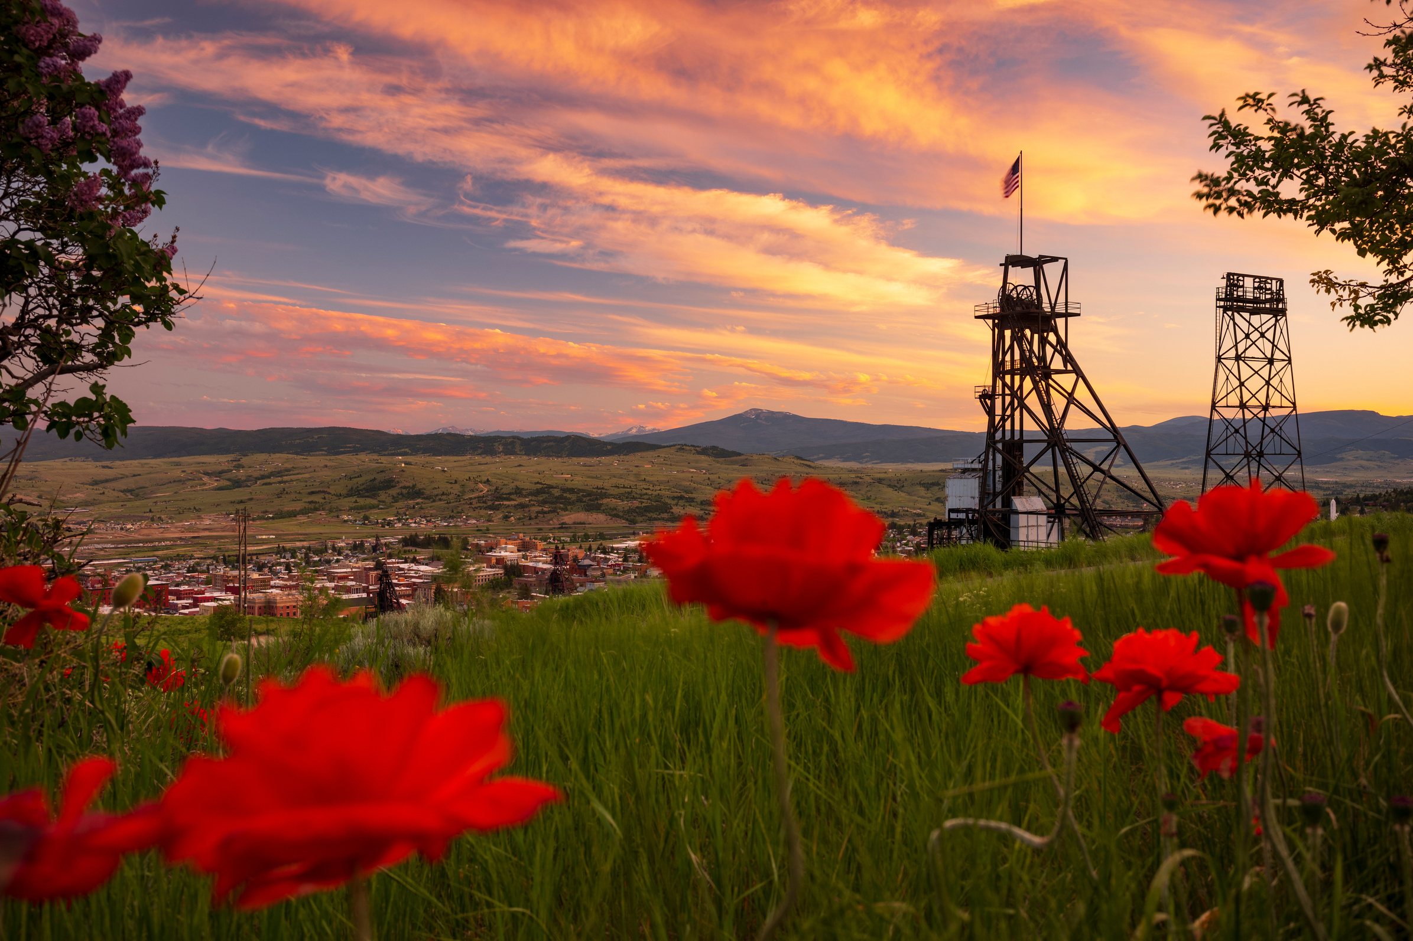
BUTTE DMO
MARKETING PLAN
2027
WILDLY HISTORIC
Presented By : Kehli Hazlett & Jeanette Kopf

Slide 2
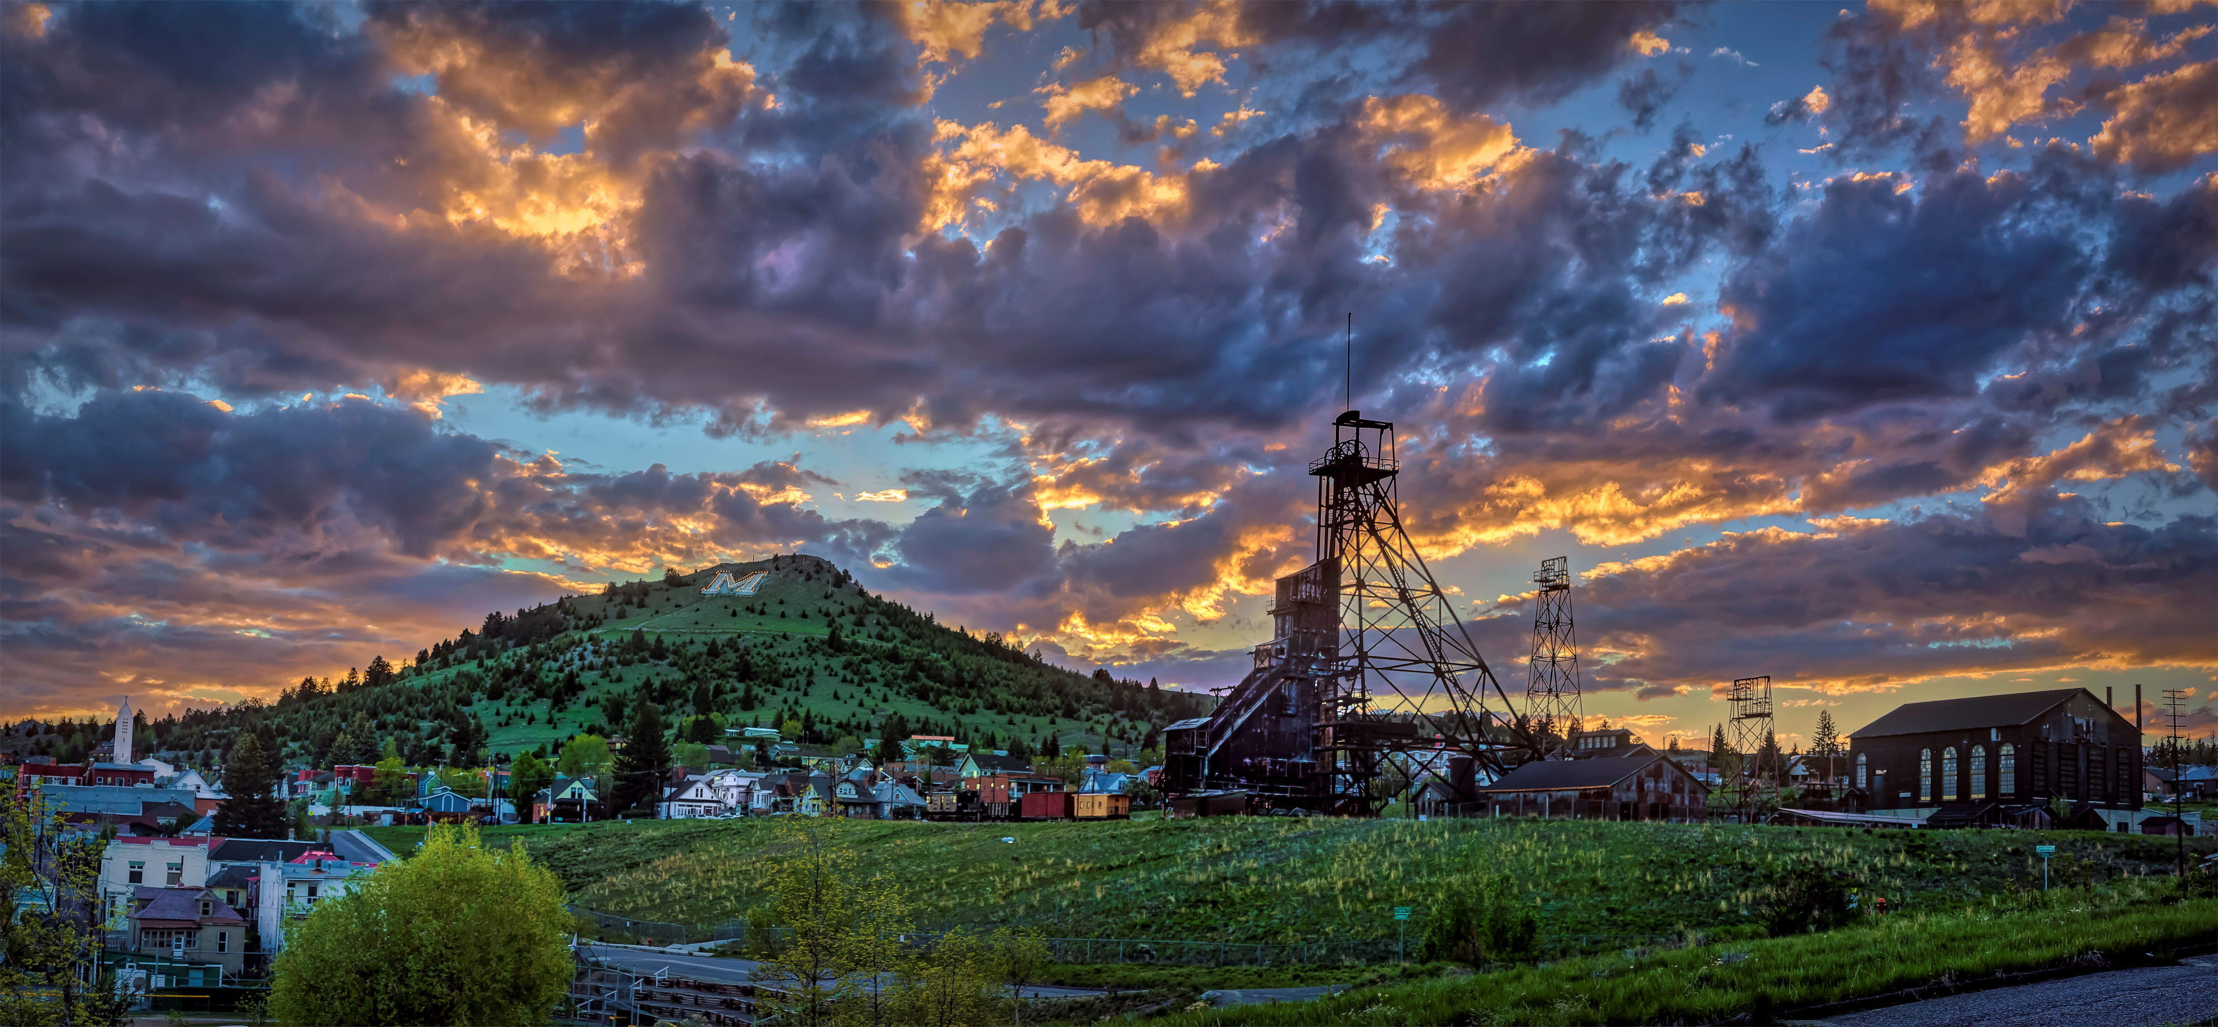
FOCUS FOR 2027
INCREASE IN DOMESTIC TOURISM
INCREASE LENGTH OF STAY & VISITOR SPENDING
STRENGTHEN BRAND IDENTITY
PROMOTE SUSTAINABLE TOURISM
Expand awareness and visitation from key regional markets including Montana, Washington, Utah, Idaho, Colorado, and
Oregon.
Increase Length of Stay and Spending: Promote historical tours, outdoor adventures, cultural events, and local businesses.
Position Butte as a must-visit, year-round destination due to its history, scenic landscapes, and festivals.
Encourage long-term growth while preserving historical, cultural & environmental assets,.

Slide 3

SUPPORTING DATA
INCREASE IN DOMESTIC TOURISM
INCREASE LENGTH OF STAY & VISITOR SPENDING
STRENGTHEN BRAND IDENTITY
PROMOTE SUSTAINABLE TOURISM
Montana, Washington, Utah, & Idaho Visitation shown through Placer.ai & ITRR.
Butte had approximately 487,000 overnight hotel stays per ITRR & TBID Butte Demographics Information.
Position Butte as a must-visit, year-round destination as the state of Montana has 3,295,000 drive-through visitors,(ITRR).
Encourage long-term growth while preserving historical, cultural & environmental assets, by converting our drive through visitors ( Butte: 92%) into longer stays.

Slide 4
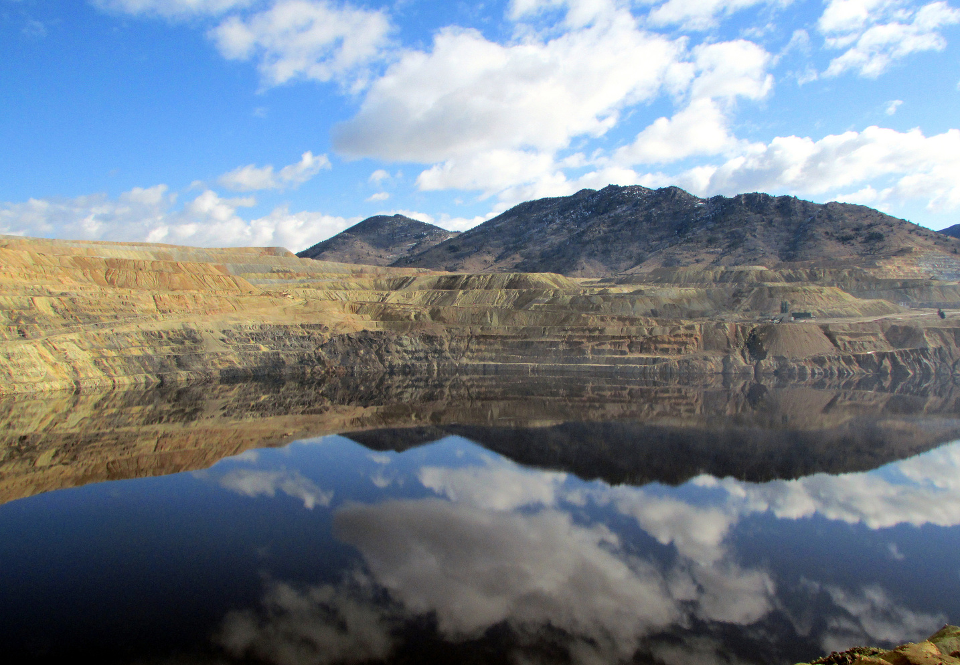

STRATEGIES
GREAT BUTTE ADVENTURE
INCREASE WEBSITE TRAFFIC
RETARGETING MARKETING ADS
WEBSITE PIXEL CLICKS
GOOGLE ADS

Slide 5
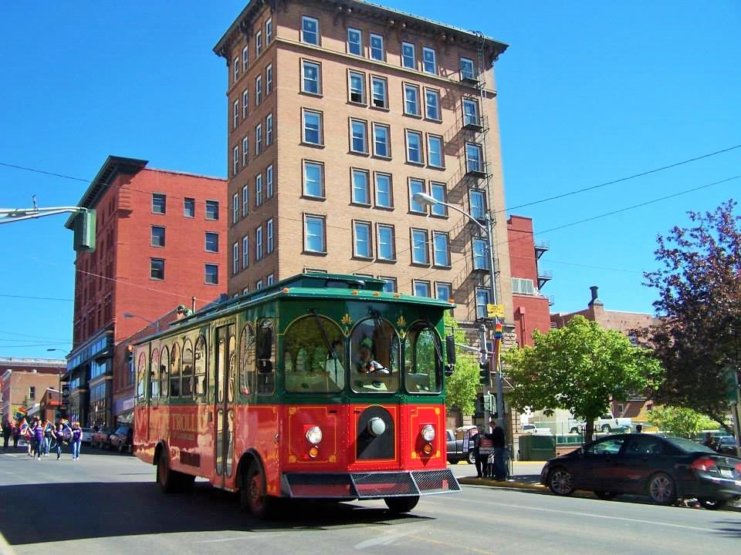

THANK YOU
BUTTE DMO
www.visitbutte.com

