Slide 1
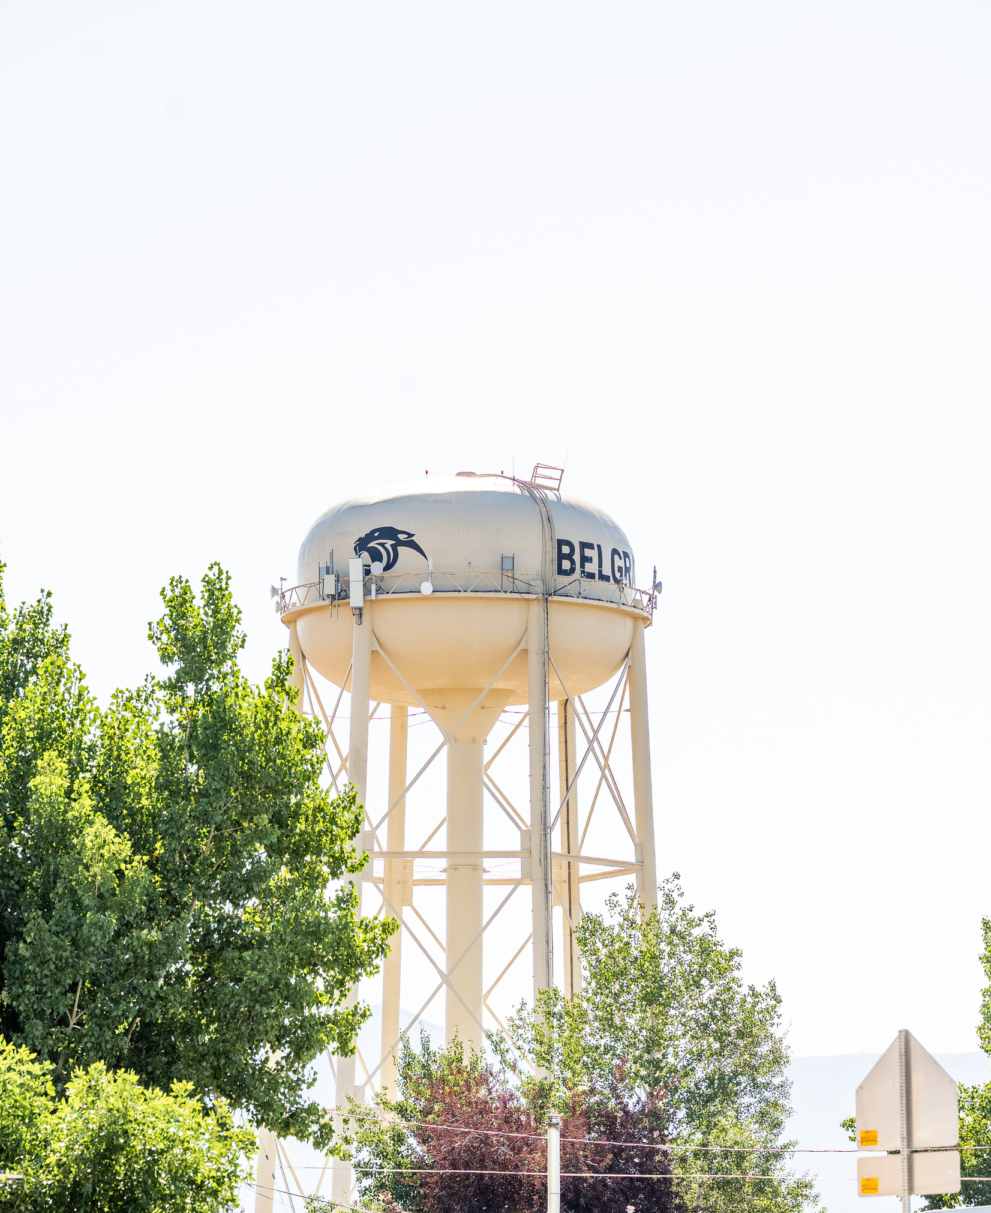

FY27 DMO Plan
BELGRADE
BUILDING MONTANA’S BASECAMP
“One small step at a time”

Slide 2
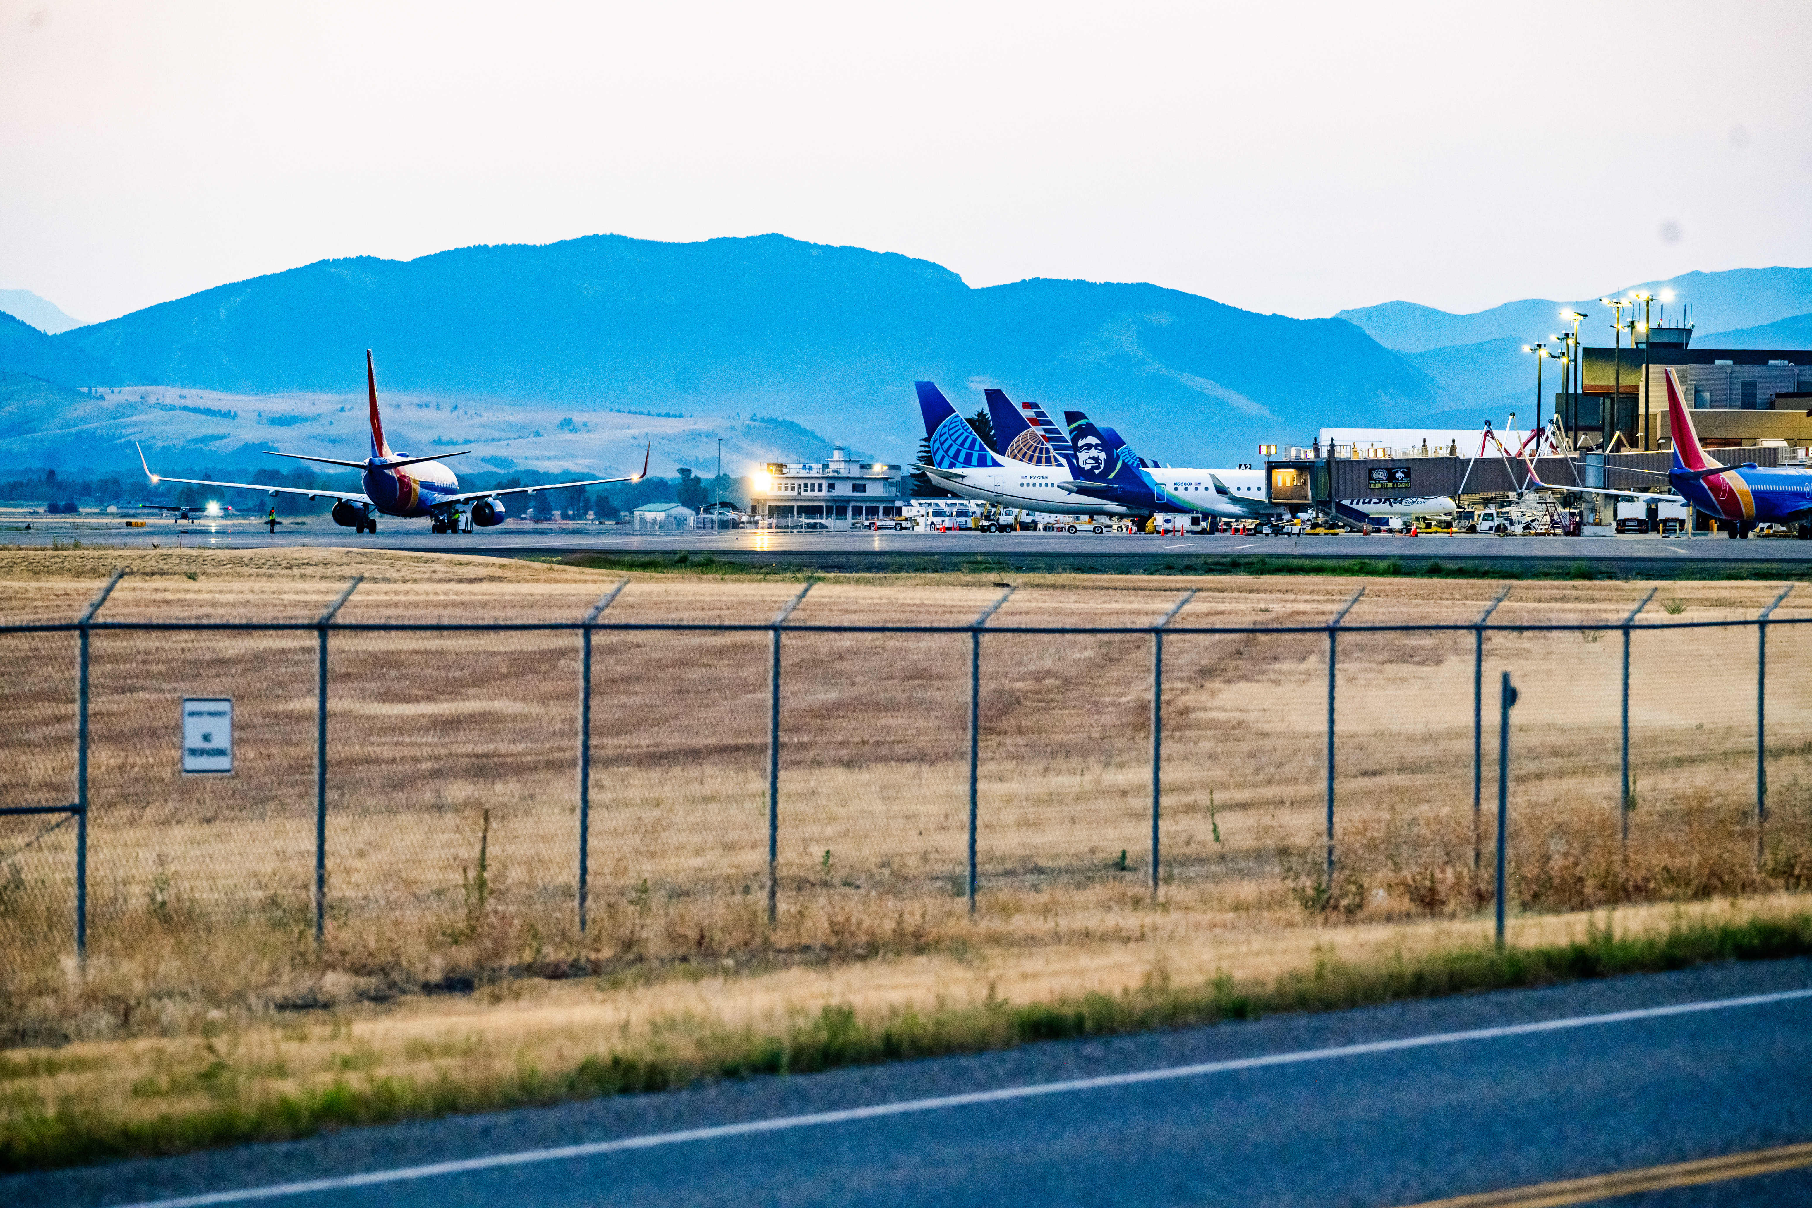
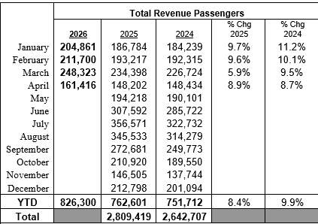
WHY BELGRADE MATTERS
First Stop outside Montana’s Busiest Airport
Gateway to Yellowstone Country
Small-town Montana Feel
Growing Community with strong local identity
We are creating meaningful first impressions of Montana visitors

Slide 3
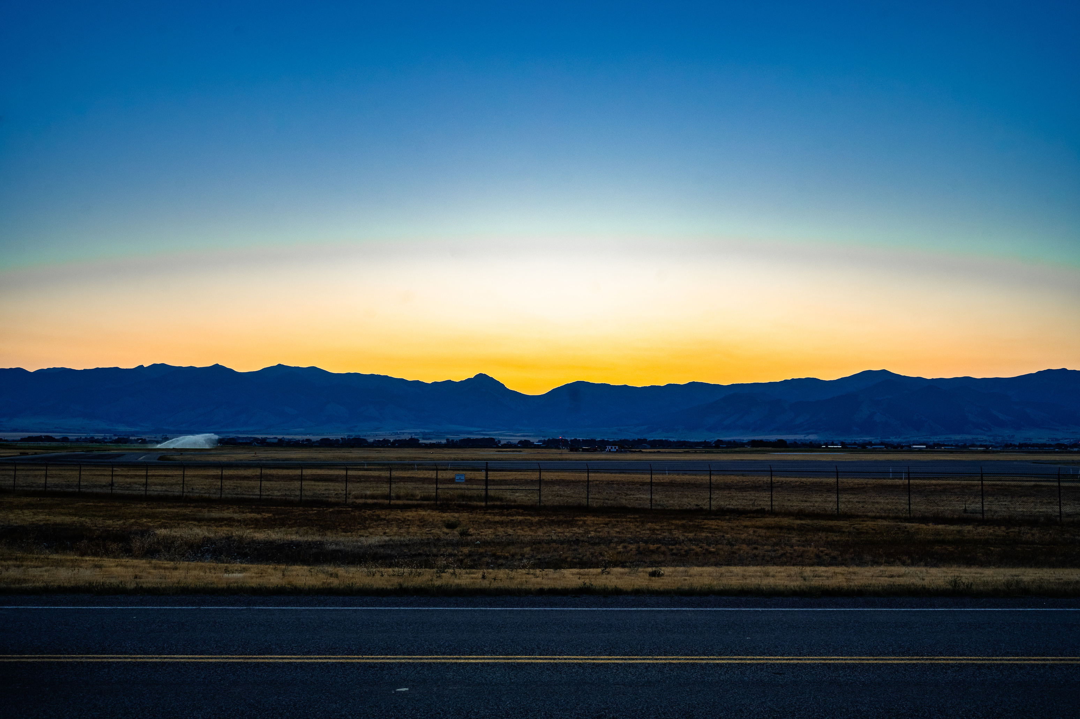
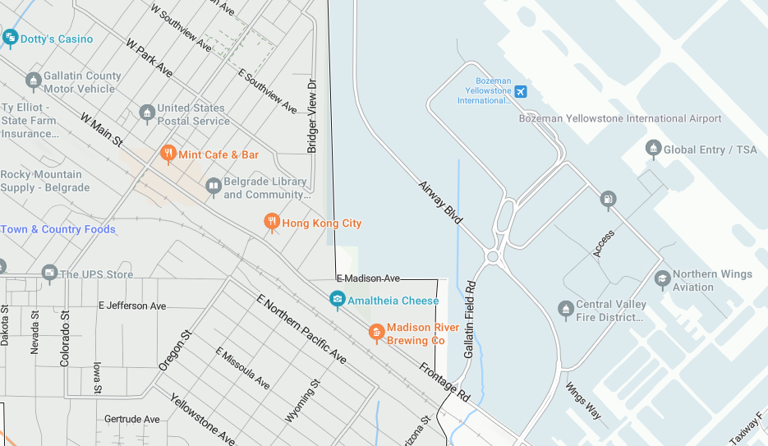
Our VIC is approximately a 3 minute drive from BZN

Slide 4


KEEP IT SIMPLE
DO THE BASICS WELL...
Build Slowly & Intentionally
Strengthen Visitor Experiences
Support Local Businesses
Encourage Visitors to Stay Longer
Position Belgrade as a Basecamp to Explore Yellowstone Country and Beyond

Slide 5
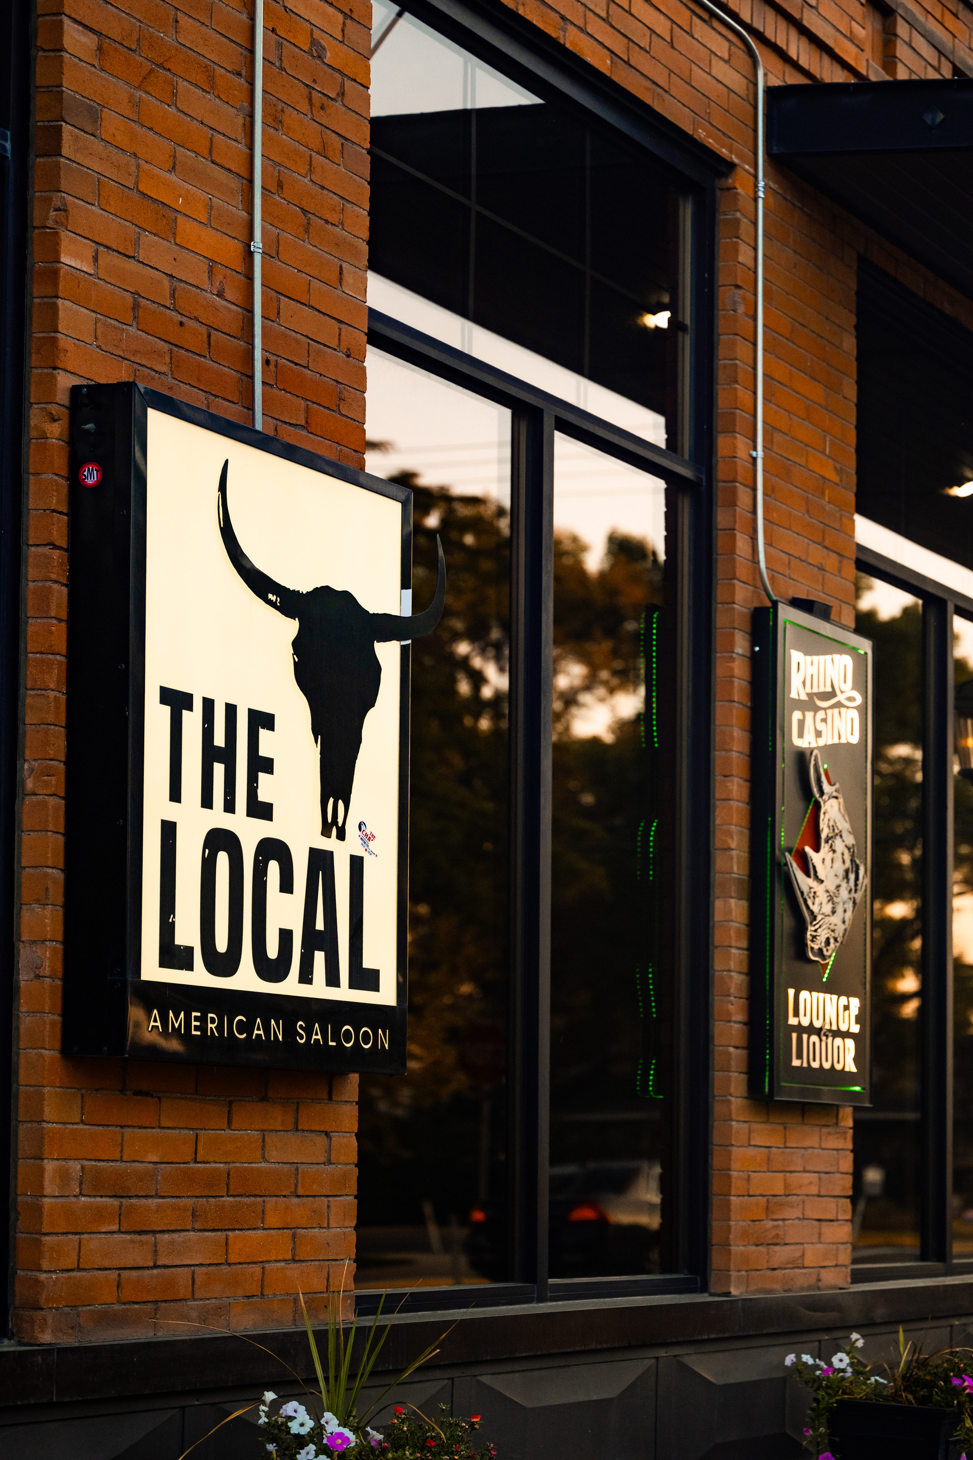
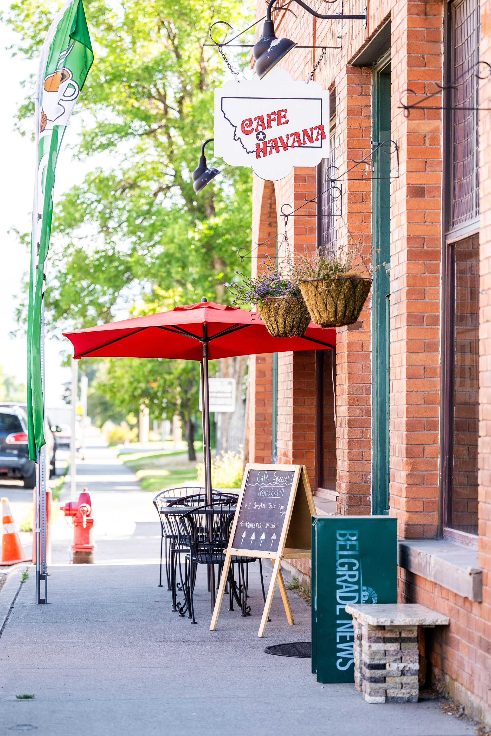
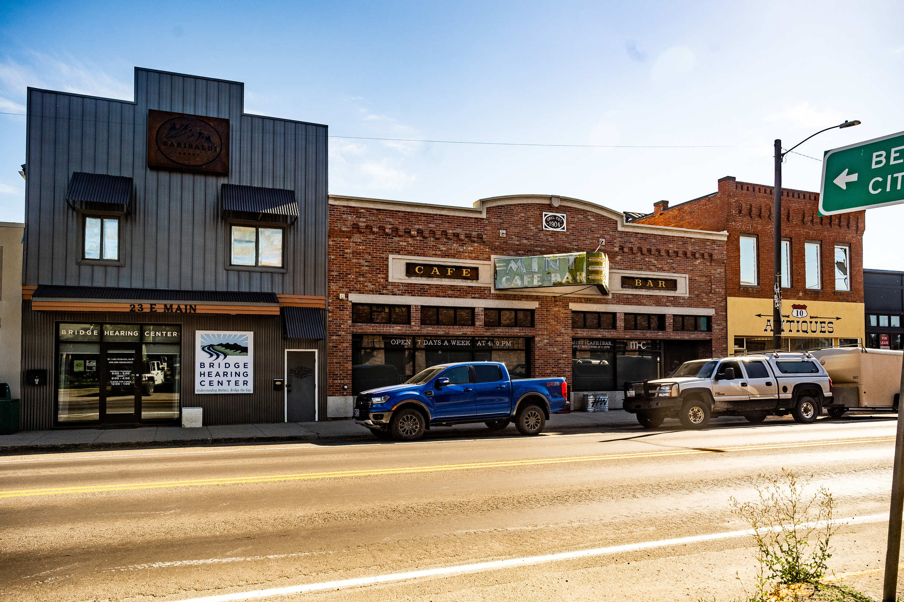
TODAY’S
TRAVELER
Authentic Experiences
Less Crowded Destinations
Convenient Locations
Local Businesses
Community Feel
Belgrade Naturally fits what today’s travelers are looking for.
Yellowstone National Park

Slide 6
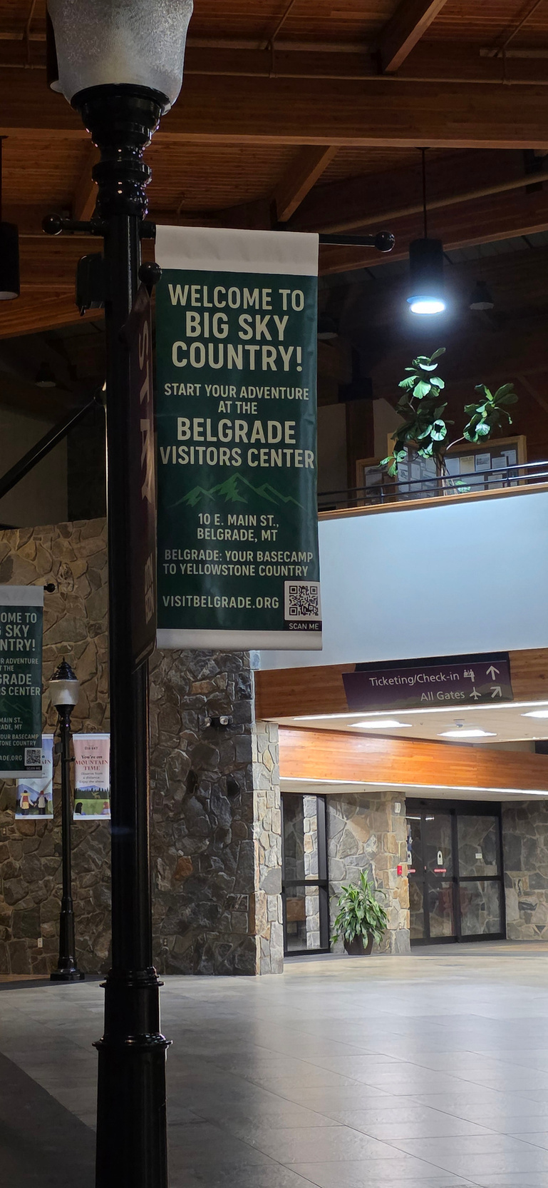
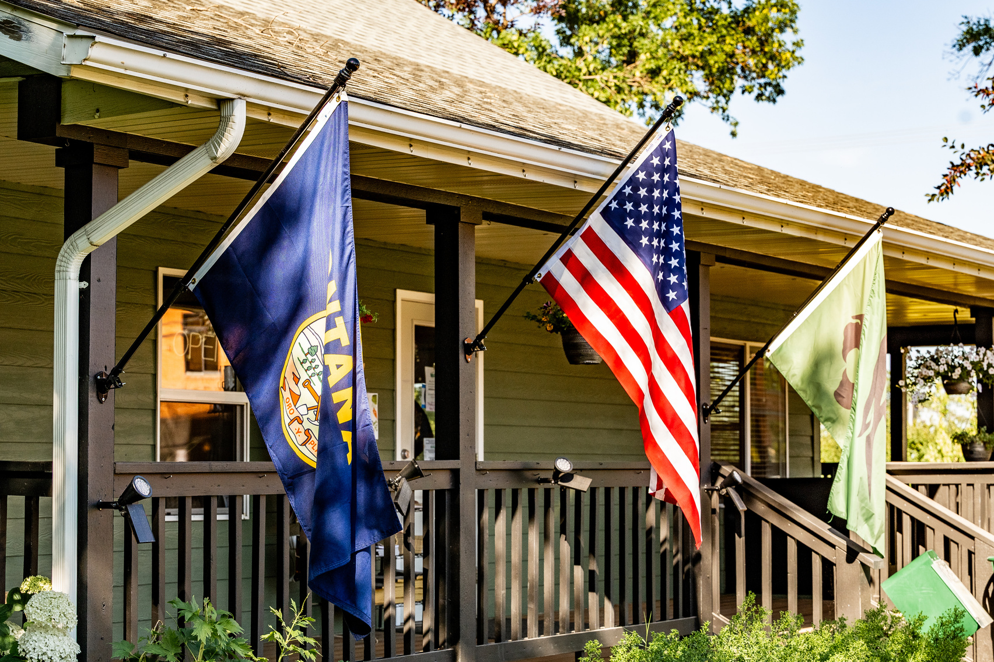
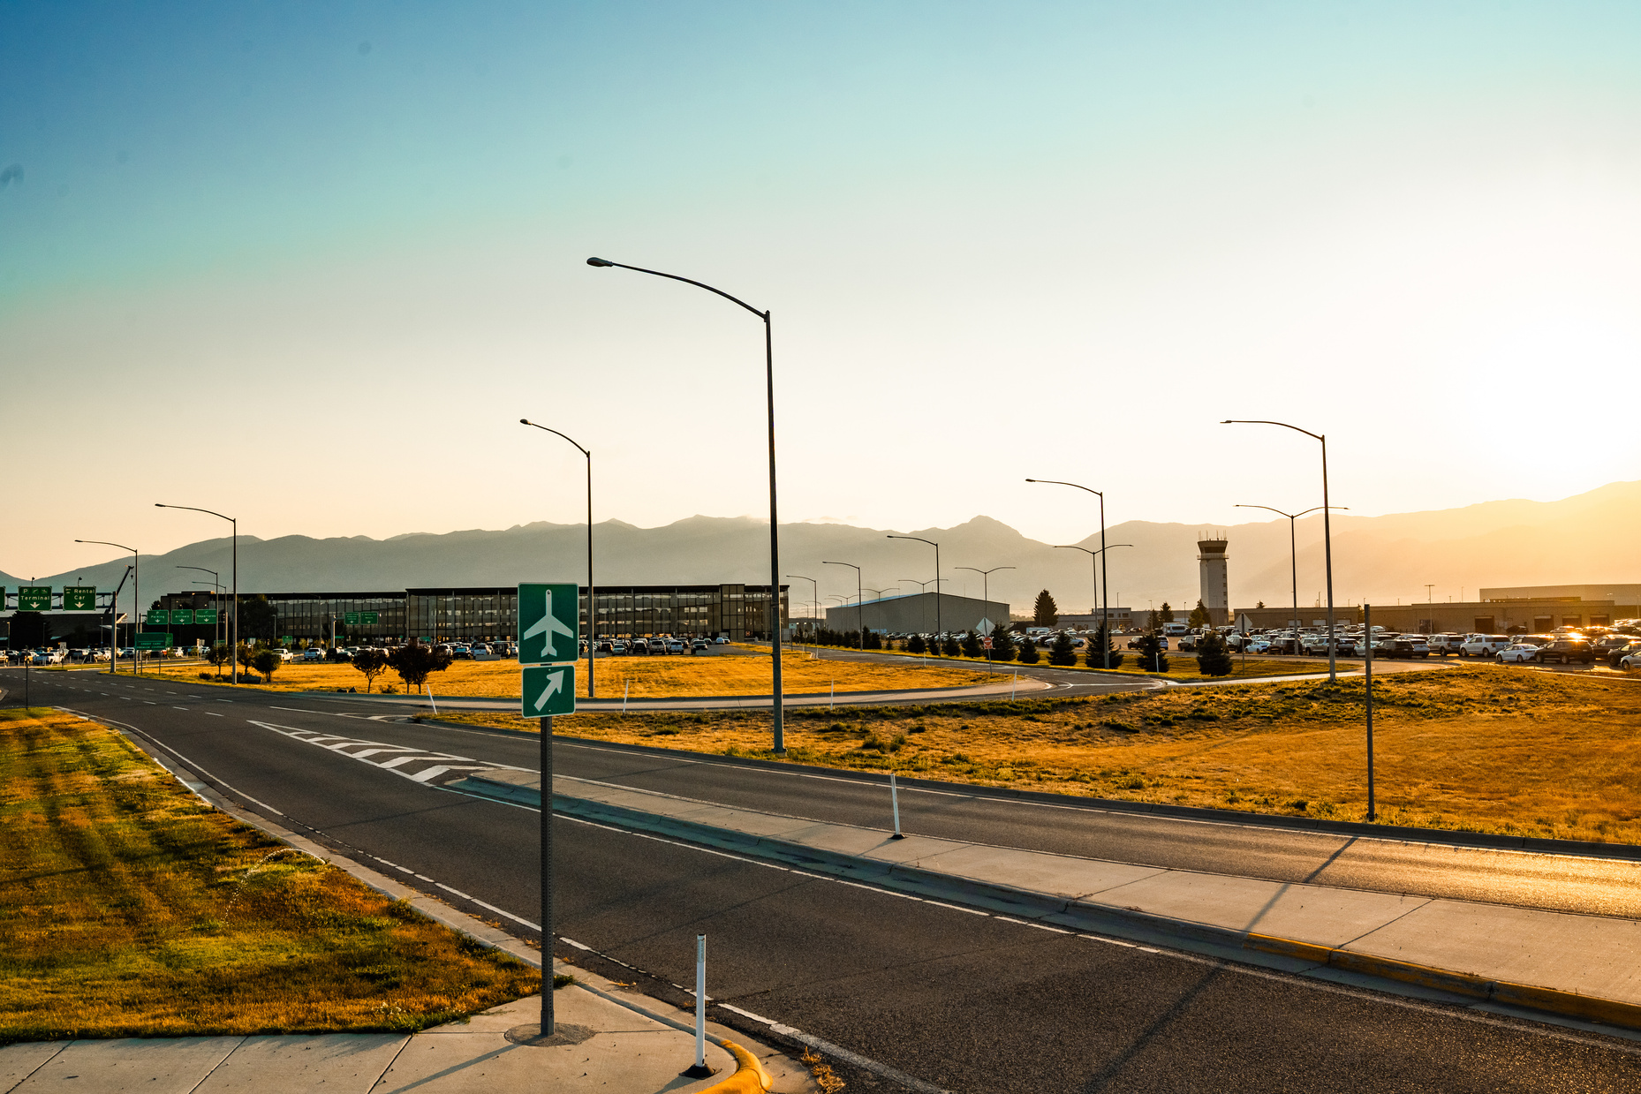
CREATING A STRONG VISITOR HUB
Increase Visibility of the VIC
Improve Signage and Wayfinding
Connect Travelers with local Businesses
Track Visitor Engagement

Slide 7
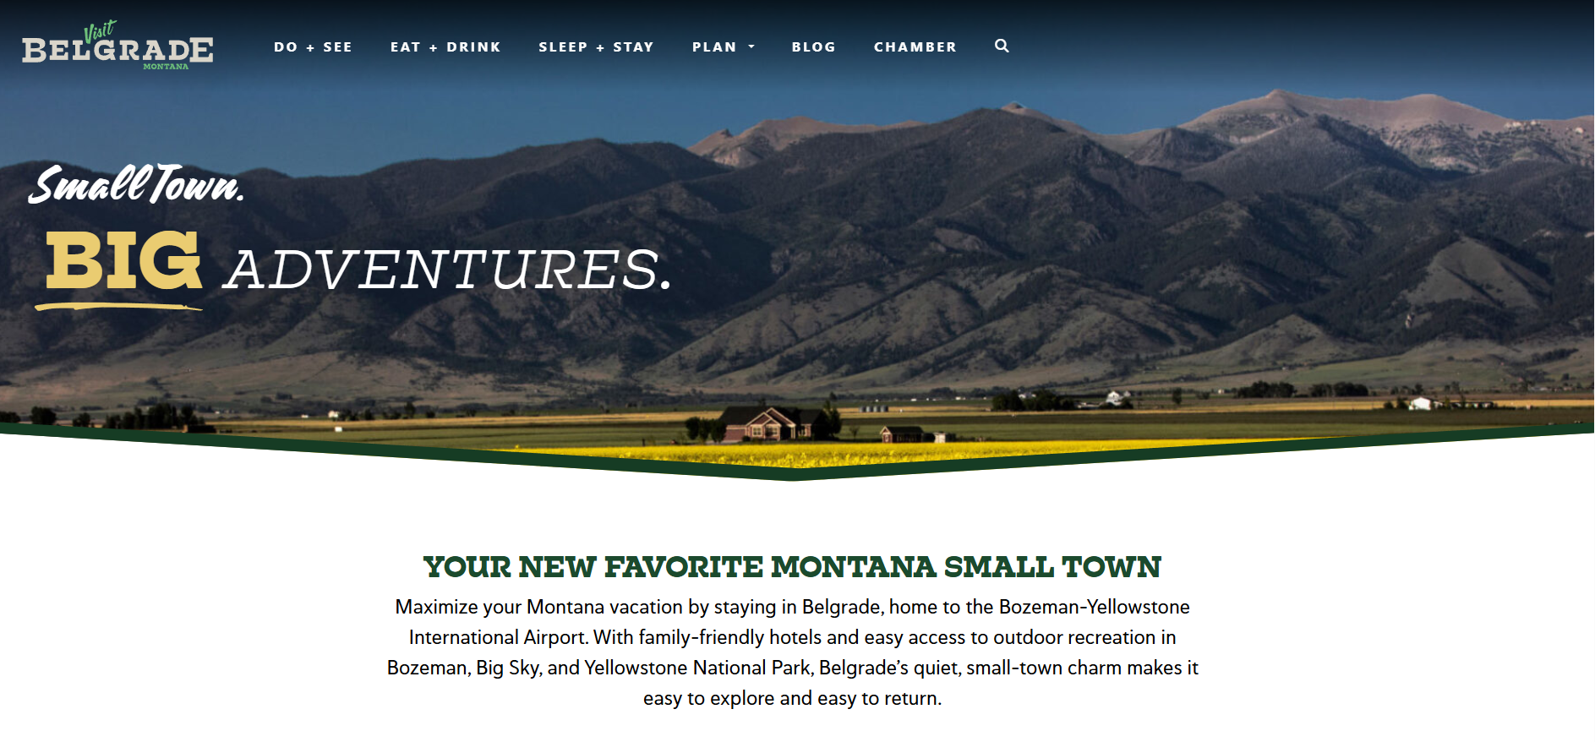

Telling Belgrade’s Story
Continue Building VISIT BELGRADE Platform with PRIME
Use PRIME’s tourism data
Imrpove Website Presence
Create a Visitor Travel Guide
Promote Shoulder Season Travel

Slide 8
THANK YOU

