Slide 1


GLENDIVE DMO FY27 MARKETING PLAN
Building awareness, improving visitor information, and supporting overnight visitation.
Presented by: Tacee DeSaye Executive Director | Glendive Chamber

Slide 2
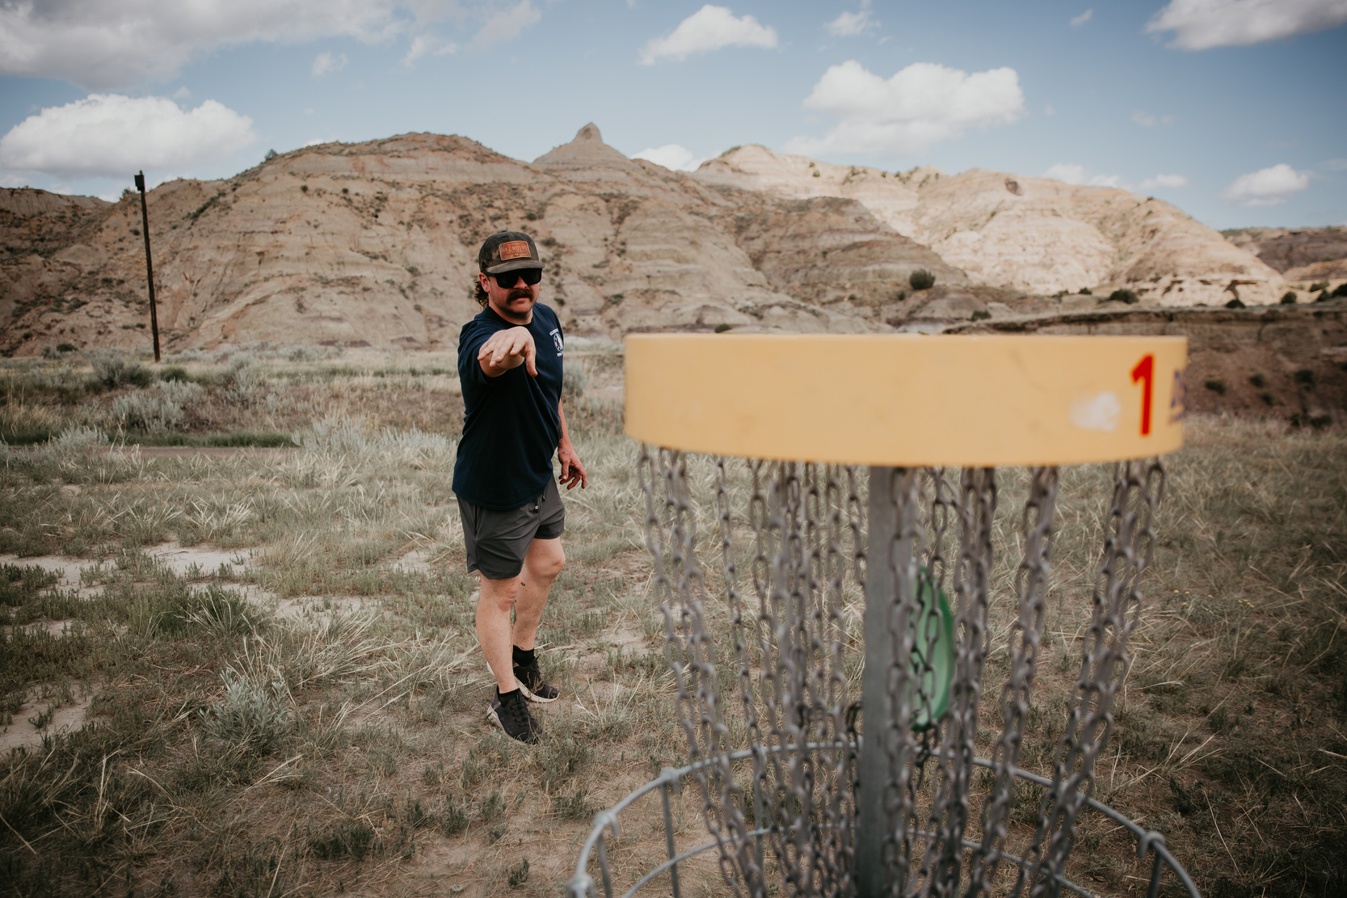
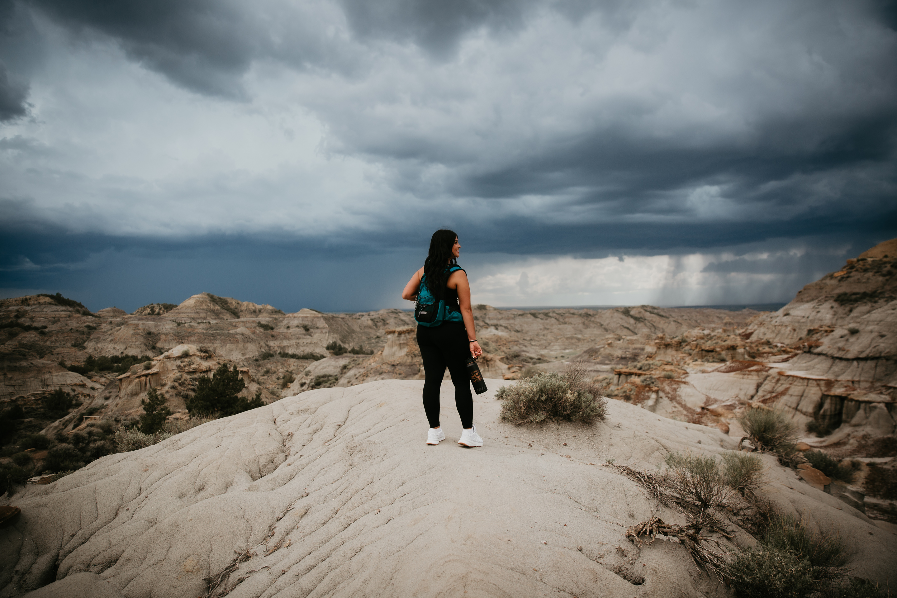
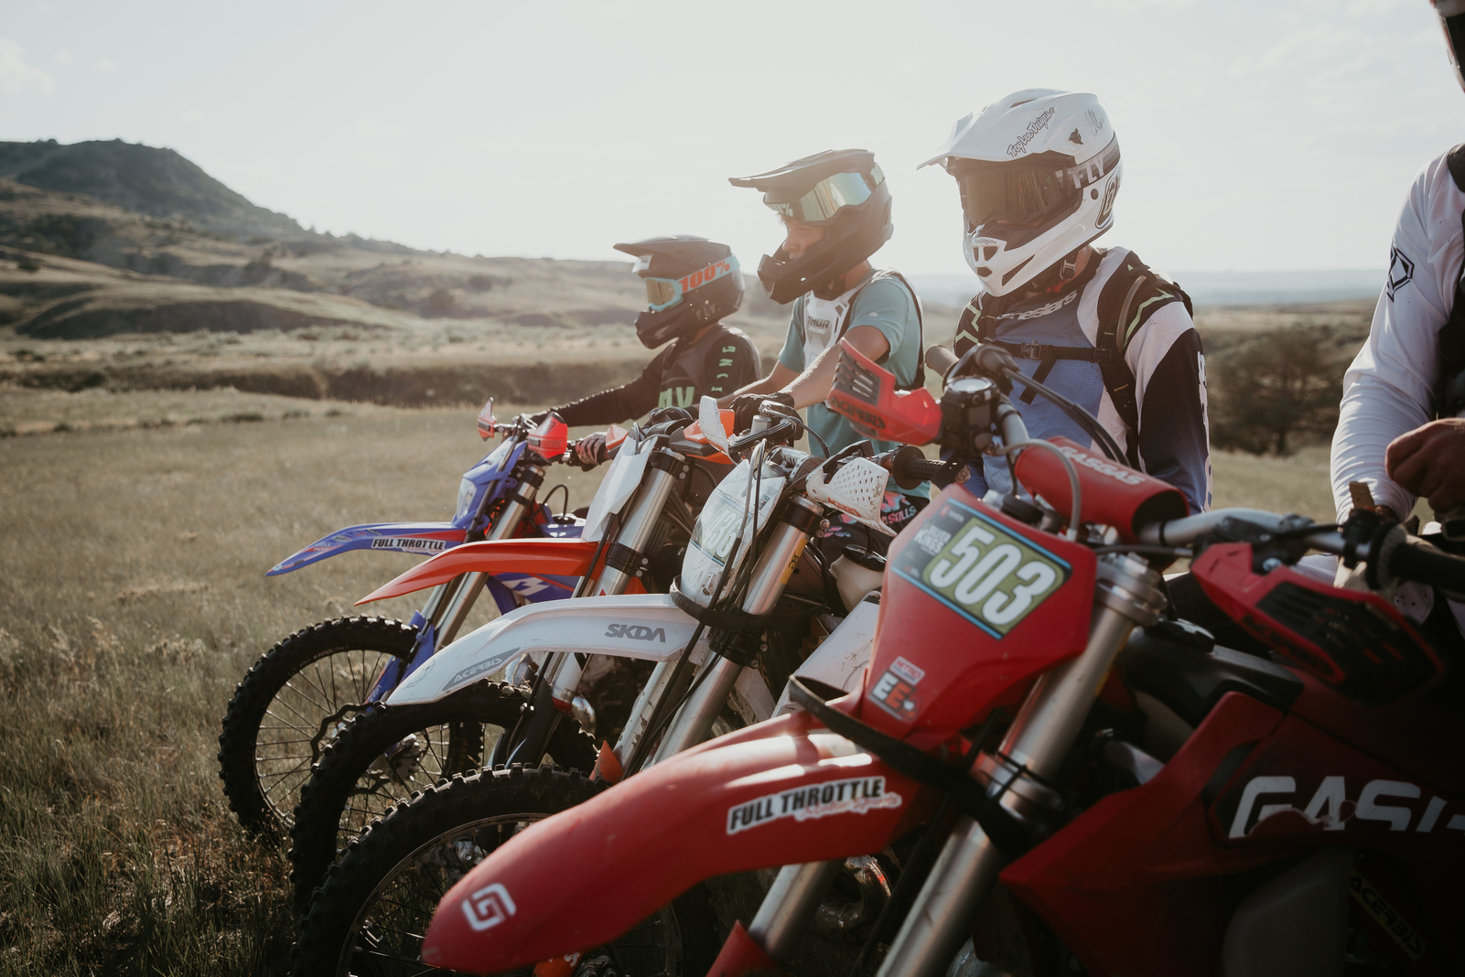
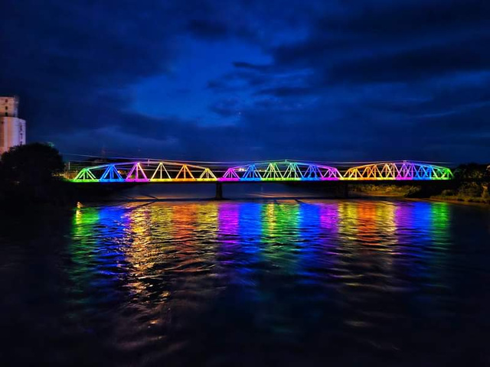
WHO
WE
Are
Discover Glendive serves as the official Visitor Center and Destination Marketing Organization for Glendive and Dawson County.
With a modest budget, our focus is maximizing impact through:
Digital marketing
Visitor information
Partnerships
Community storytelling
CONTACT US
406.377.5601
discoverglendive.com
glendivechamber@gmail.com
808 N. Merrill Ave, Glendive, Montana

Slide 3
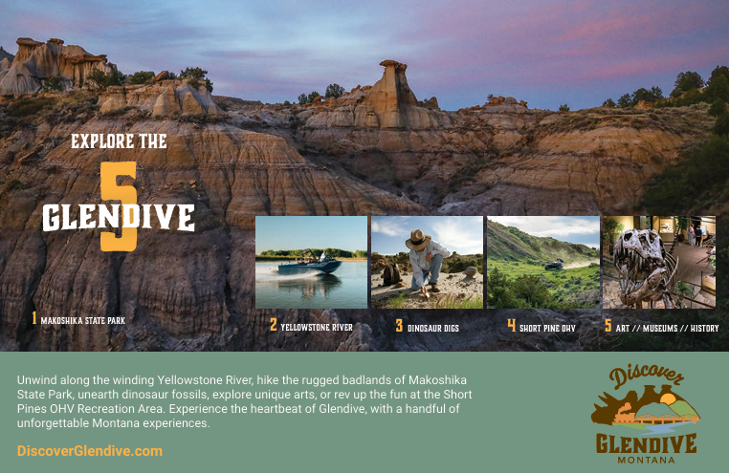

Slide 4
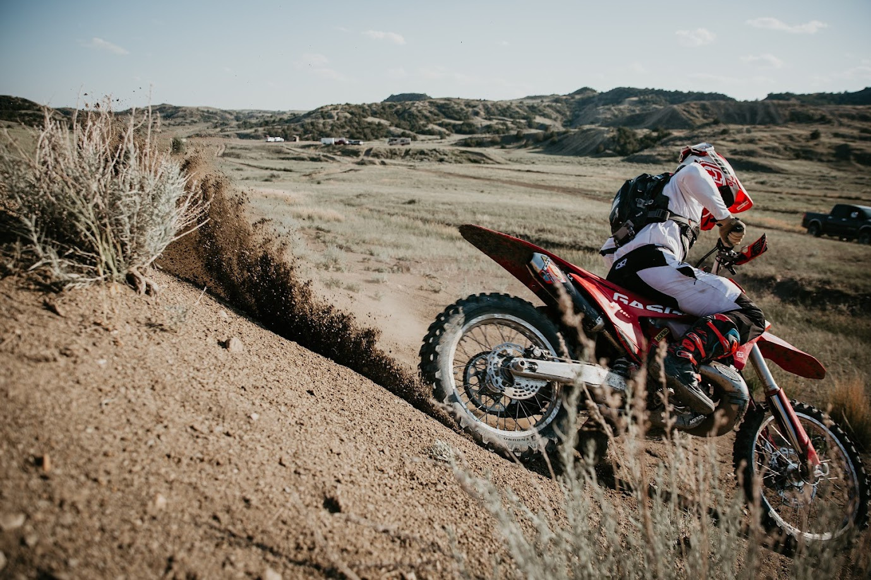
FY27 GOAL
Make it easier for visitors to discover, plan, and experience Glendive.
Everything we do this year supports that goal.

Slide 5
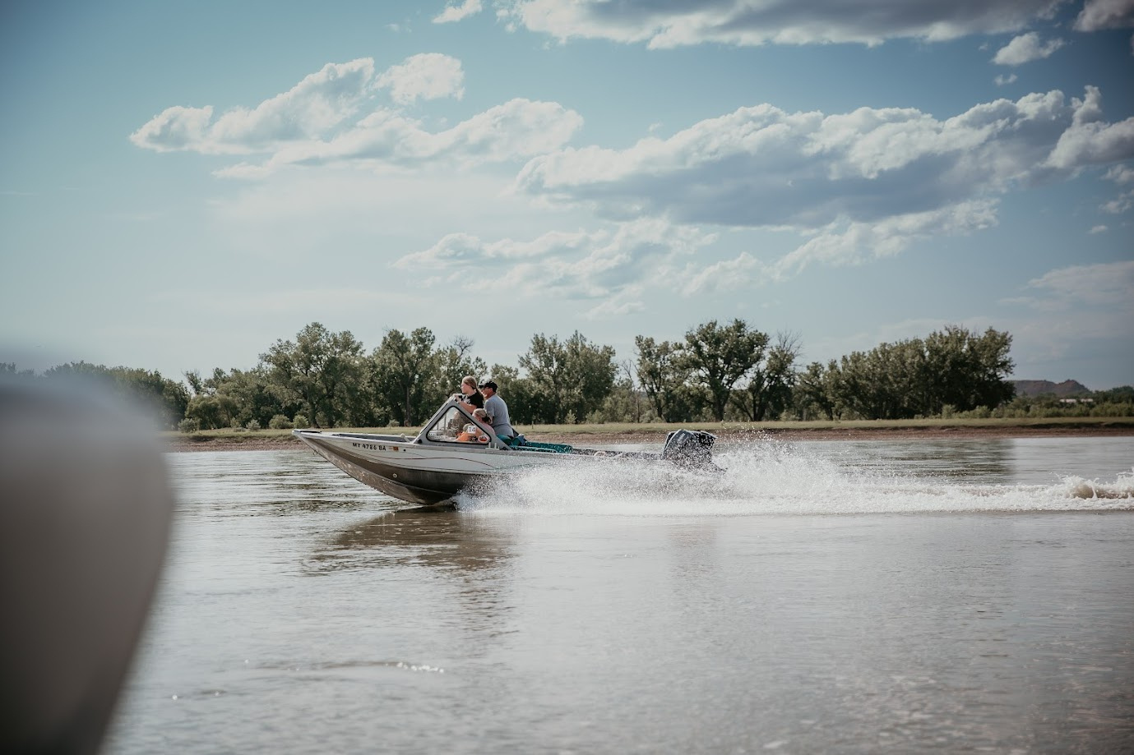
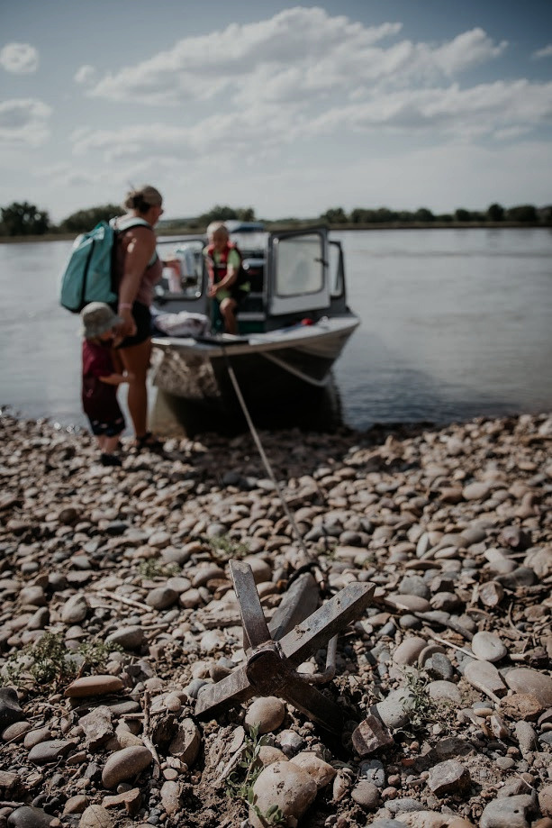
Improve Our Website
PLAN YOUR TRIP
  Continue website updates
  Improve SEO
  Add a blog section
  Improve itineraries and travel tips
MAKOSHIKA STATE PARK
YELLOWSTONE RIVER
SHORT PINE OHV
DINOSAUR DIGS
MUSEUMS/ ART / HISTORY
DISCOVER MORE
www.discoverglenidve.com

Slide 6

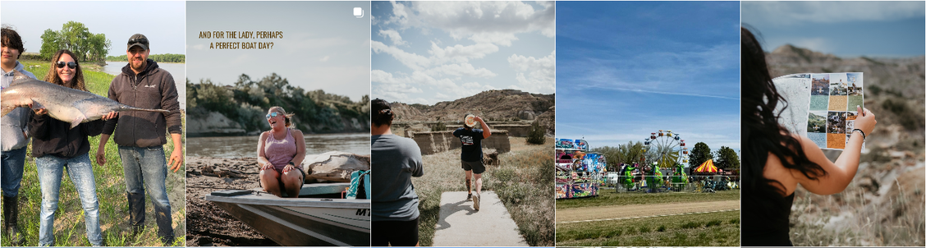
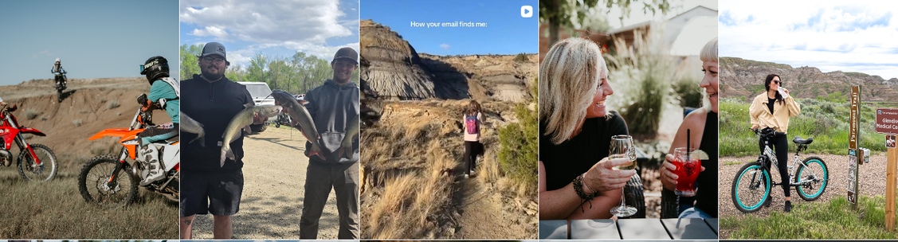
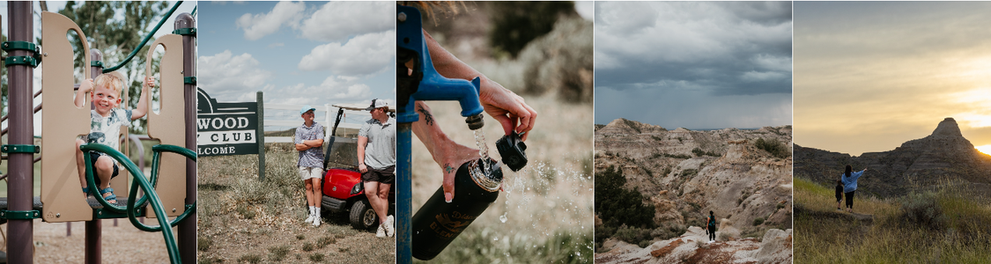
discoverglendive
Strengthen Social Media and Digital Storytelling:
Discover Glendive
The official Instagram for Discover Glendive, Montana. | Share your #Discoverglendive to inspire fellow travelers. 📸
discoverglendive.com
  More reels and video content
  Share blogs and local stories
  Highlight seasonal experiences
  Promote events and attractions
  Explore influencer partnerships

Slide 7
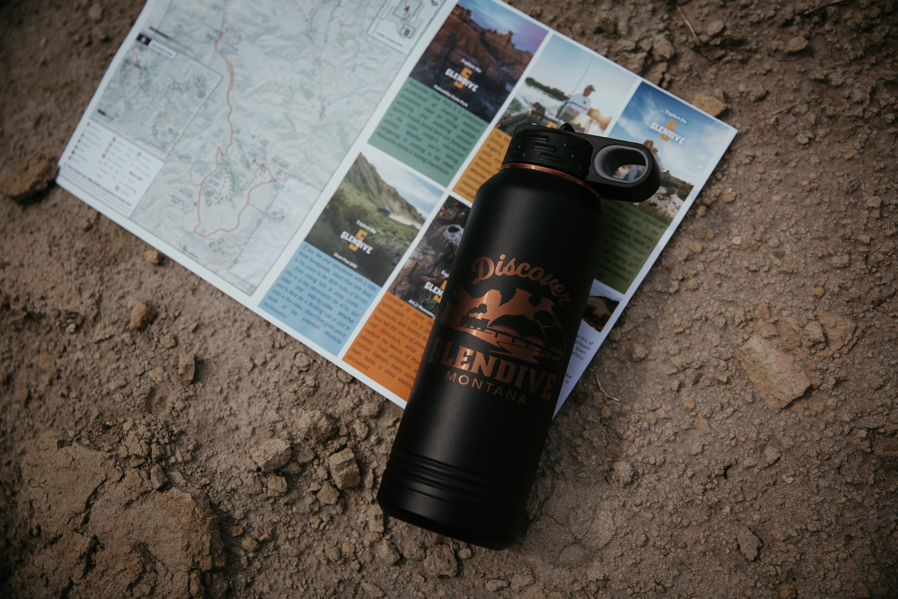
Improve Visitor Hospitality
  More reels and video content
  Share blogs and local stories
  Highlight seasonal experiences
  Continue promoting events and attractions
  Explore influencer partnerships

Slide 8
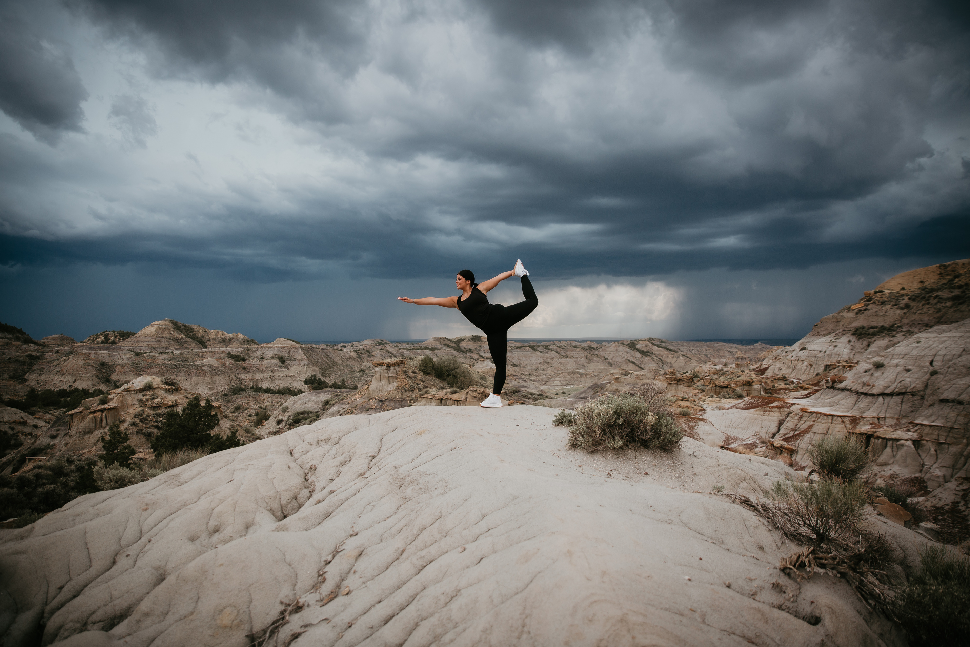
How We Stretch a Small Budget
  Volunteer support
  Community ambassadors
  Organic social media
  Website content
  Strategic use of print materials
As one of Montana's smaller DMOs, our focus is on targeted, measurable projects
that directly support visitation and the visitor experience.

Slide 9
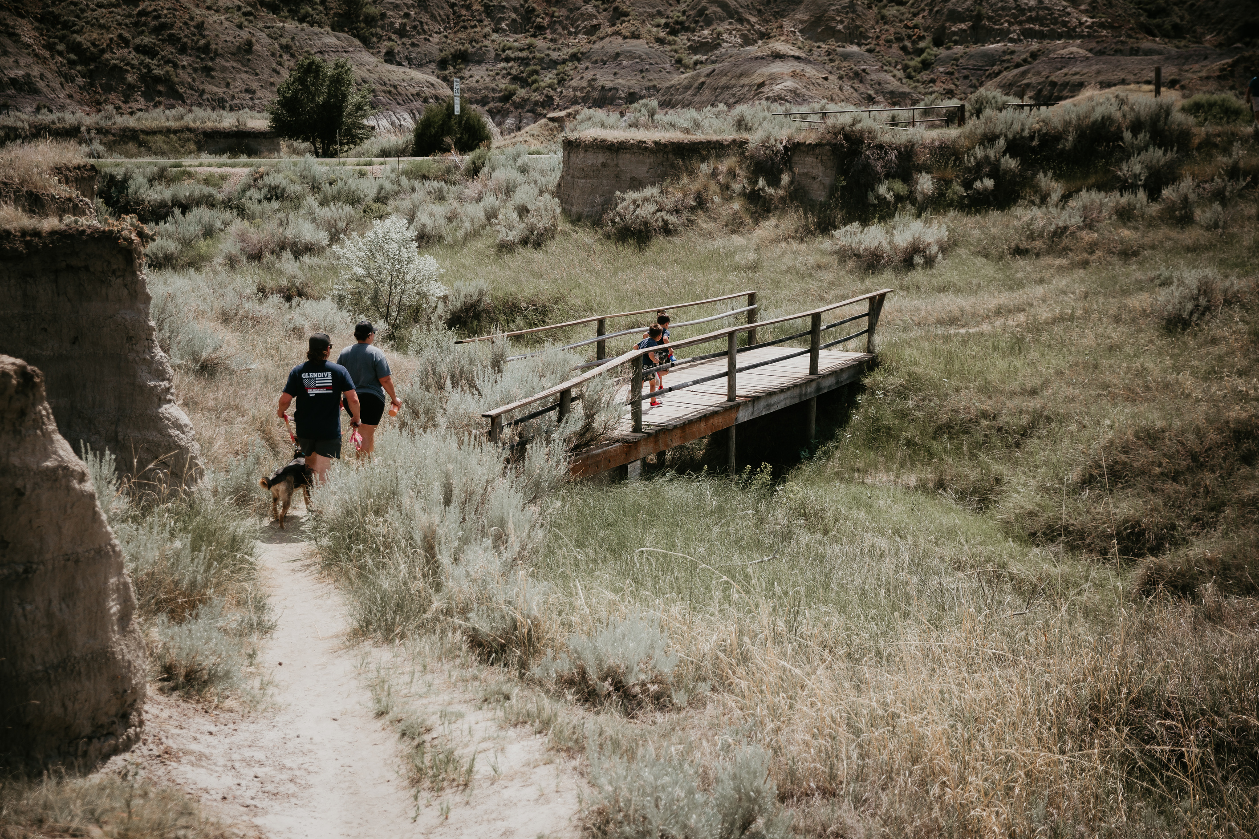

Thank You
Tacee DeSaye | Executive Director
glendivechamber@gmail.com | 406.377.5601

