Slide 1
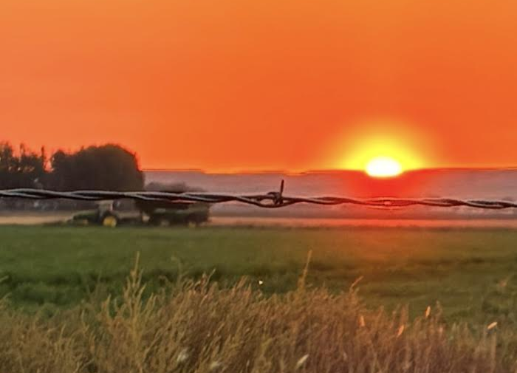
FY27 Destination Marketing Strategy
Sidney Area Chamber of Commerce & Agriculture
Sidney, Montana

Slide 2
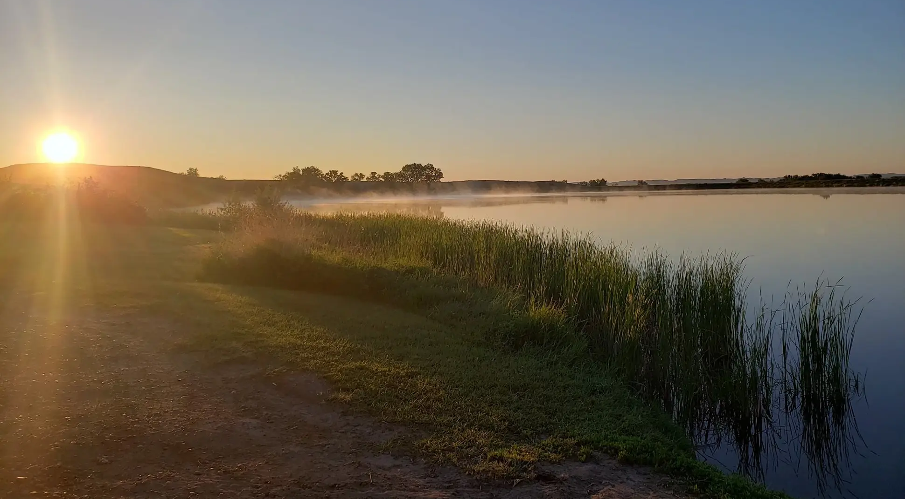
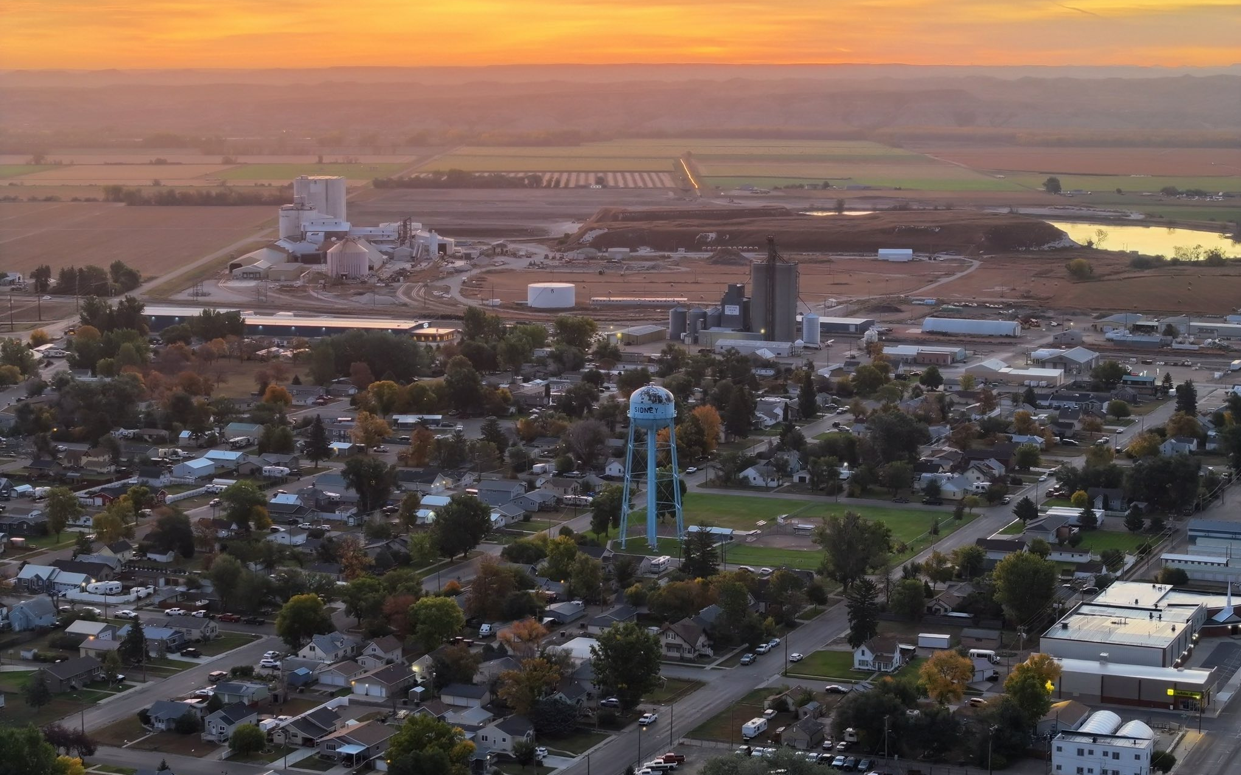
Destination Overview
Sidney, Montana is a regional hub in the Yellowstone River Valley supporting agriculture, energy, business travel, and tourism.
FY27 Focus: Position Sidney as a regional gateway destination where visitors intentionally stay, explore, and engage.

Slide 3
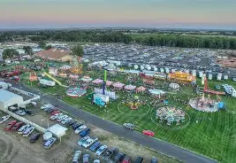
Strengths
600+ hotel rooms and strong hospitality base
Established event infrastructure (fairgrounds, venues, schools)
Highway, airport, and Amtrak access
Active downtown business core
Strong agriculture and energy economy
Yellowstone River recreation access

Slide 4
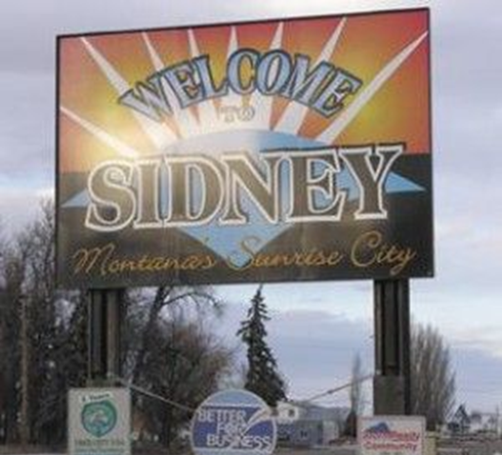
Opportunities
Expand event and group travel
Develop outdoor recreation packaging
Convert pass-through traffic into overnight stays
Grow business and energy travel demand
Increase downtown visitor engagement
Build regional travel itineraries

Slide 5
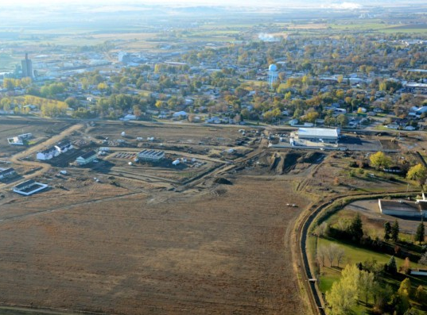
Challenges
Competition from major Montana destinations
High pass-through traffic with low conversion
Seasonal tourism fluctuations
Workforce limitations in hospitality
Limited marketing budget
Perception as a service/stopover town

Slide 6
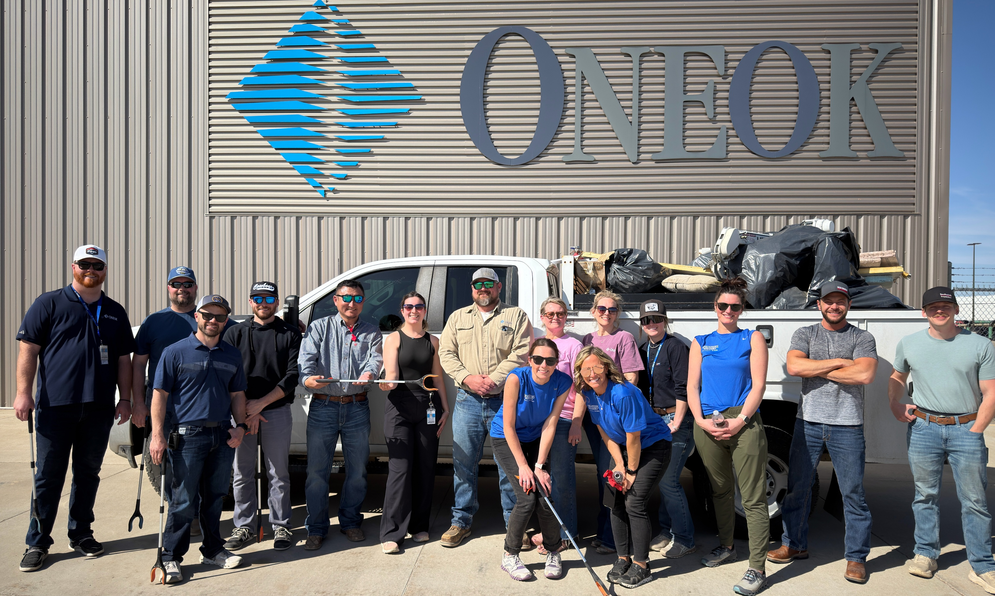

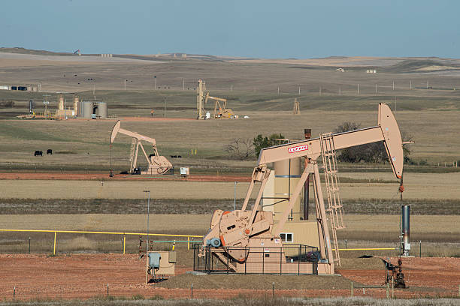
Montana Brand Alignment
Sidney reflects Montana’s authentic identity through:
Working agricultural landscapes
Yellowstone River and open space access
Genuine small-town hospitality
Sidney supports the Montana brand as a functional, real-world gateway community.

Slide 7
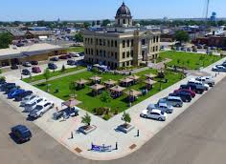
Strategic Roles & Audience
Roles:
Marketing | Development | Stewardship
Audiences:
Adults 30–70
RV and retiree travelers
Business travel (energy/agriculture)
Families and regional travelers
Event and group markets
Drive-market visitors

Slide 8
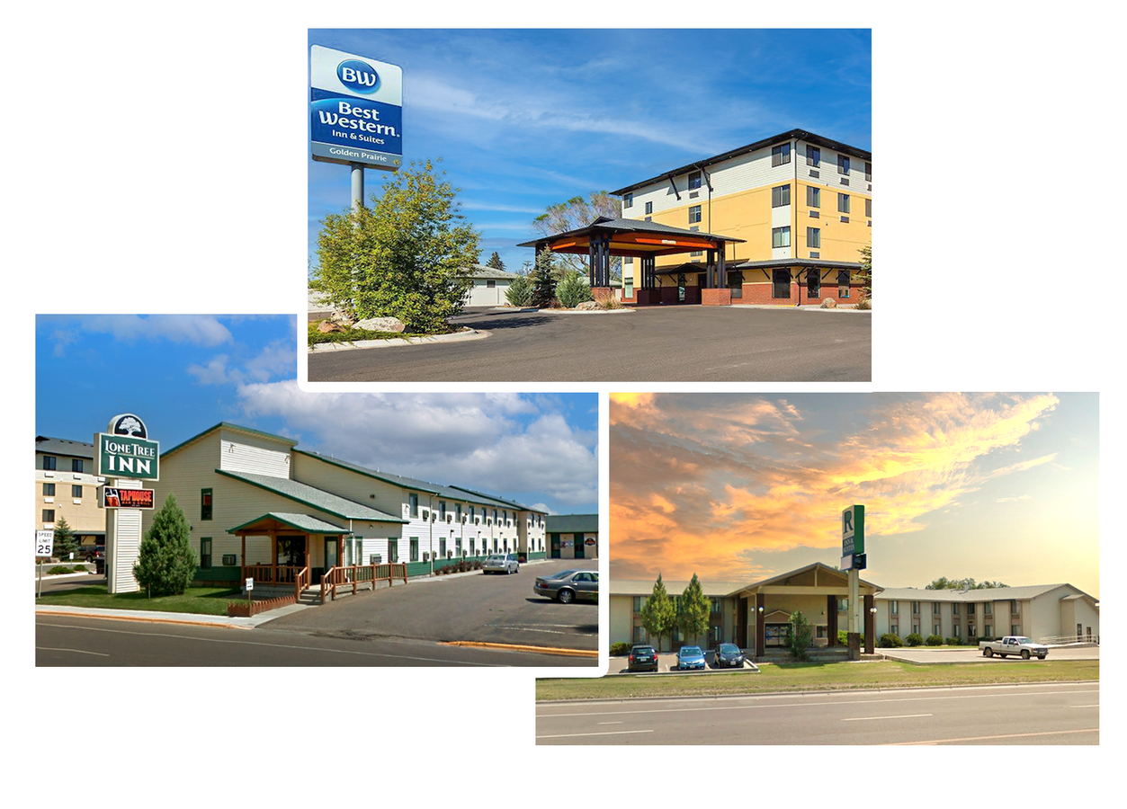
Emerging Markets
Stopover / drive-market travelers
Event and group travel growth
Energy and agriculture workforce travel
Outdoor micro-adventure tourism
RV and long-haul road travelers
Focus: Increase overnight conversion and stay length

Slide 9

FY27 Goals
Increase overnight visitation
Strengthen gateway destination identity
Reduce seasonality
Increase visitor spending
Improve pass-through conversion

Slide 10

FY27 Tactics
Paid digital advertising campaigns
Cooperative marketing partnerships
Opportunity marketing initiatives
Product development (itineraries, wayfinding, packaging)
Marketing personnel execution
Administrative compliance support

Slide 11
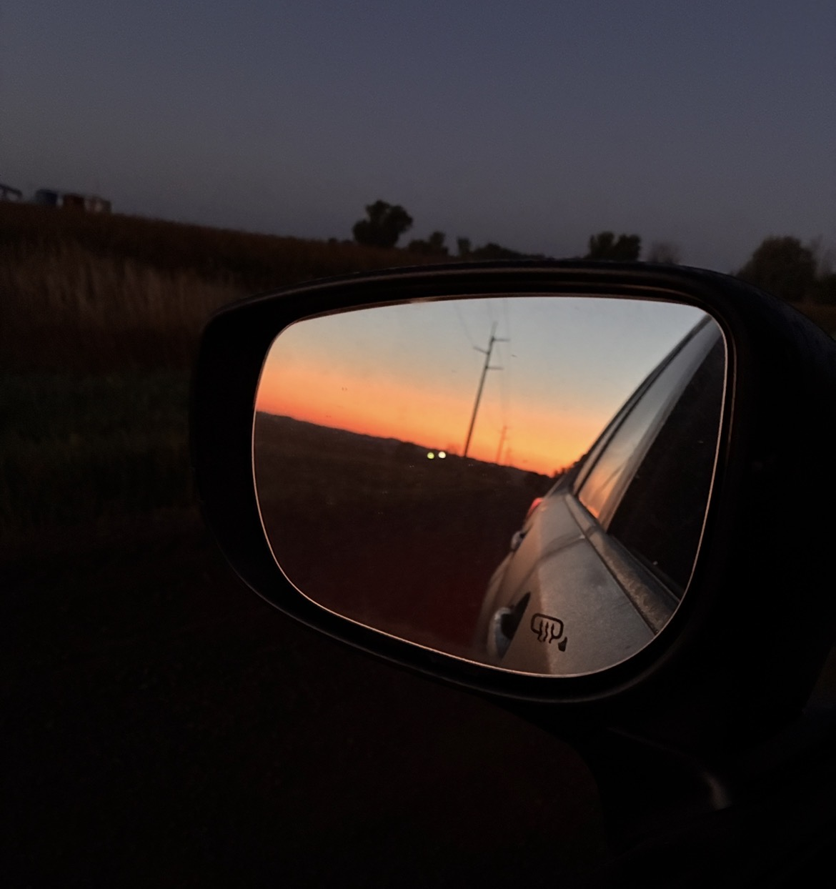
Objectives & Metrics
+3% lodging occupancy / bed tax growth
+5% digital engagement growth
+10% increase in events and group travel
Higher itinerary and trip planning engagement
Increased midweek occupancy stability

Slide 12
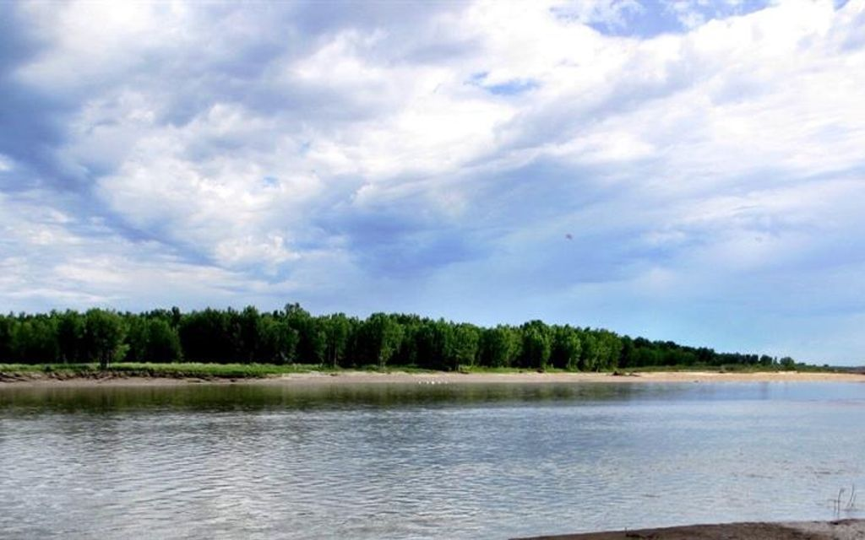
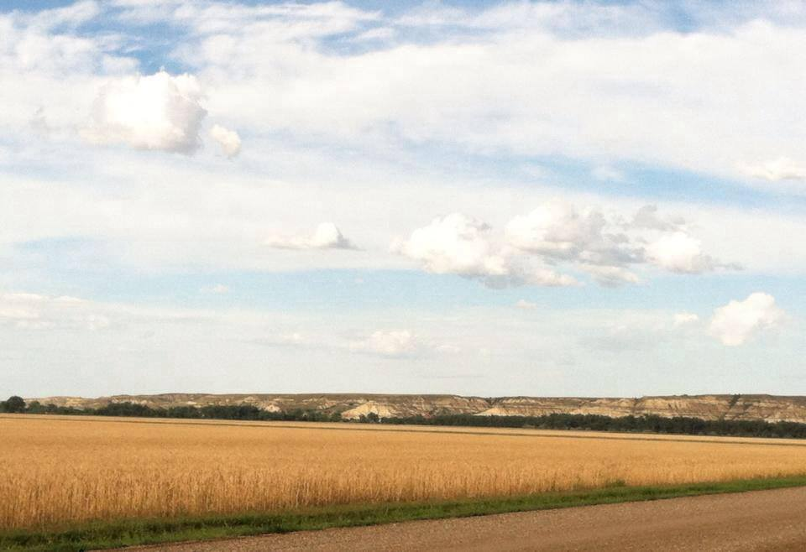
Conclusion
FY27 Strategy:
Transform Sidney into a regional gateway destination where visitors intentionally stay, explore, and contribute to the local economy.

