Slide 1
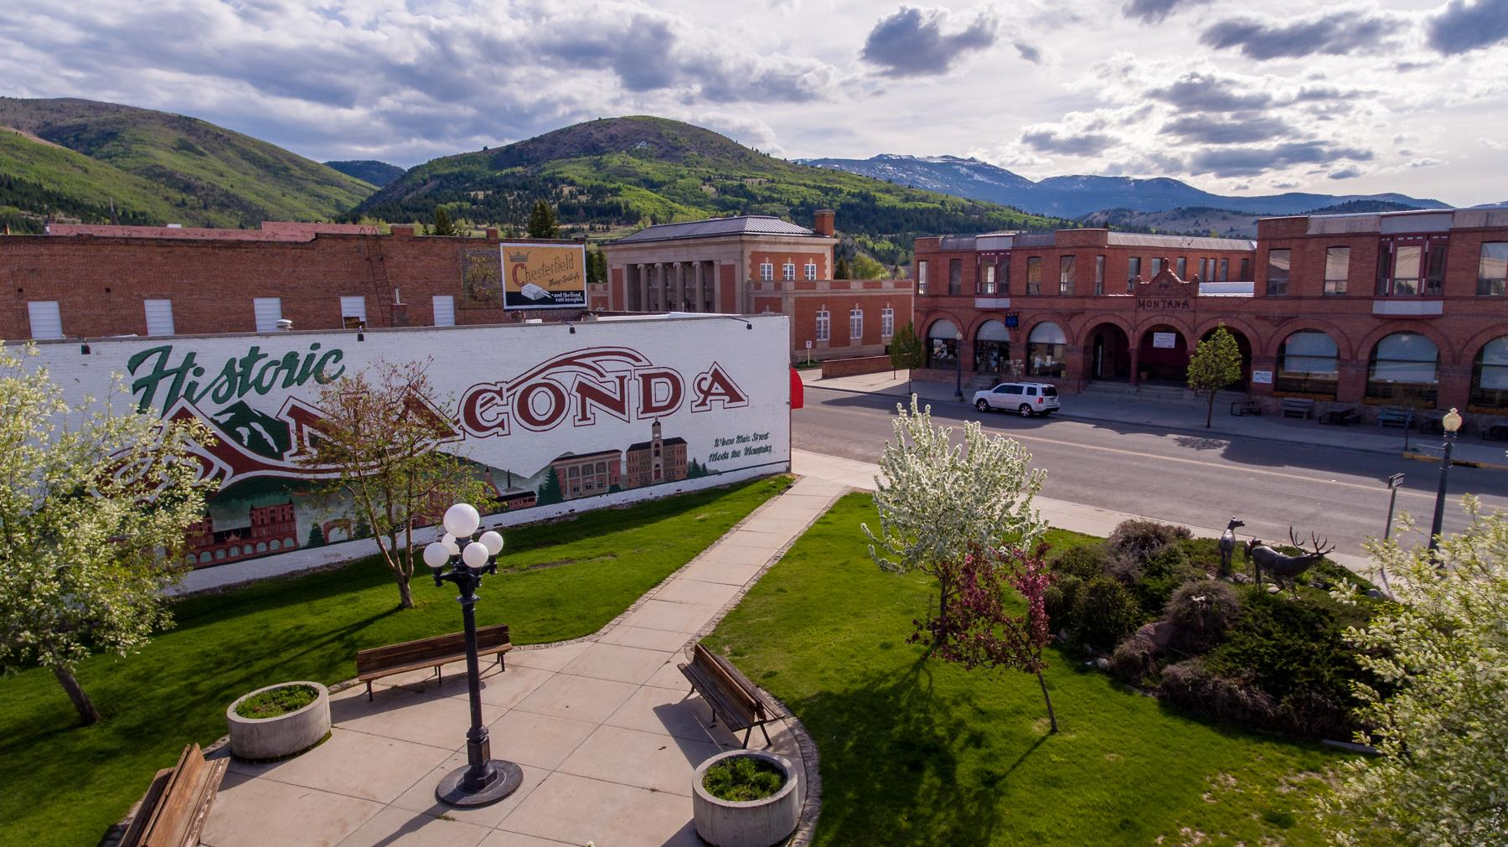

DISCOVER ANACONDA
FY27 DMO PLAN

Slide 2
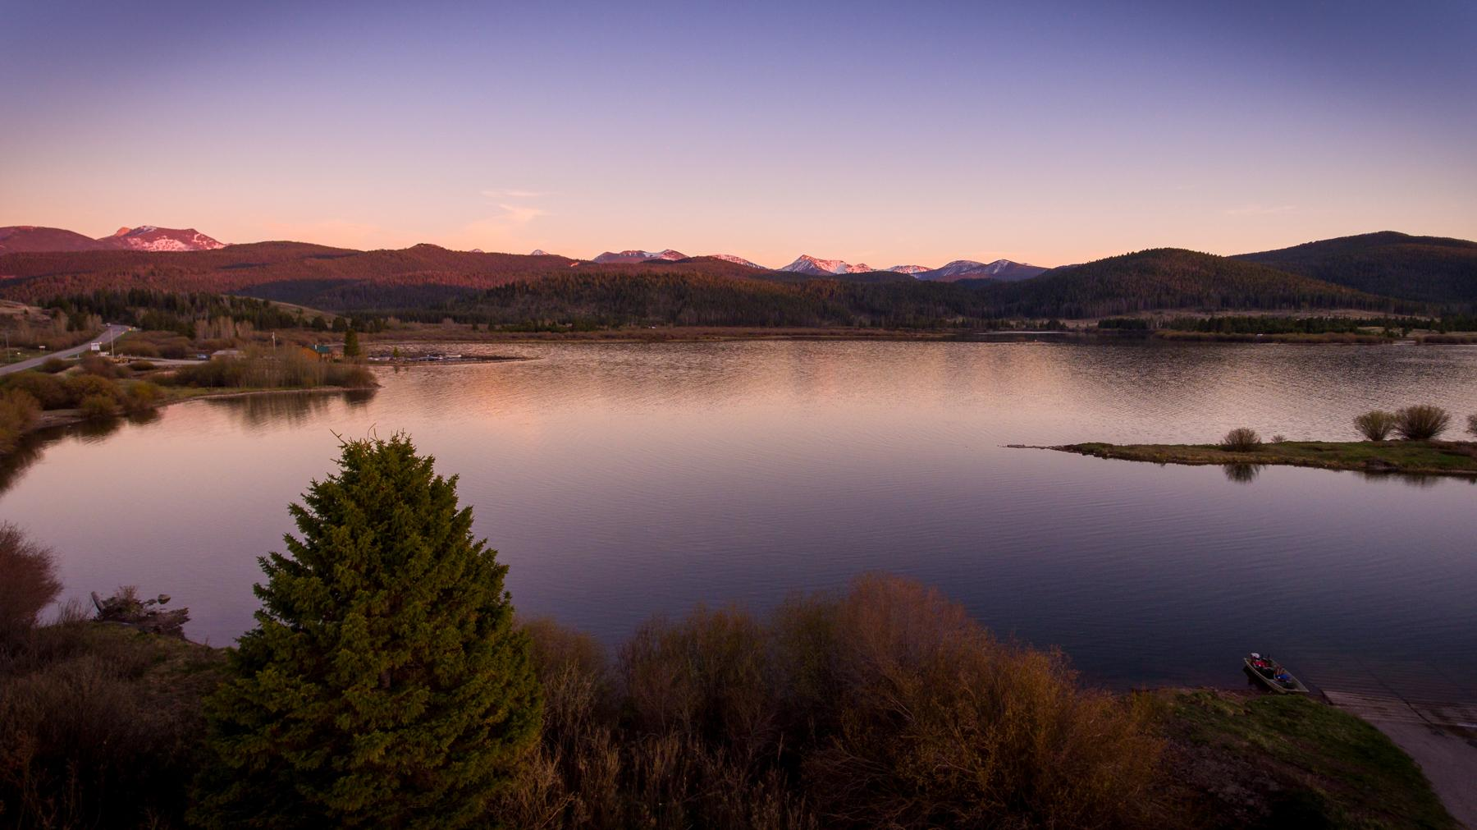
Year-Round Tourism Promotion
Anaconda is a year-round tourism destination - we need to let everyone know.
How do we do that?
Invest in digital marketing, emphasizing shoulder season
Re-design, optimize Events Calendar on Discover Anaconda website
Re-design Discover Anaconda brand with community feedback
Notes:
“To begin, I’d like to tell you about something new and noteworthy we plan to do in FY27.”
“Anaconda does a wonderful job of promoting itself as a spring and summer tourist destination. We’re surrounded by hiking trails, a gorgeous 28-hundred acre lake, and we hold our most beloved community event each and every August.”
“But Anaconda has a lot to offer when the sun isn’t shining - our job is to make sure everyone knows that.”
“This year, we are going to make major investments in digital marketing, emphasizing everything Anaconda has to offer tourists during the shoulder season, like Discovery Ski Area and our annual Winter Festival. We want to ensure Anaconda is one of the first destinations people think of when planning their travels to Montana.”
“We are also redesigning our Events Calendar on the Discover Anaconda website. Right now, the layout and design of the page is a bit basic and doesn’t paint the full picture of everything happening in our community. We want to update it with more eye-catching images and colors, as well as implementing a feature that allows local businesses and organizations to add their own events.”
“We are currently working with an outside branding agency to design a brand based on community feedback. With the input we’ve received, we are redesigning our logo and will use it to promote tourism in Anaconda.”

Slide 3
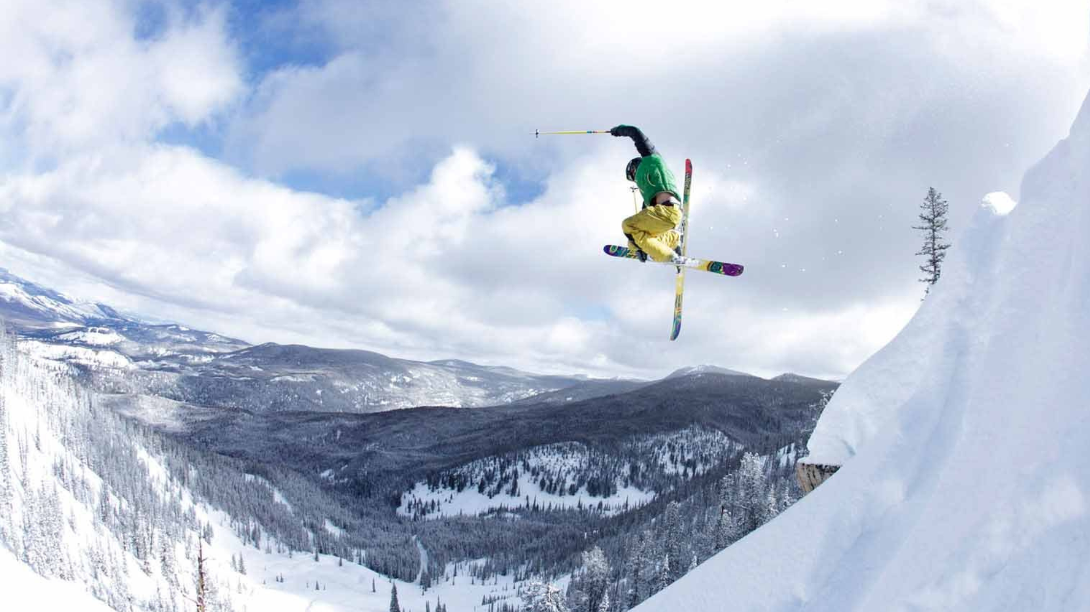
Pilot Community Tourism Grant
Awarded to Anaconda Deer Lodge County in 2024 to enhance winter tourism
Hockey rink will be up for the winter 2026/2027 season, upgrades to existing facilities planned.
To be installed by winter 2026/2027
Notes:
“Last year, we received a Pilot Community Tourism grant from the Department of Commerce to enhance winter tourism. Planned developments include a new ice hockey rink, and upgrades to our existing facilities to ensure consistent winter recreation opportunities. At last check, the county just sent out for bids to construct the hockey rink which be completed in fall of 2026.

Slide 4
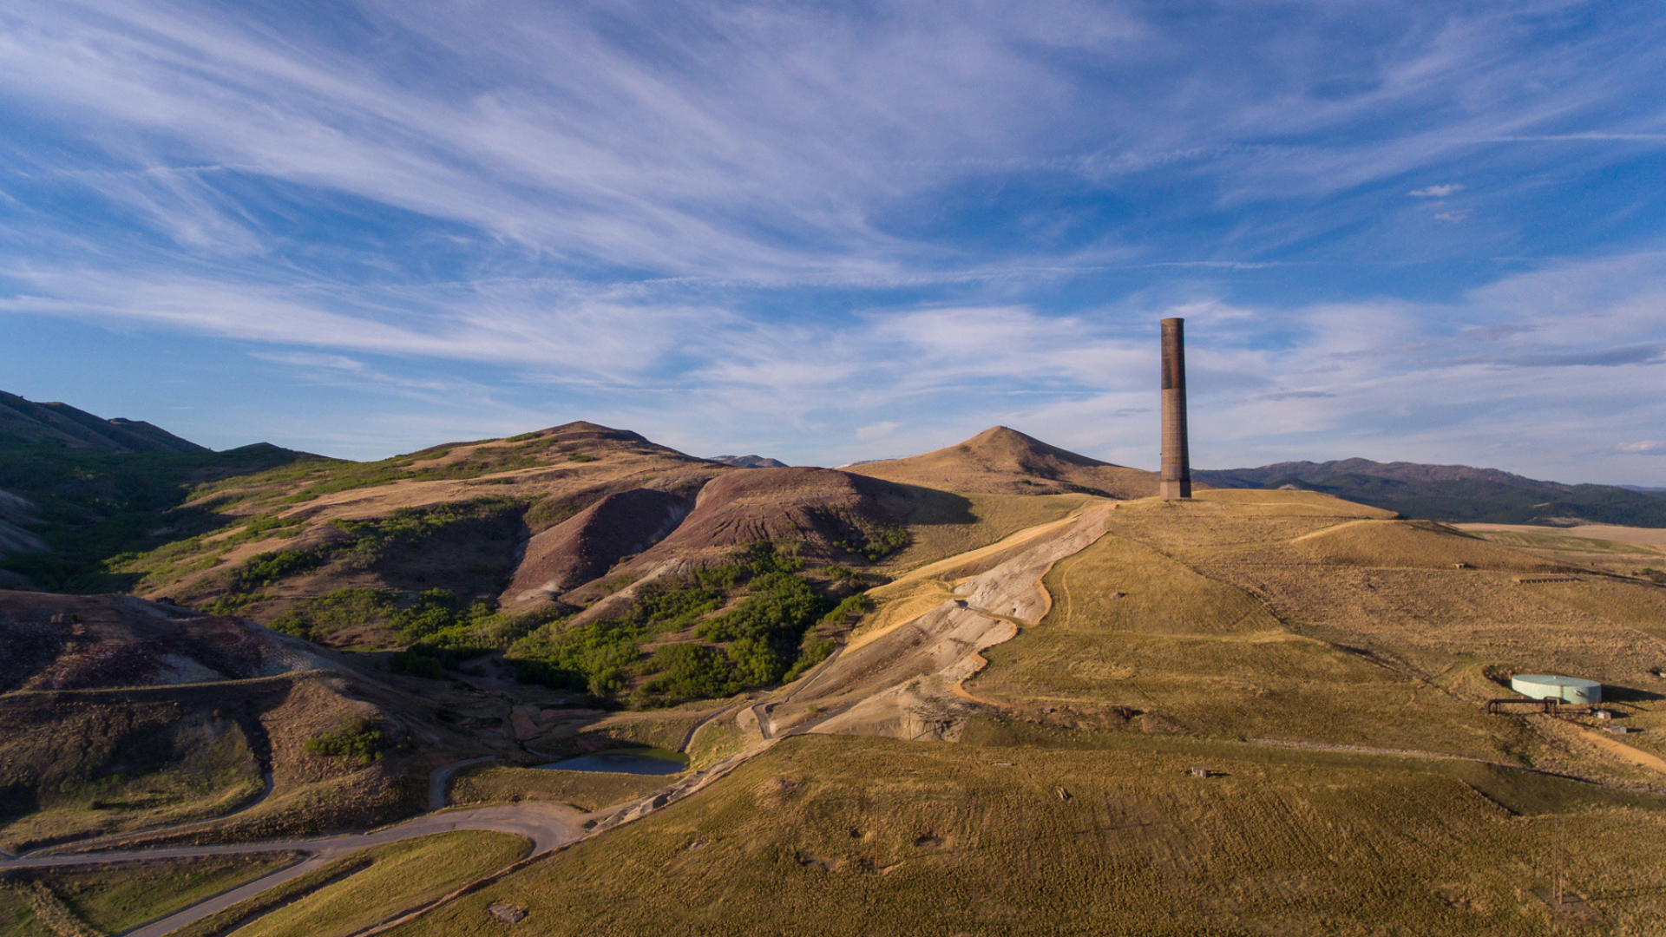
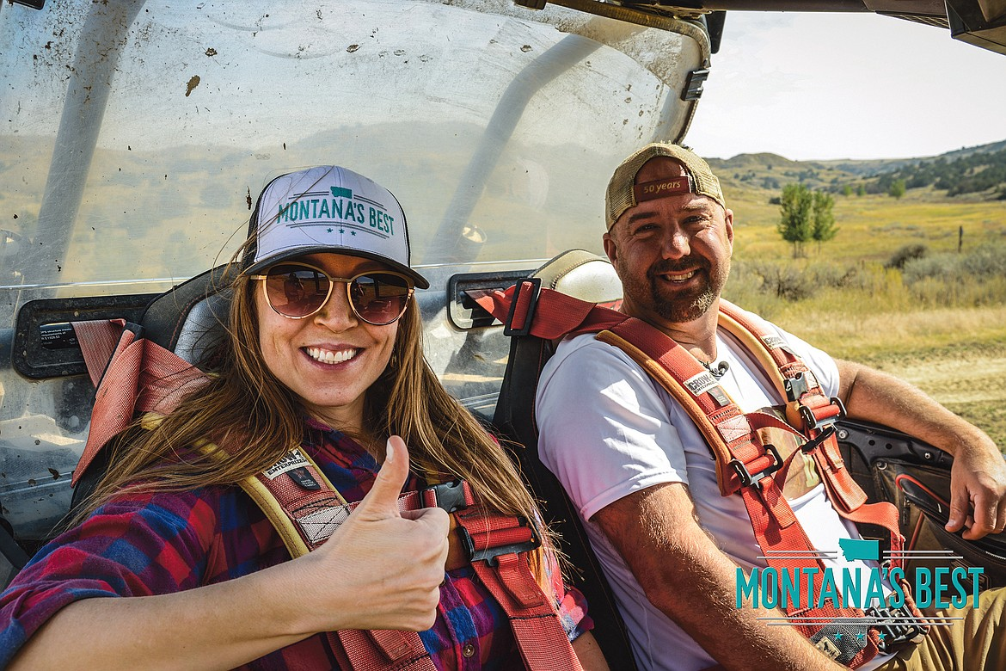
Montana’s Best
Anaconda’s exciting tourism developments was completed in March 2026 center in a two-part special produced by Montana’s Best TV.
Their profiles of Montana tourist destinations have gathered more than 430K views on YouTube since 2022.
On track to begin filming September 2025
Notes:
“Next, I’d like to inform the council about something exciting we’re working on in FY27. There are a lot of exciting developments happening in Anaconda, specifically when it comes to tourism, and now, we’re getting the chance to put those developments on display to a vast local audience.
This year, we’re partnering with Julie Mac and her team over at Montana’s Best TV to produce a two-part episode about everything Anaconda has to offer. From popular tourist attractions like the zipline and Smelter Stack State Park, to the unknown stories of our historic downtown, Julie and her team are going to bring the things that make Anaconda one of the best tourist destinations in the state…to her audience. These episodes have just been released.
Their profile on Libby, Montana, gathered a combined 10,000 views on YouTube, where their tourist destination profiles have garnered an impressive 430,000 views over the last three years. Montana’s Best is also now airing on NBC Montana, which covers approximately 45% of the state and reaches more than 175,000 households. This is a great opportunity to present Anaconda to the growing Montana’s Best Audience and to increase visitor foot traffic in Anaconda.
Frankly, this is going to put Anaconda in front of people that would never have known it existed otherwise.
Right now, we’re finalizing the shooting schedule and meeting with local businesses and attractions we want to include in the episodes, and we’re on track for Julie’s crew tcompleted filming September of 2025.”

Slide 5
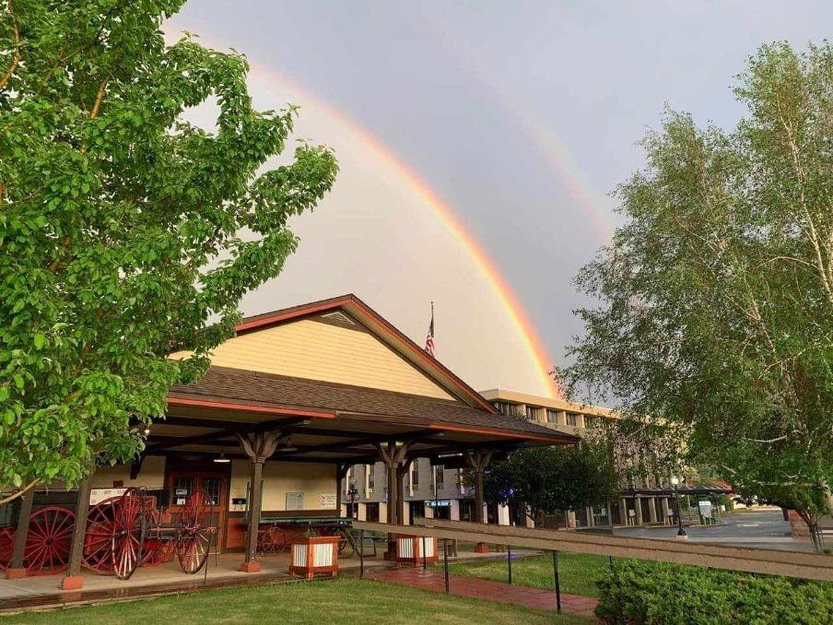
THANK YOU!
RUTH MOEN
ruth@discoveranaconda.com
Notes:
“And to wrap things up, here’s a photo of our beautiful Visitor Center. Can I answer any questions?”

