Slide 1


Slide 2
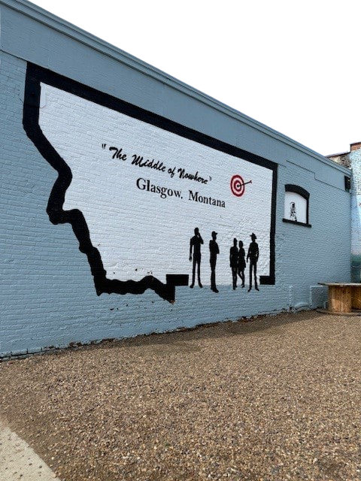

MORE THAN A STOP ALONG THE WAY
Glasgow offers visitors a true Montana experience: open space, friendly people, outdoor adventure, small-town hospitality, and a deep connection to history.
Located near Fort Peck Lake, the Missouri River, the Milk River, and the Montana Dinosaur Trail, Glasgow is well-positioned as a hub for travelers looking for authentic experiences in Northeast Montana.

Slide 3
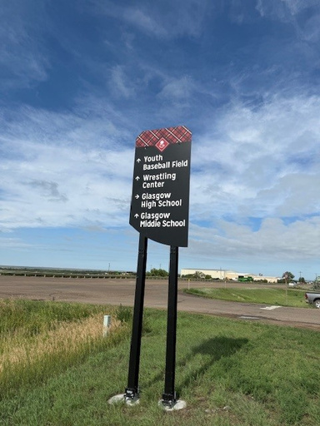
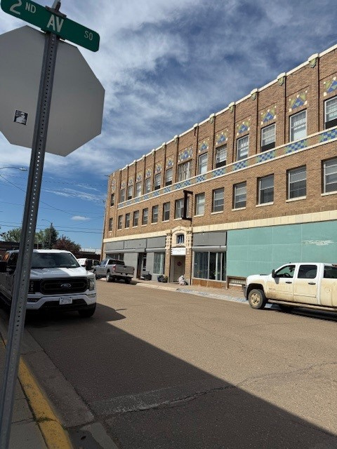
WHAT MAKES GLASGOW STAND OUT
Glasgow’s strongest tourism assets include:
  Outdoor recreation, especially fishing, boating, hunting, hiking, and wildlife viewing
  Cultural and historical attractions, including museums, local art, architecture, and Native American history
  Fort Peck Summer Theatre and regional events
  Signature annual events such as the Glasgow Rodeo, Northeast Montana Fair, Milk River Catfish Days, and more
  A strong hospitality base with lodging, restaurants, shopping, and services
  Strategic location along US Highway 2 and Amtrak’s Empire Builder route

Slide 4
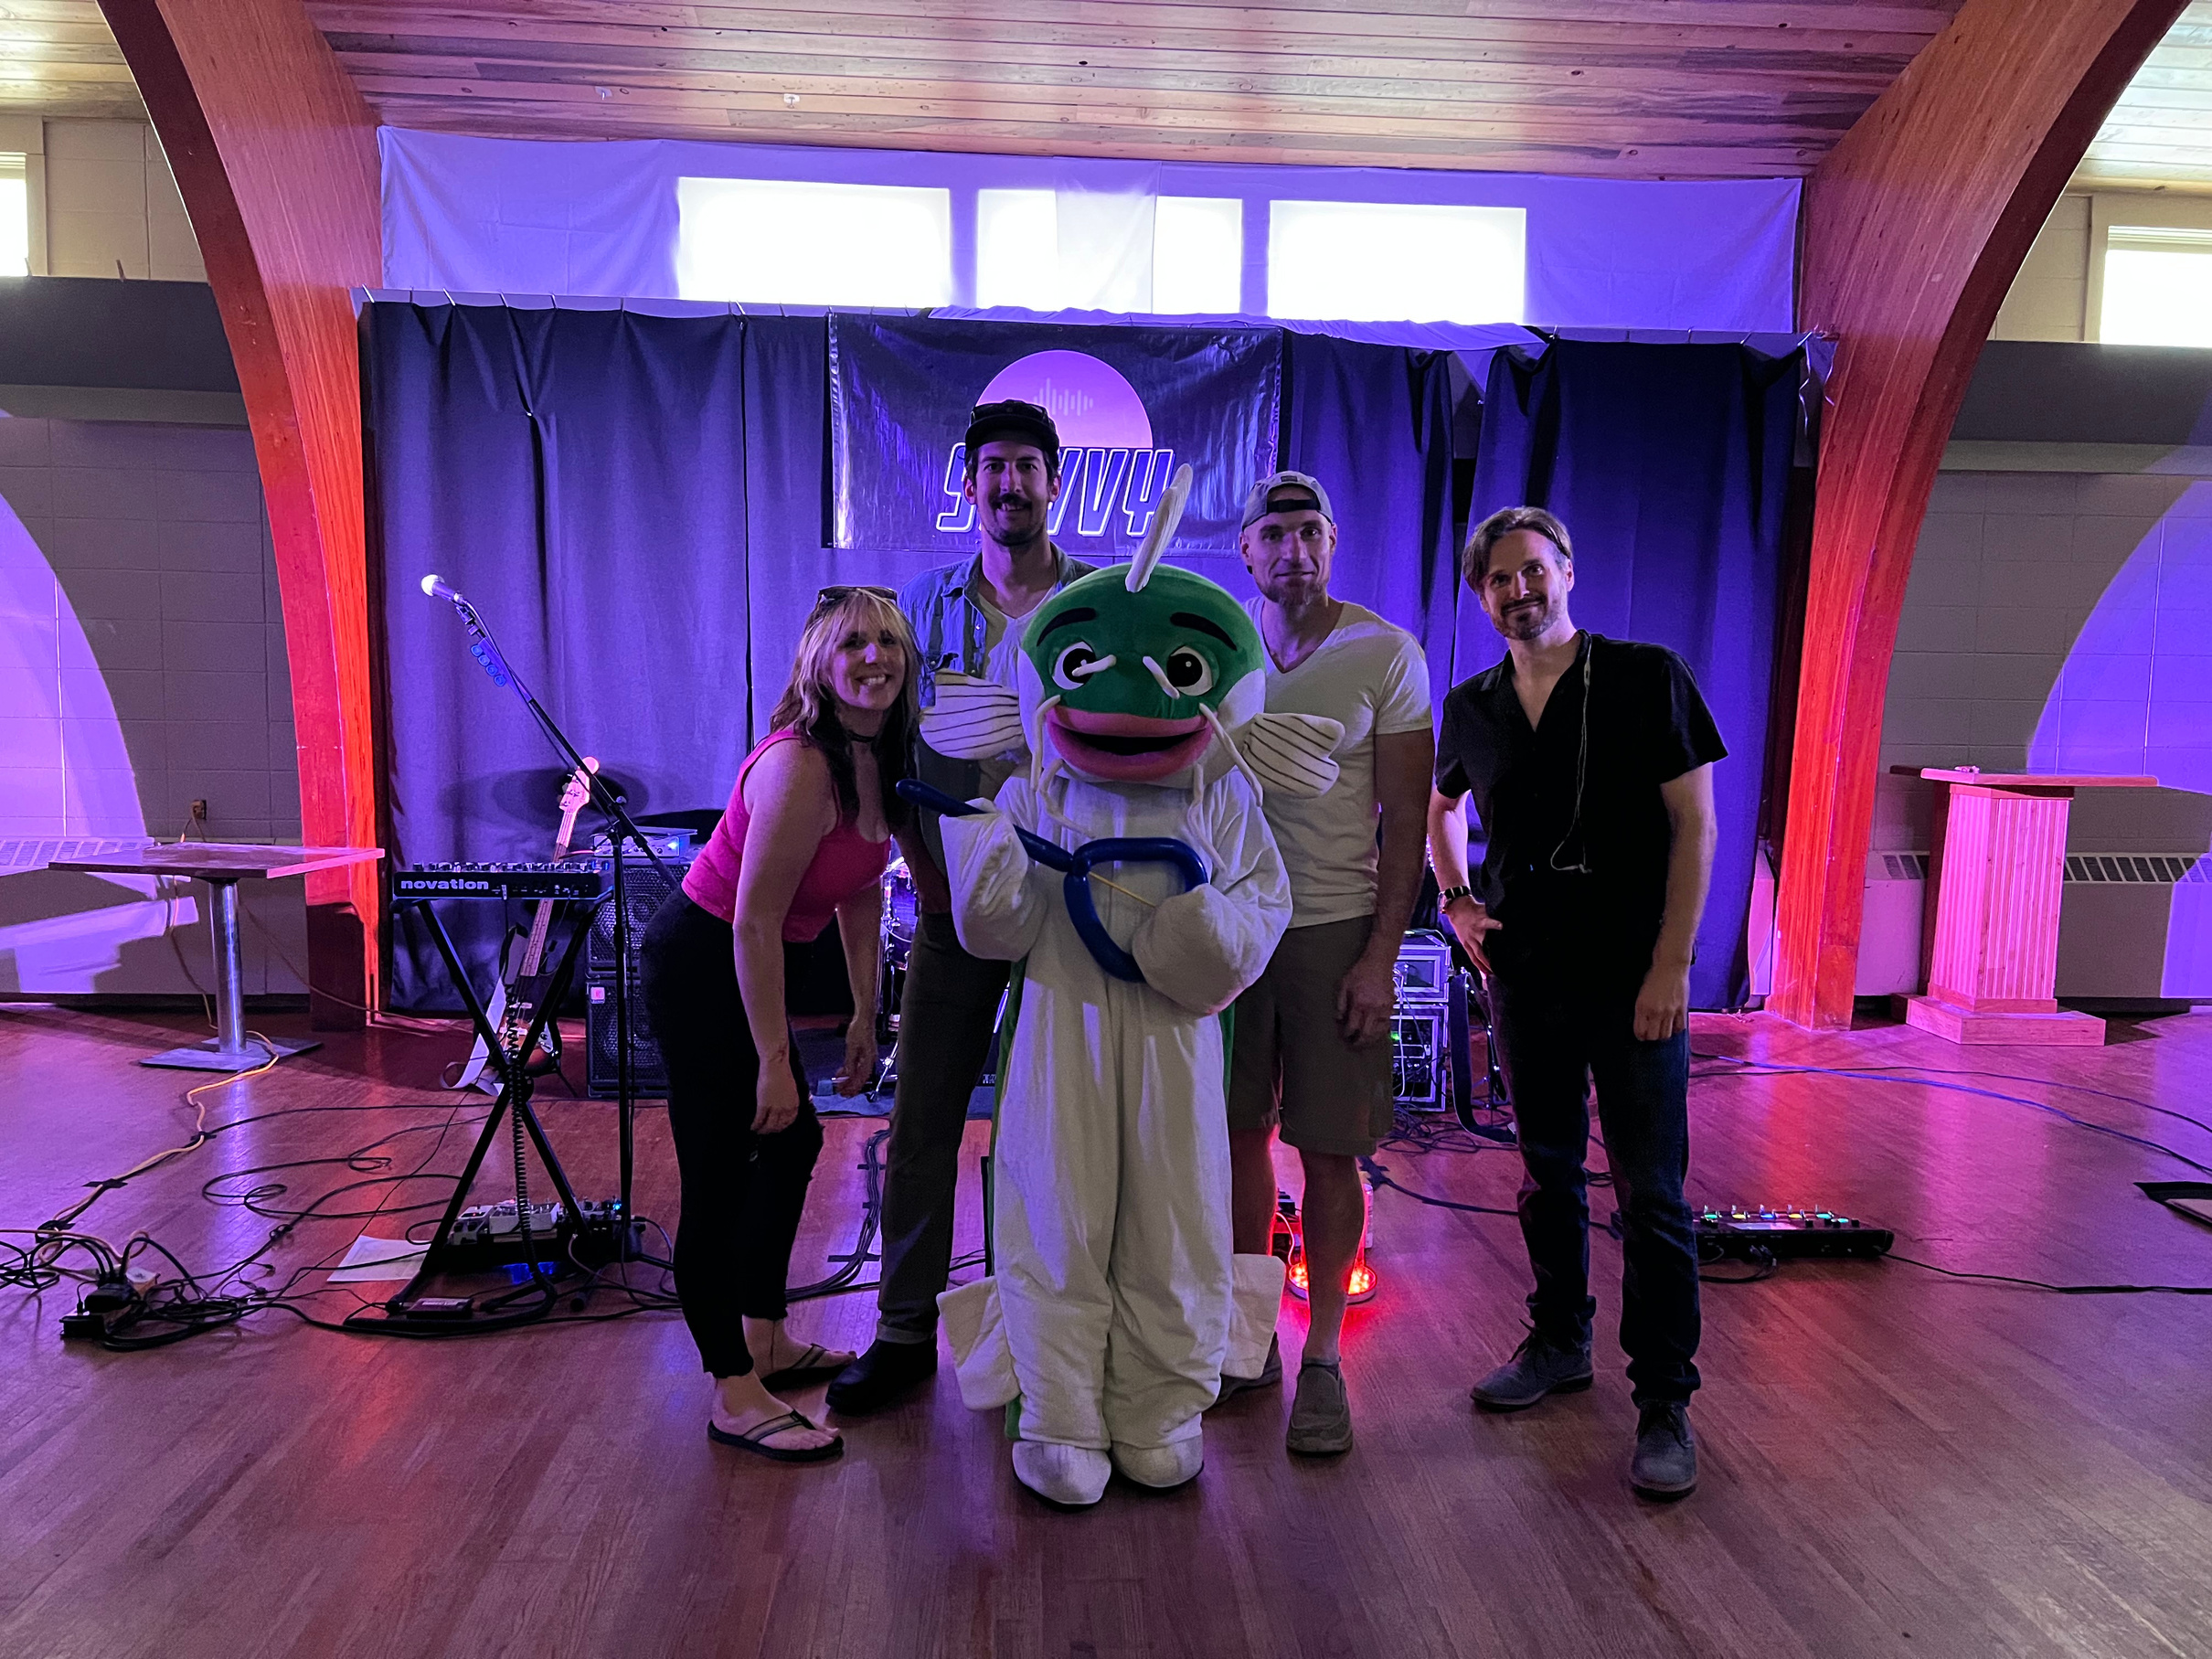
TURNING AWARENESS INTO VISITATION
Glasgow is already a strong regional destination, but many travelers are still unfamiliar with everything our area offers.
Our opportunity is to tell Glasgow’s story more clearly, more consistently, and more strategically so visitors see us as a destination worth planning around—not just passing through.

Slide 5
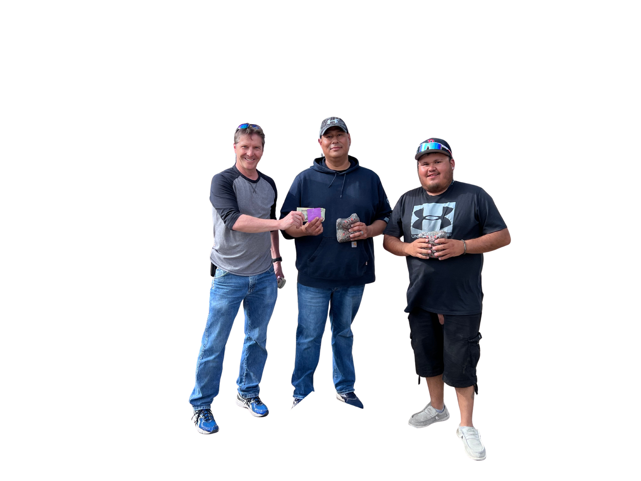
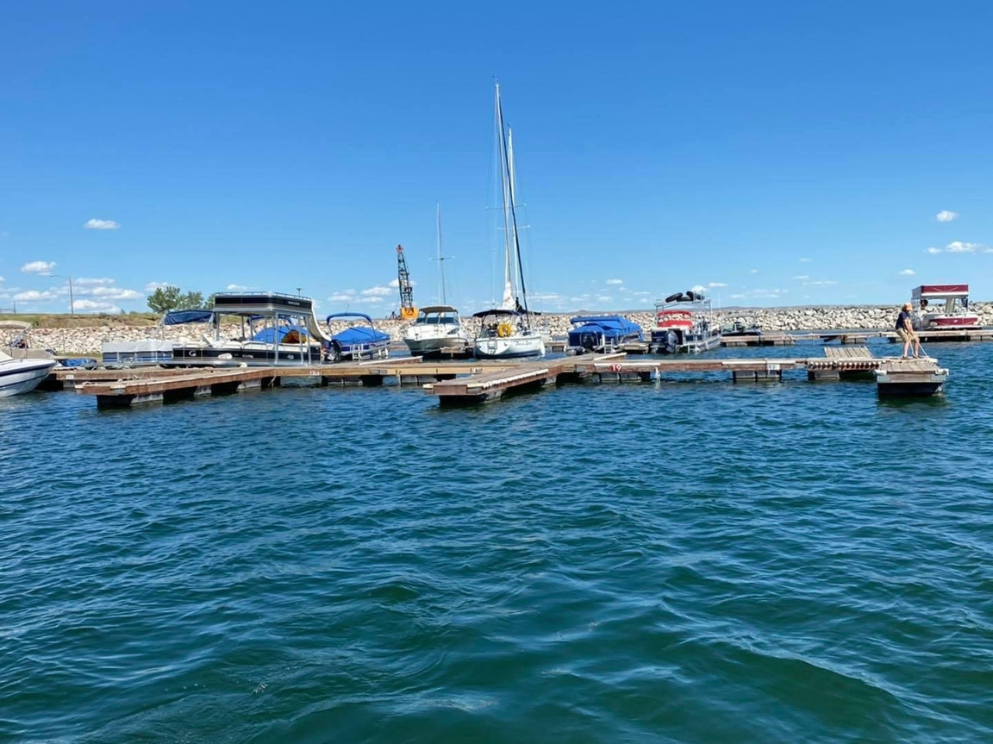
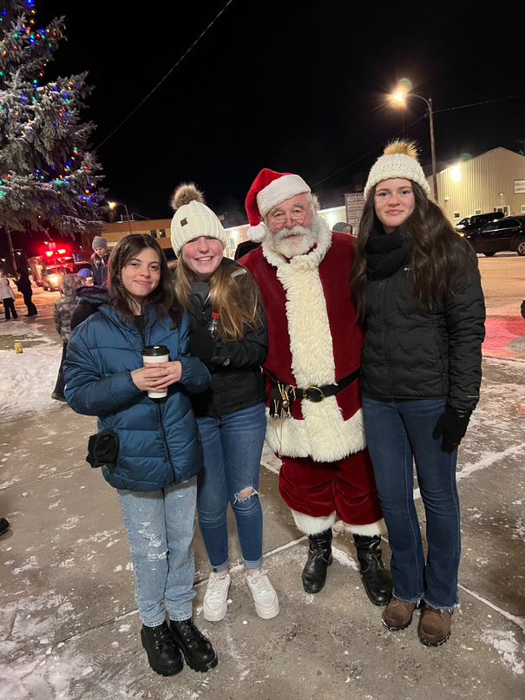
EXPAND DIGITAL MARKETING & VISITOR ENGAGEMENT
We will strengthen Glasgow’s online presence by improving how visitors discover, plan, and experience our destination.
Key efforts include:
  Refreshing and improving the tourism website
  Creating stronger social media content
  Using email marketing and blog content to reach audiences
  Improving SEO and Google visibility
  Exploring user-generated content and influencer partnerships
The goal is to make Glasgow easier to find, easier to understand, and easier to choose.

Slide 6
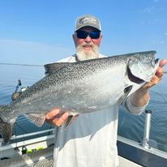
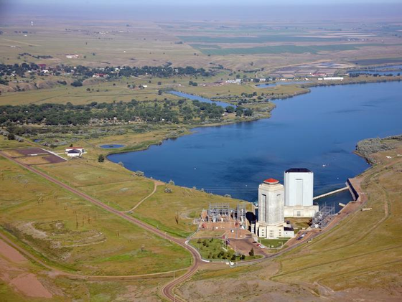
Fort Peck Lake, the Missouri River, and nearby public lands give Glasgow a major opportunity to grow as an outdoor recreation destination.
Our plan includes:
  Promoting fishing, boating, hiking, hunting, and wildlife watching
  Highlighting seasonal outdoor opportunities
  Creating maps, guides, and digital content for visitors
  Working with local businesses to make outdoor travel easier
  Improving signage, access points, and visitor information where possible
PROMOTE WATER & OUTDOOR RECREATION

Slide 7
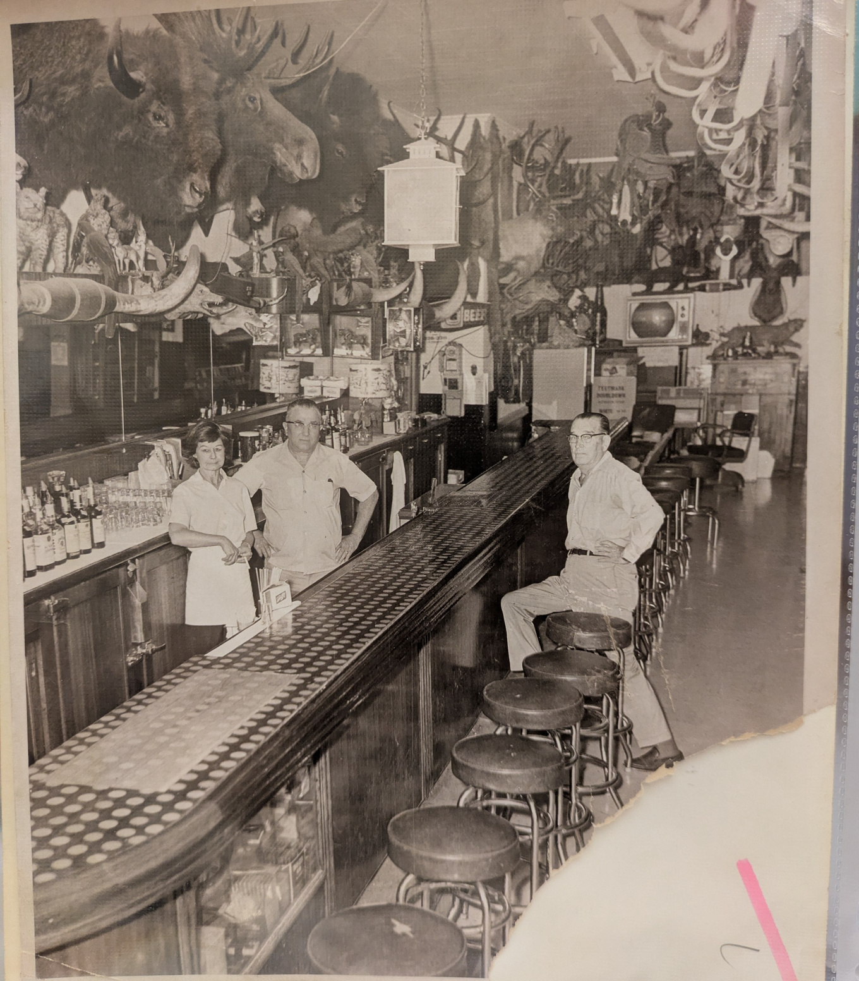
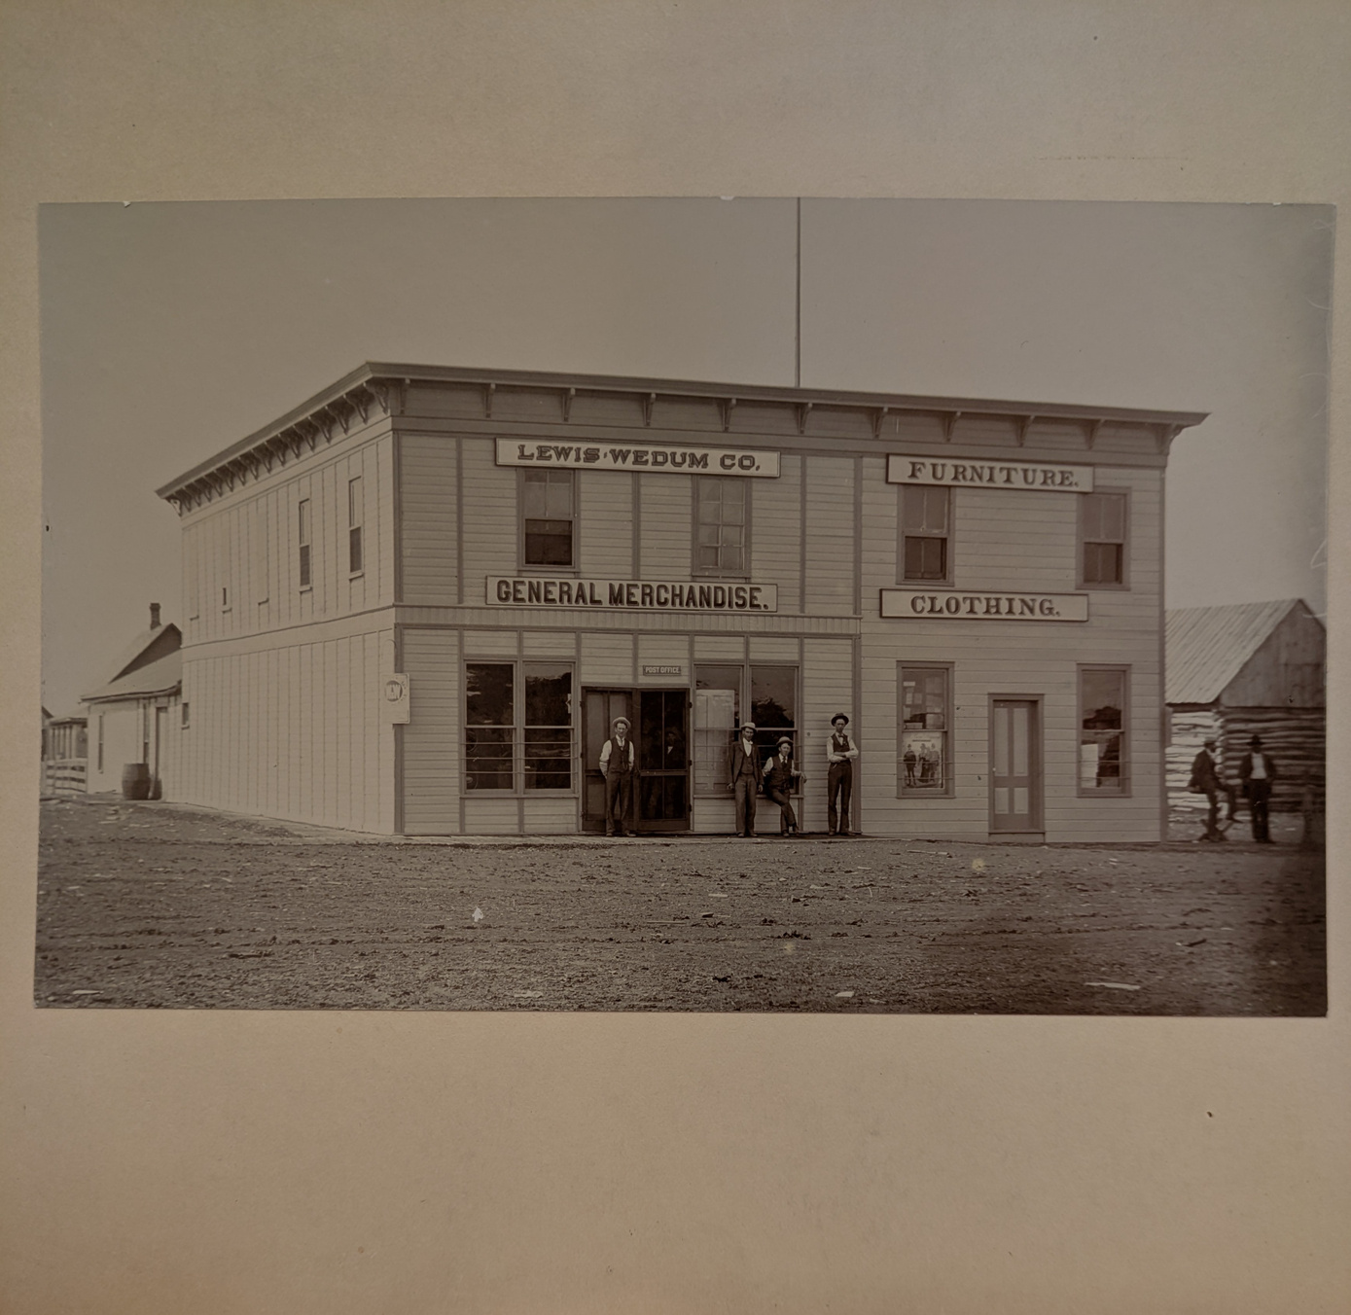
Glasgow’s history, cultural assets, and connection to the Montana Dinosaur Trail create meaningful opportunities for heritage-based travel.
Priorities include:
  Promoting museums, historic sites, and local stories
  Highlighting railroad, homesteading, rural heritage, and Native American history
  Supporting paleontology and dinosaur-related tourism
  Positioning Glasgow as part of a broader Northeast Montana heritage route
  Partnering with local organizations to build stronger visitor experiences
TURNING GLASGOW’S HISTORY INTO VISITOR EXPERIENCES

Slide 8
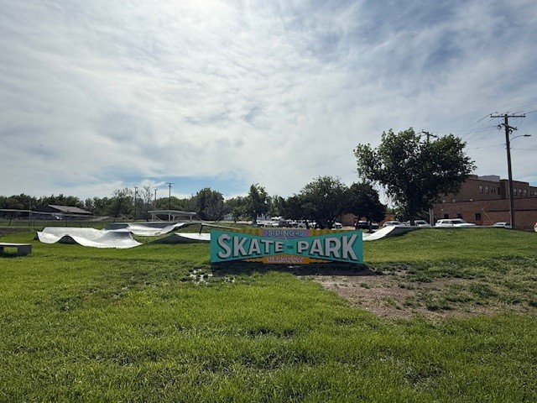
Our primary audiences include:
  Outdoor sports enthusiasts interested in fishing, boating, hunting, hiking, and wildlife viewing
  Family travelers looking for affordable, educational, and safe outdoor experiences
  Heritage and cultural travelers interested in museums, history, genealogy, and rural Montana stories
  Road trip and RV travelers moving along Highway 2
Emerging opportunities include paleontology tourism, eco-tourism, agritourism, tribal and Indigenous cultural tourism, and heritage/genealogy travel.
WHO WE ARE TRYING TO REACH

Slide 9
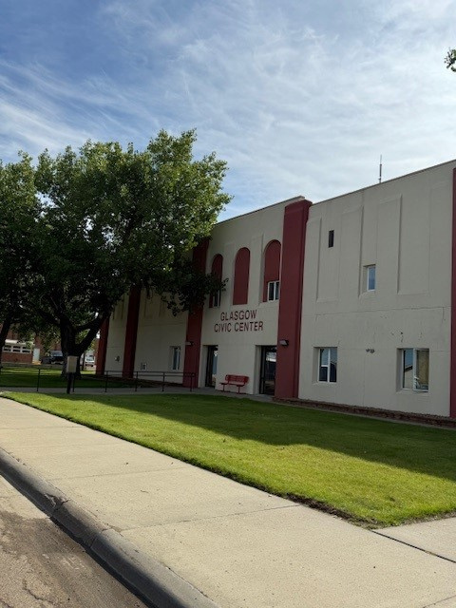
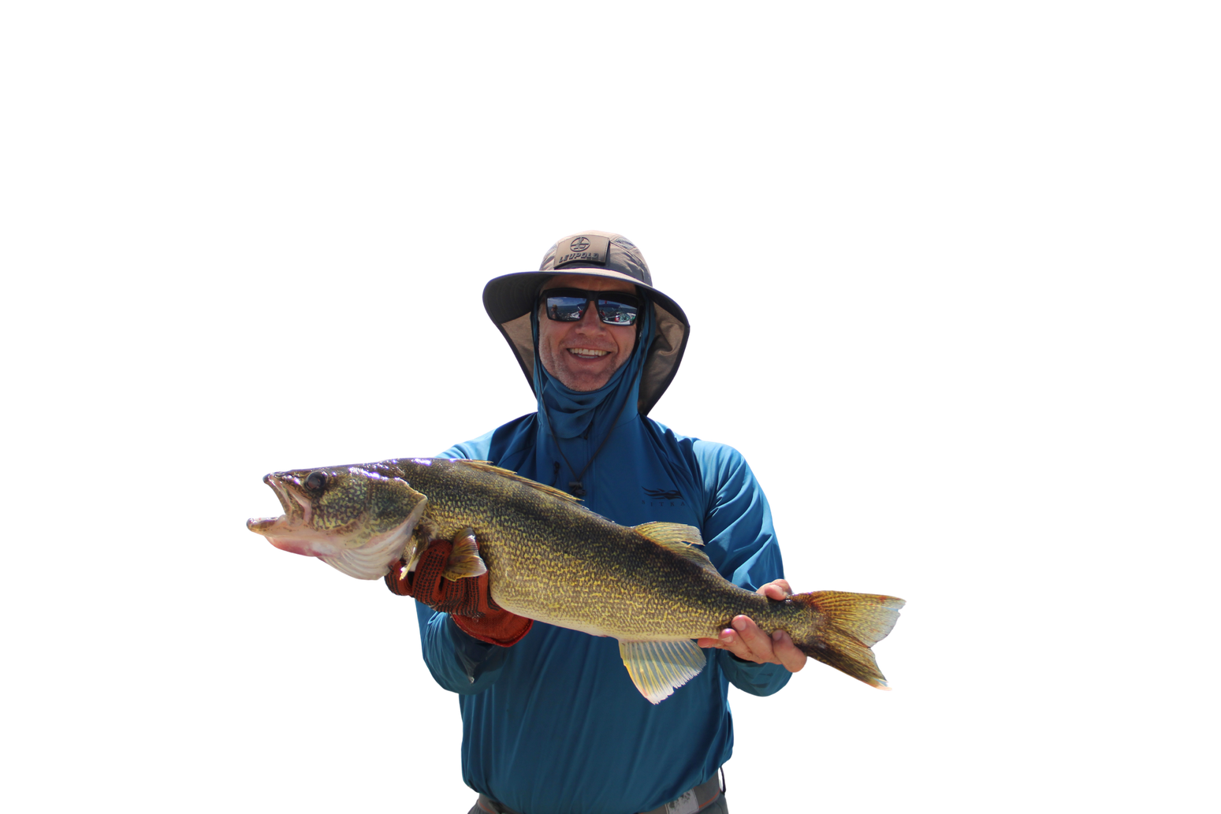
Our DMO plan includes four major goals:
  Increase year-round visitation
  Raise local awareness of the value of tourism
  Improve visitor information and access to attractions
  Support implementation of the Glasgow Resiliency Plan
Together, these goals support visitor growth, stronger local partnerships, and community benefit.
WHAT WE ARE WORKING TOWARD

Slide 10
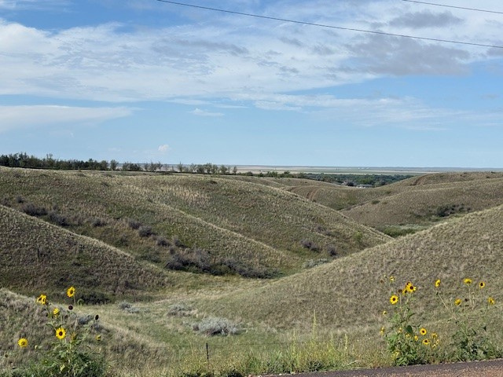
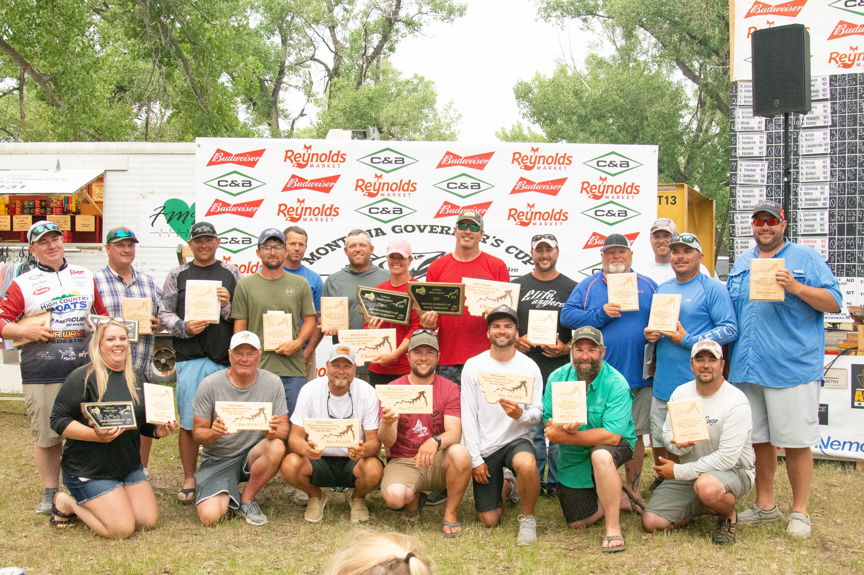
The plan identifies several challenges that impact tourism development:
  Limited regional air service and reliance on road and rail travel
  Seasonal tourism patterns, with stronger visitation in summer and early fall
  Limited marketing budget and staff capacity
  Competition from better-known Montana destinations
These challenges also create an opportunity to be more focused, collaborative, and intentional in how we market Glasgow.
BEING STRATEGIC WITH LIMITED RESOURCES

Slide 11
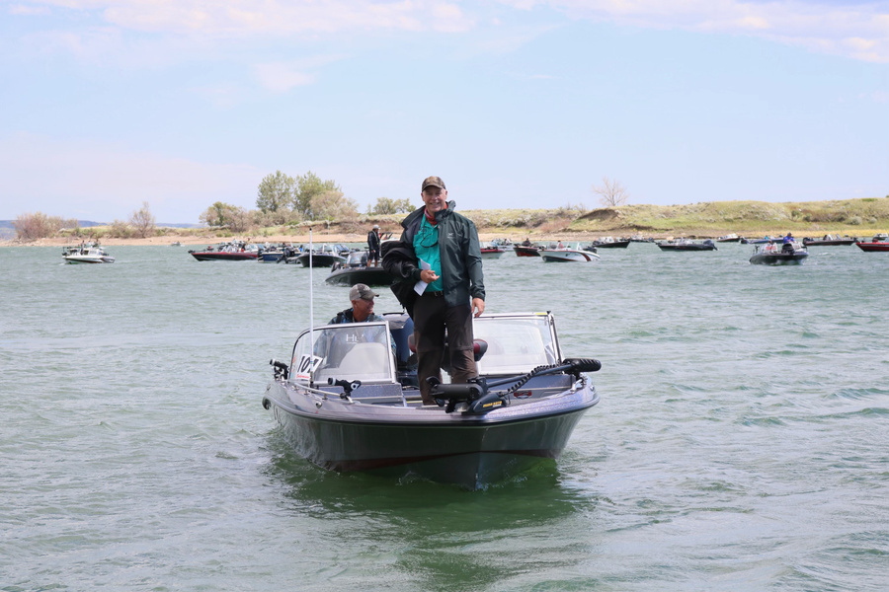
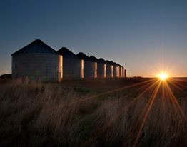
TRACKING PROGRESS AND INVESTING IN VISIBILITY
We will measure progress through:
  Website traffic and engagement
  Social media reach and engagement
  Visitor inquiries and digital interactions
  Increased awareness of Glasgow’s tourism assets
  Stronger partnerships with local businesses and attractions
  Completion of key marketing and visitor information projects
Budget priorities include advertising, website development, social media and digital marketing, printed visitor materials, and promotional resources that strengthen Glasgow’s tourism presence.

Slide 12
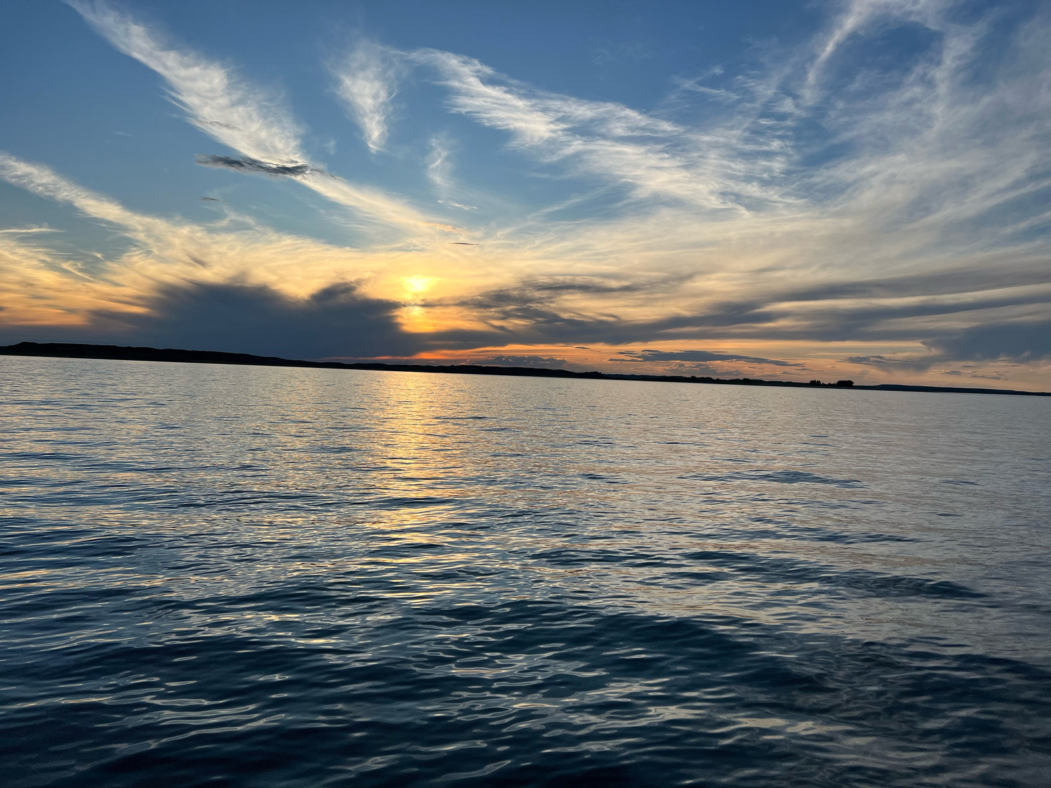
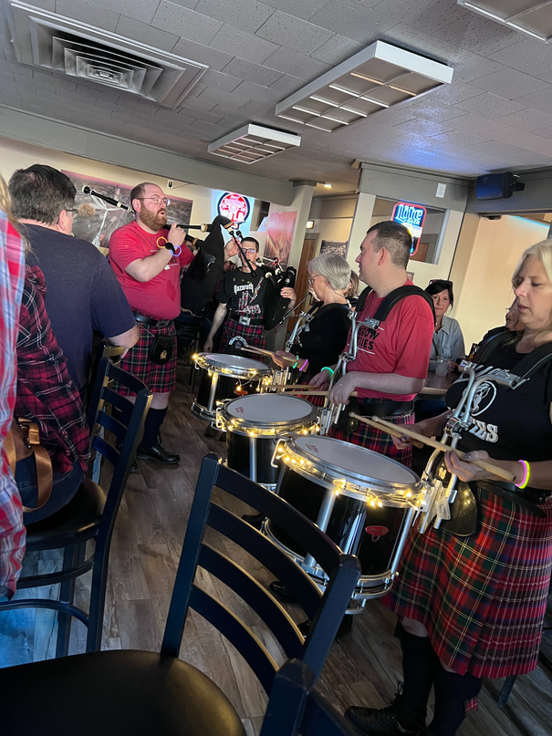
TELLING GLASGOW’S STORY WITH PURPOSE
Glasgow has the assets, hospitality, and authenticity visitors are looking for.
The Tourism Advisory Council plays an important role in helping this plan move from paper to action through:
  Feedback on priorities
  Ideas for partnerships and promotion
  Input on visitor needs and community opportunities
  Help identifying gaps in the visitor experience
  Support in keeping tourism connected to local businesses and residents
By working together, we can position Glasgow as a memorable Northeast Montana destination—one that invites visitors to explore, stay longer, return often, and feel connected to our community.

Slide 13
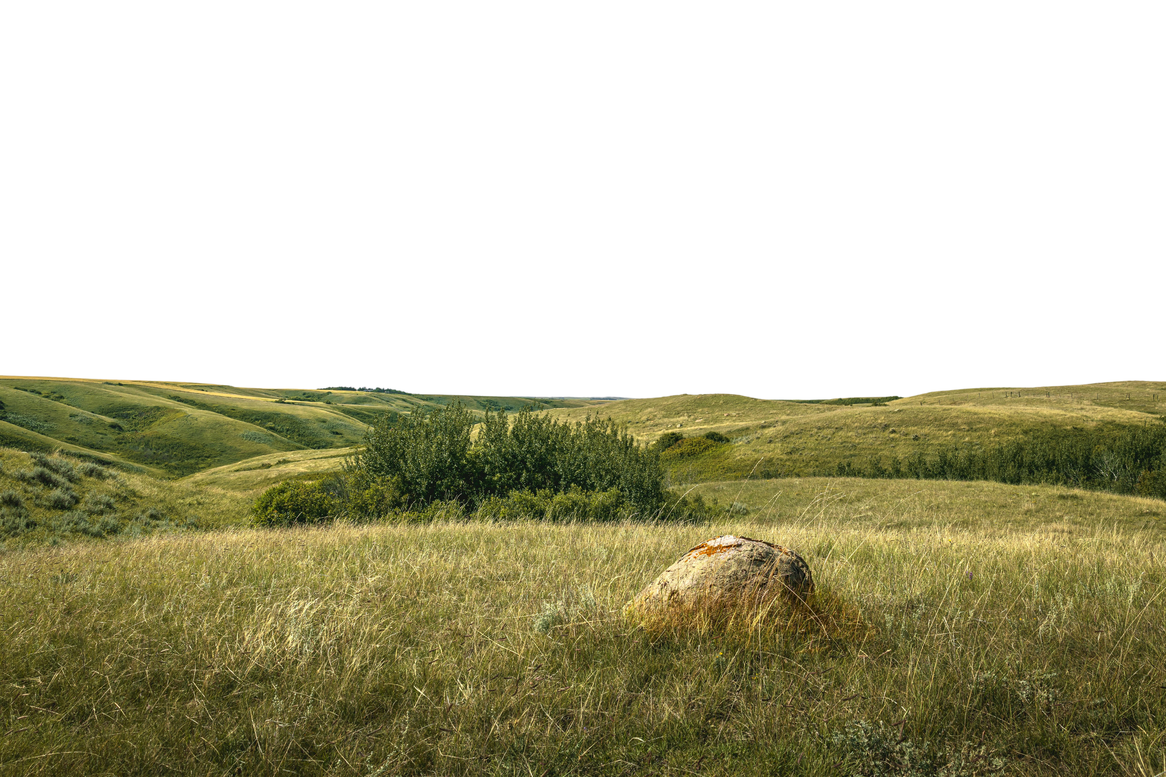
THANK YOU

