Slide 1
Miles City DMO
FY 2027
Marketing Plan
Miles City DMO Marketing plan
FY2027

Slide 2
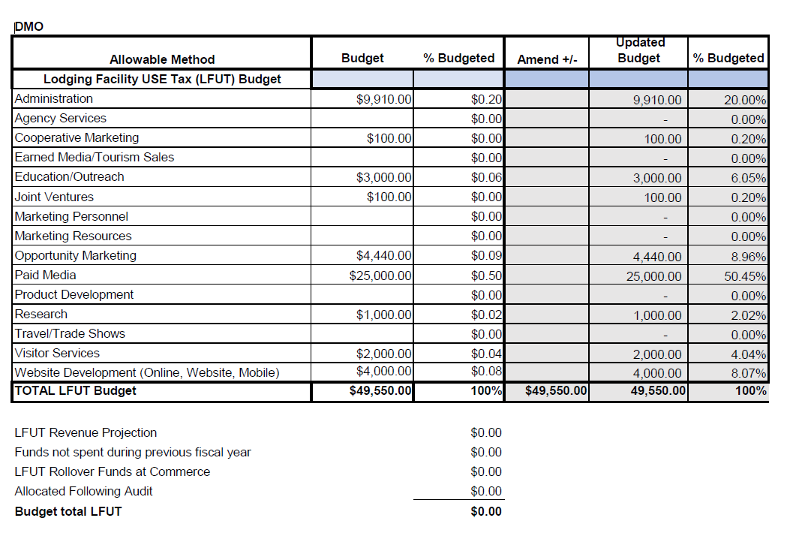
FY 2027
Budget

Slide 3
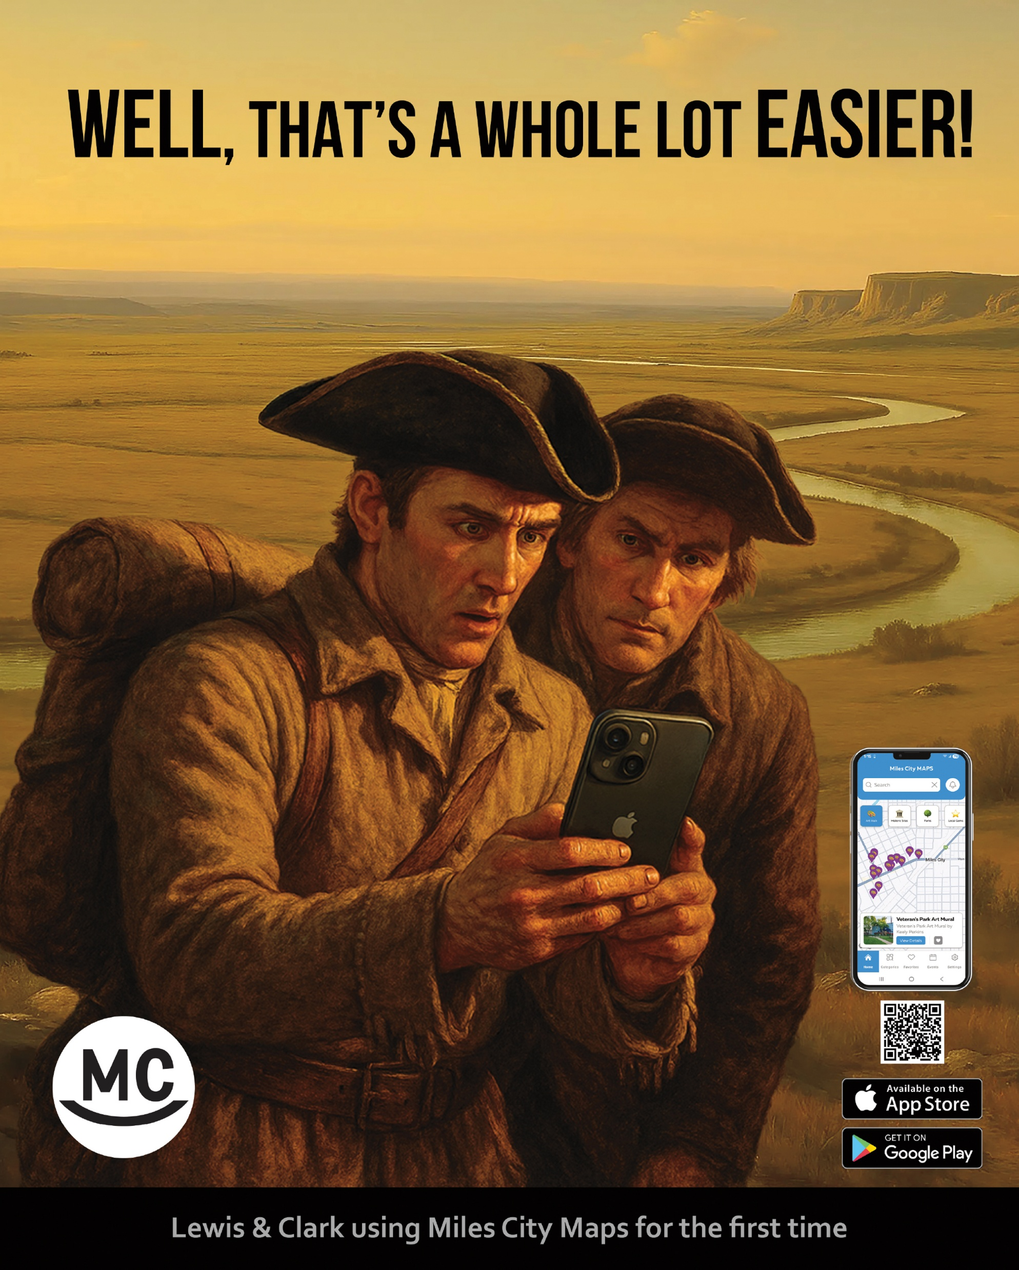
Welcome to
Miles City Maps App

Slide 4
The Miles City App. was an idea that was started in the current fiscal year and has become a reality within the last couple of months. We rolled it out before the Bucking Horse Sale to see it’s impact on travelers. It is about 85% finished but we still need to shoot some stills of locations, but we wanted to wait until they had a spring/ summer look to them. We have already what we will call the first quarter analytics, and we are very proud to say we have already had 13,000 visits with the time spent on the app at over 3 minutes with parks and events being the most view pieces to date. Direct search has obviously been the primary search. We plan to increase these numbers with the marketing we have planned for FY27.

Slide 5
Shareable V.I.C.
One day Bailey and I were sitting in our offices, and a visitor came in asking about what to do in Miles City and the surrounding area. After planning his next 3 days we decided we should be marketing this for, not only Miles City but the rest of the region. This year is the 150th anniversary of the Battle of the Little Bighorn near Hardin, as well as the opening of the Theodore Roosevelt Presidential Library. We have heard of visitors in the hundred of thousands going between these locations this summer, so we thought this is the time to put this in place. So, as you will see we turned our old dungeon into a bright, shiny new facility with a new mission. Our mission is to assist visitors in planning their time in our area. We offer a TV for all area events, a corner for displays such as museum displays. We also offer staffing Monday through Friday, 9 to 5 to aide in keeping our visitors around for as long as possible. This is how it turned out.

Slide 6
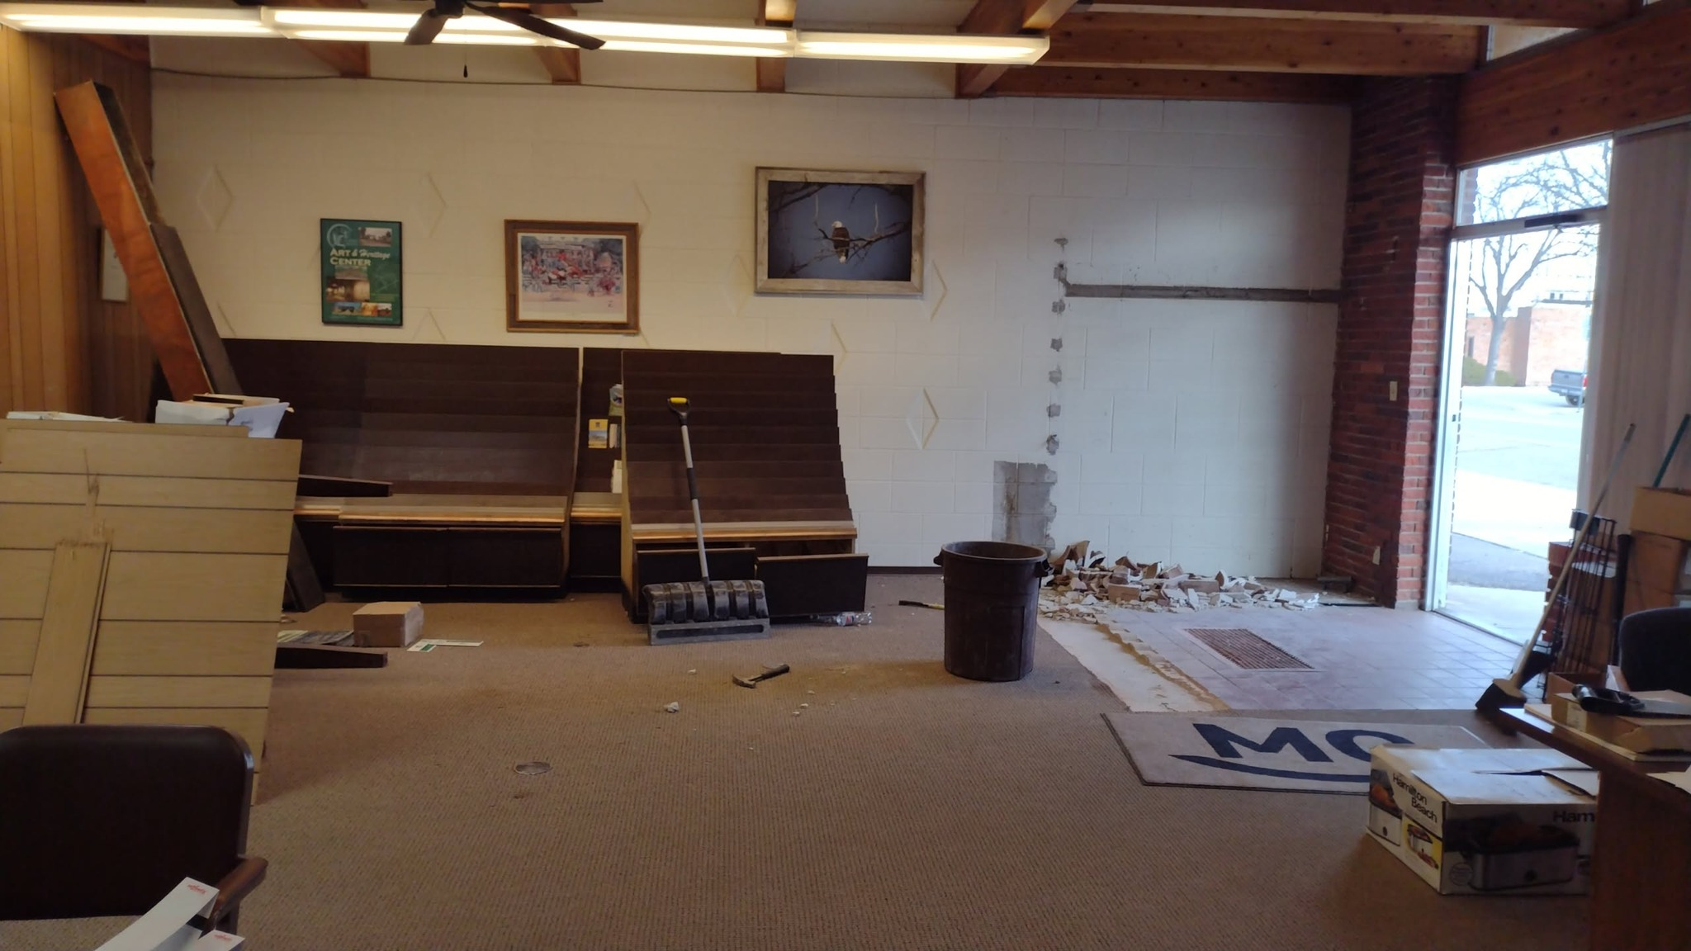
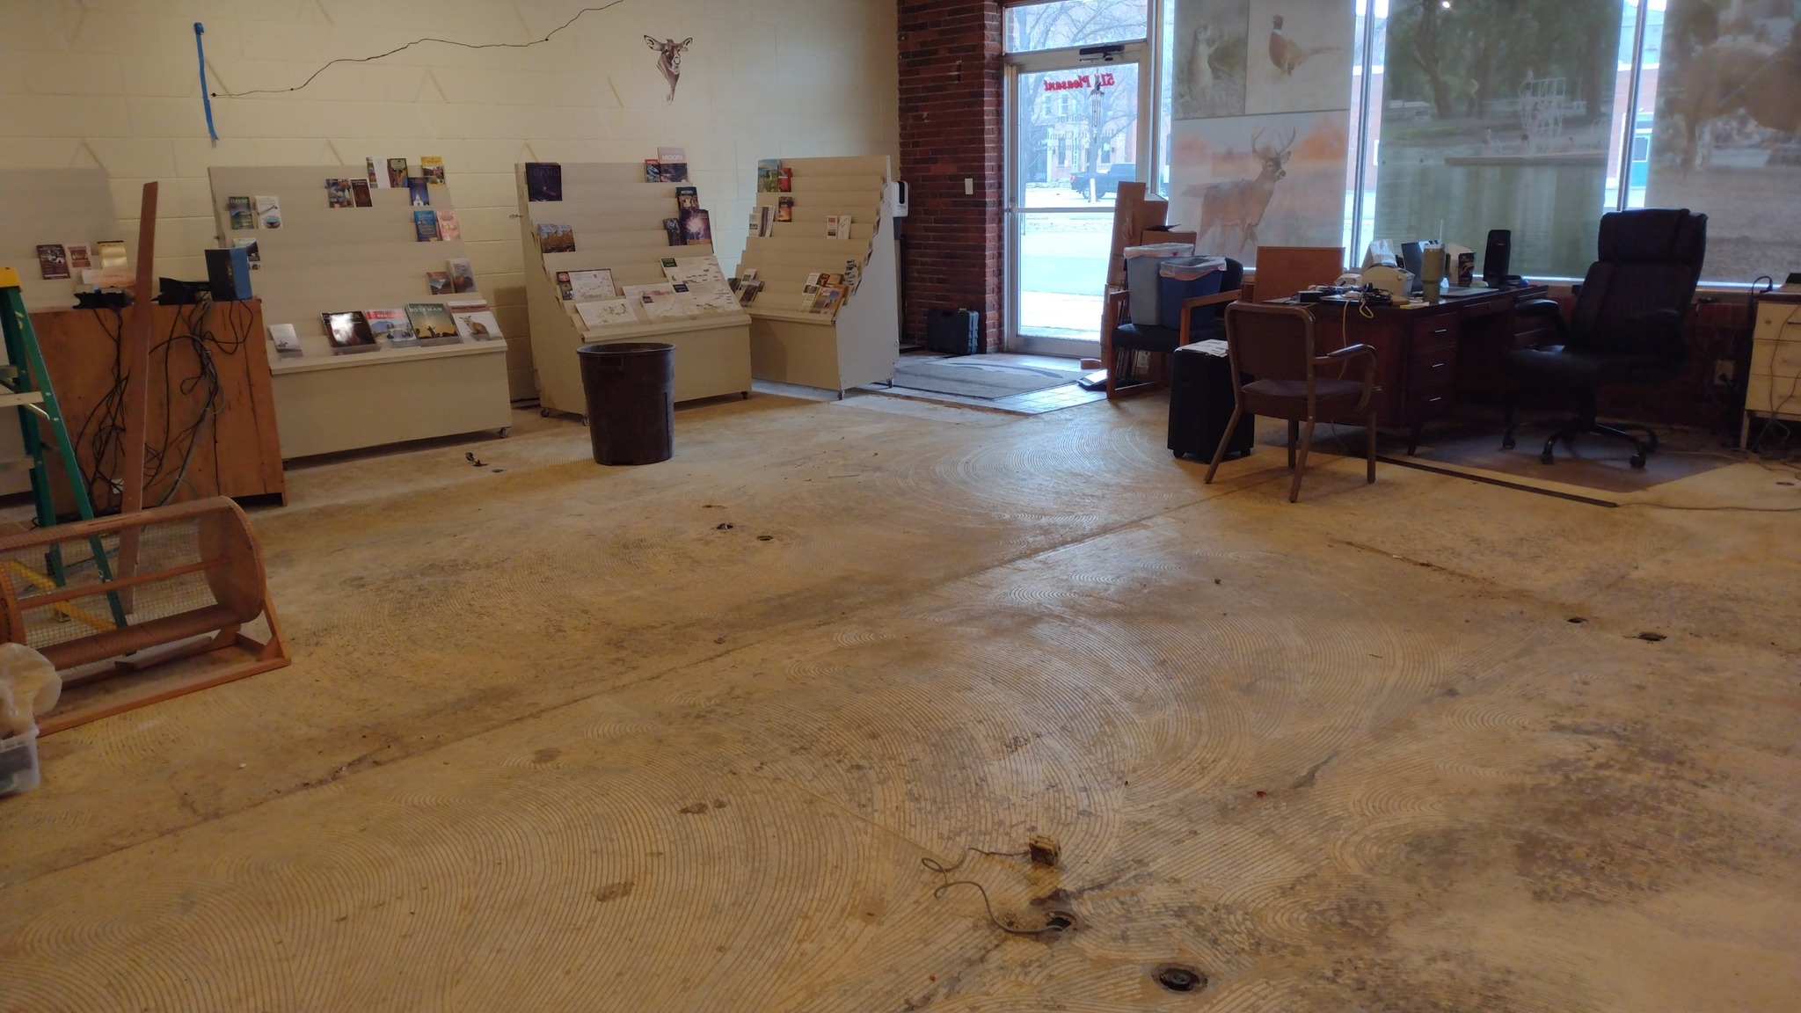

Slide 7
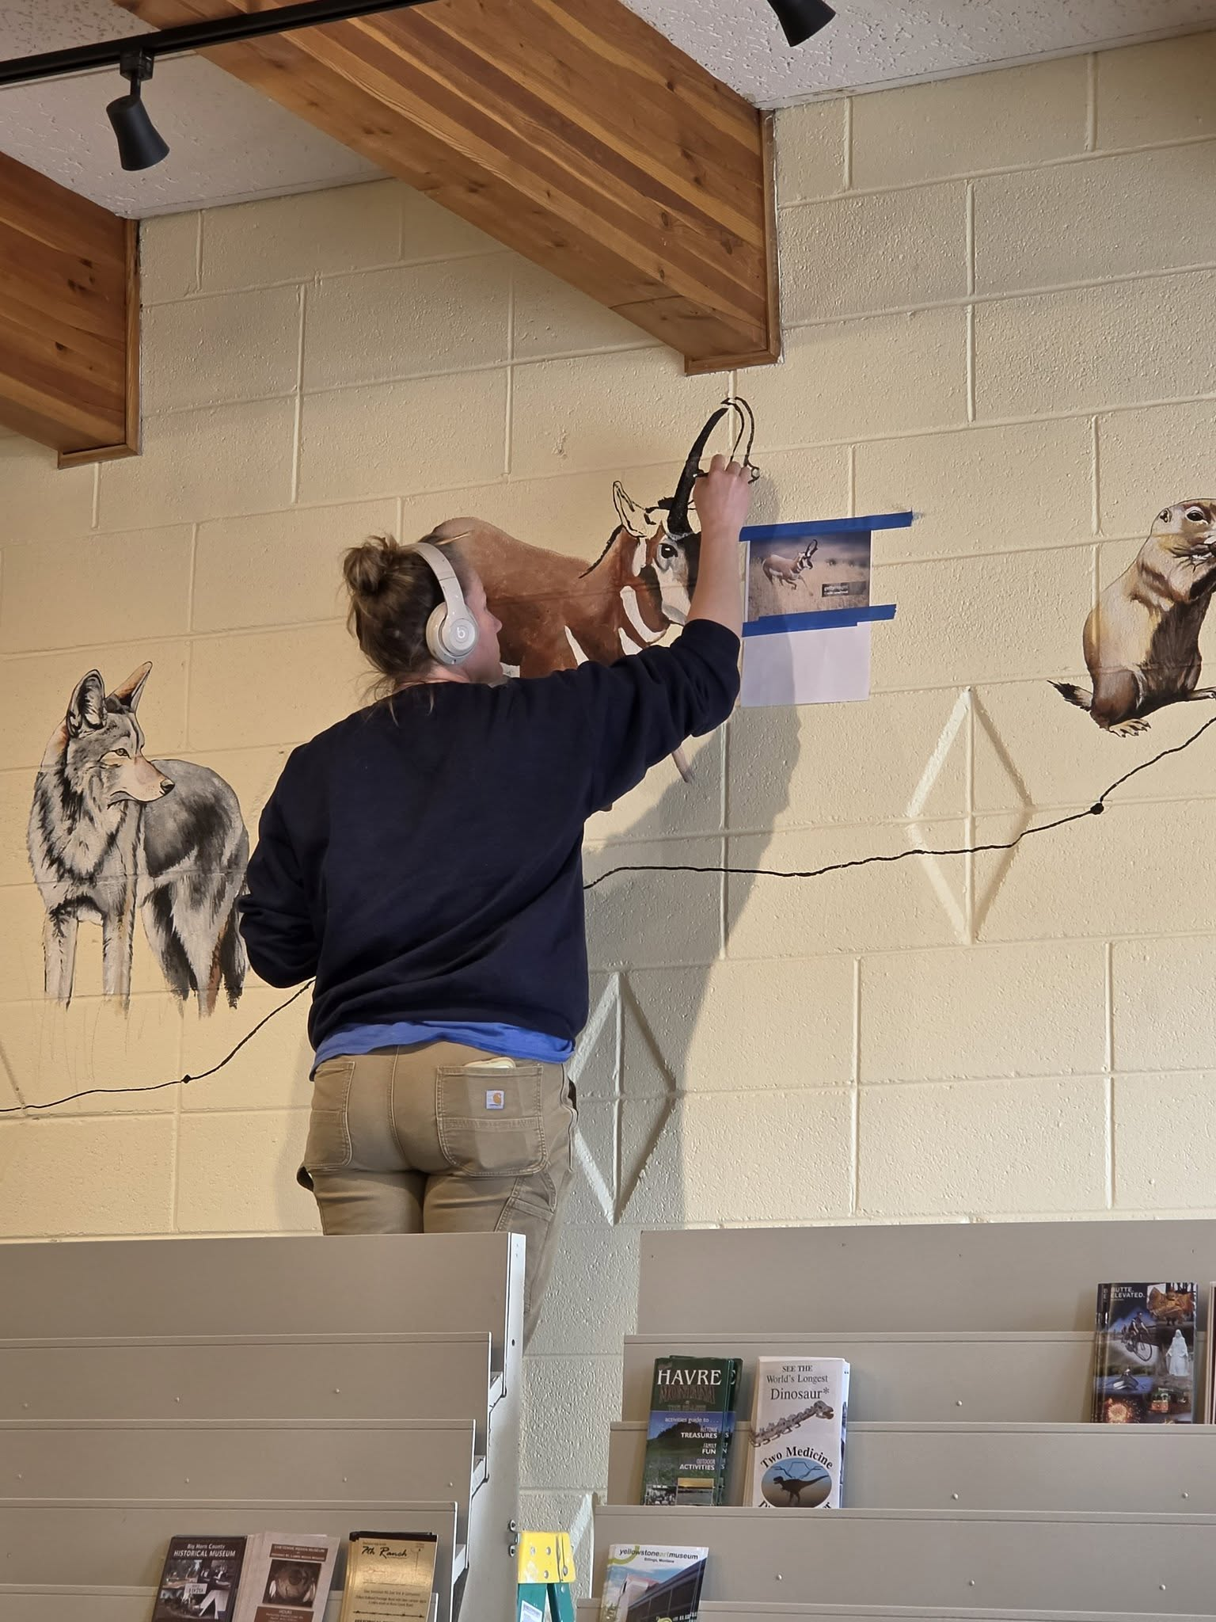
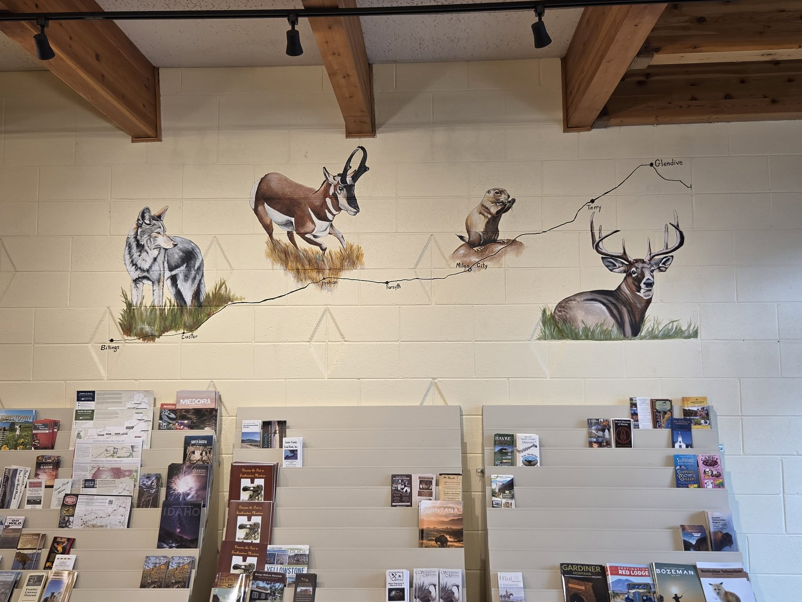

Slide 8
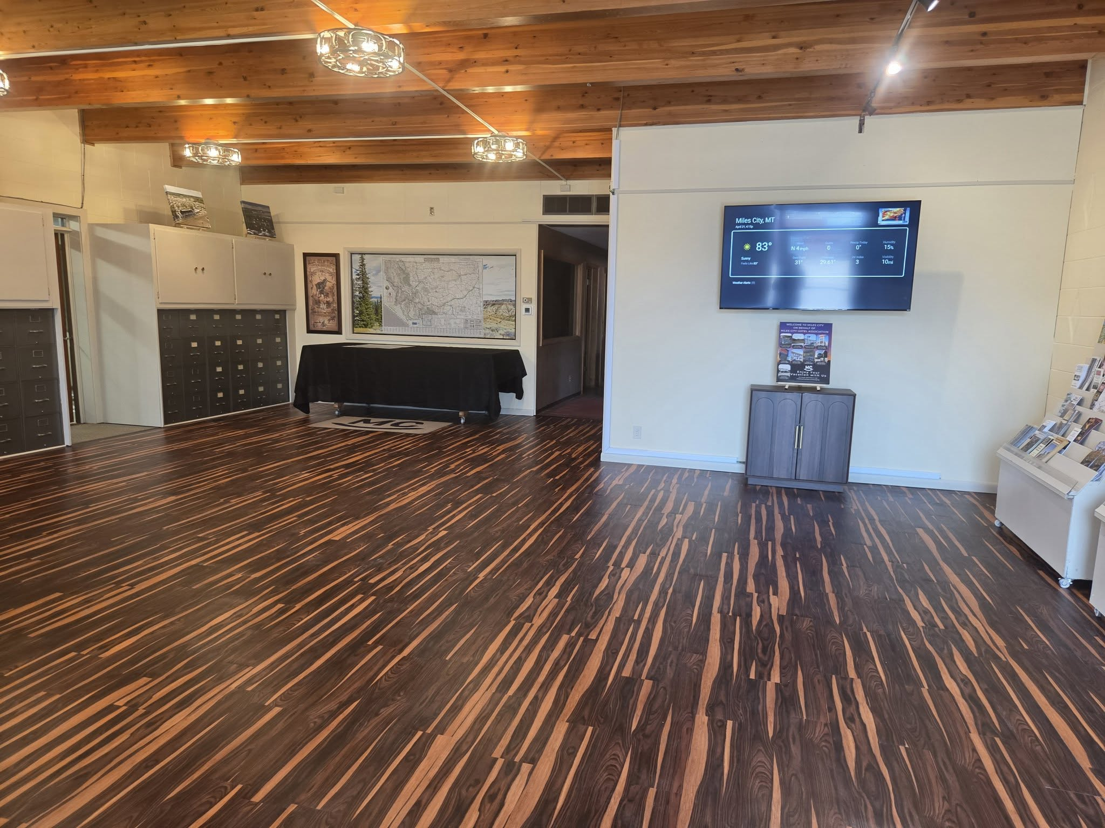

Slide 9
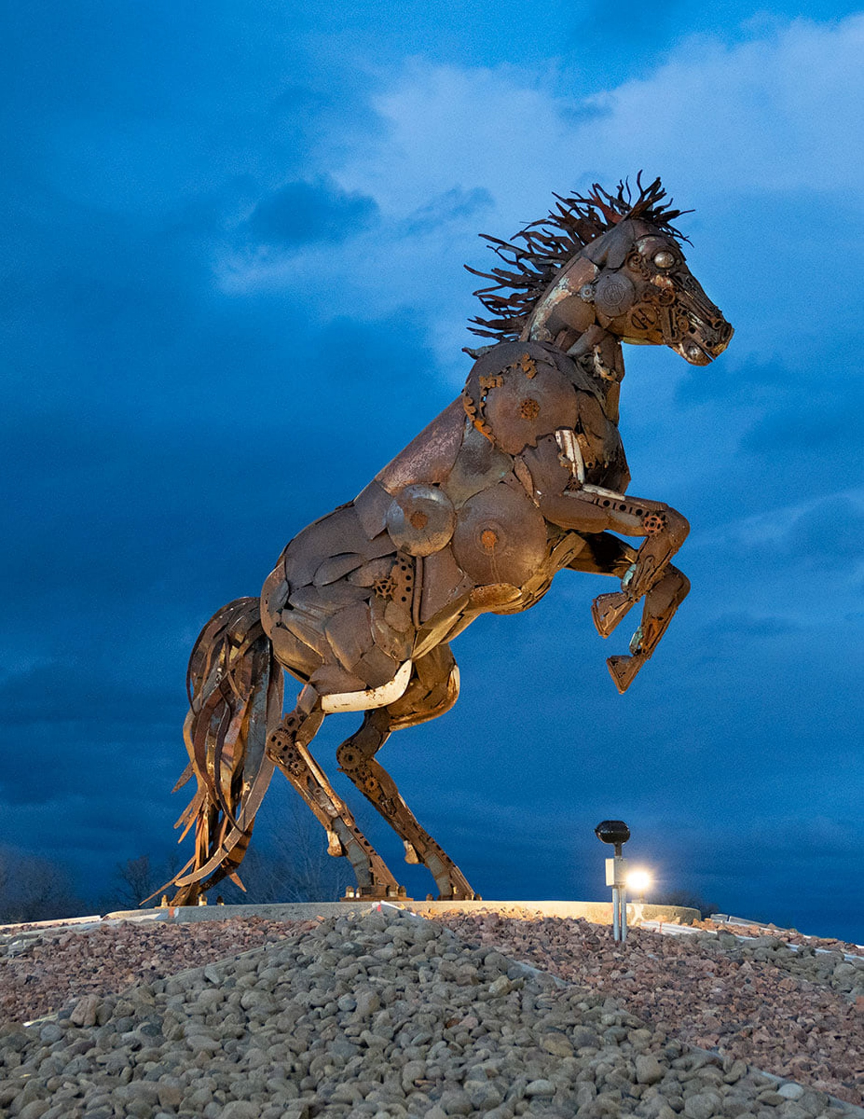
The End

