Slide 1
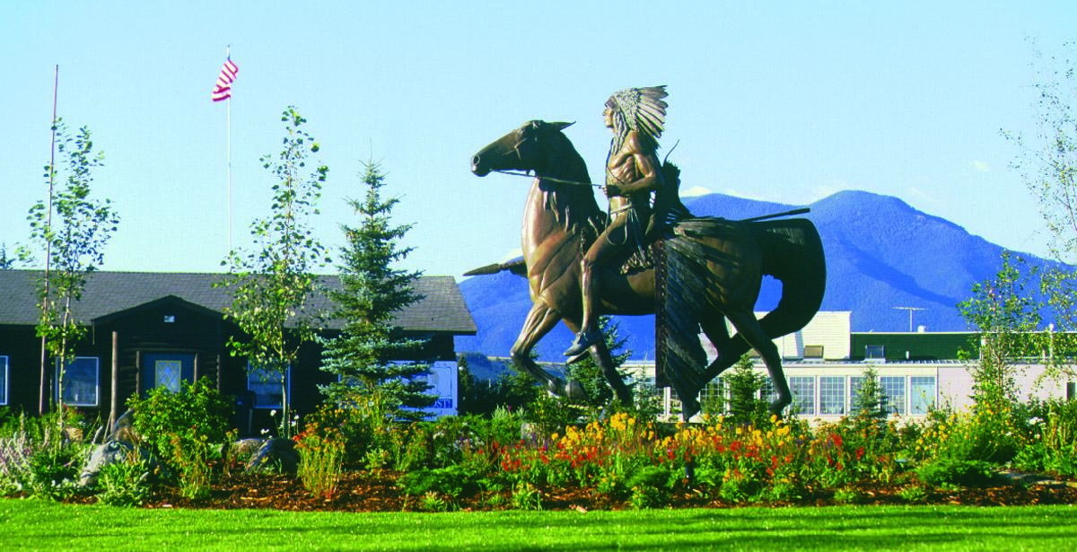

Red Lodge DMO FY27

Slide 2
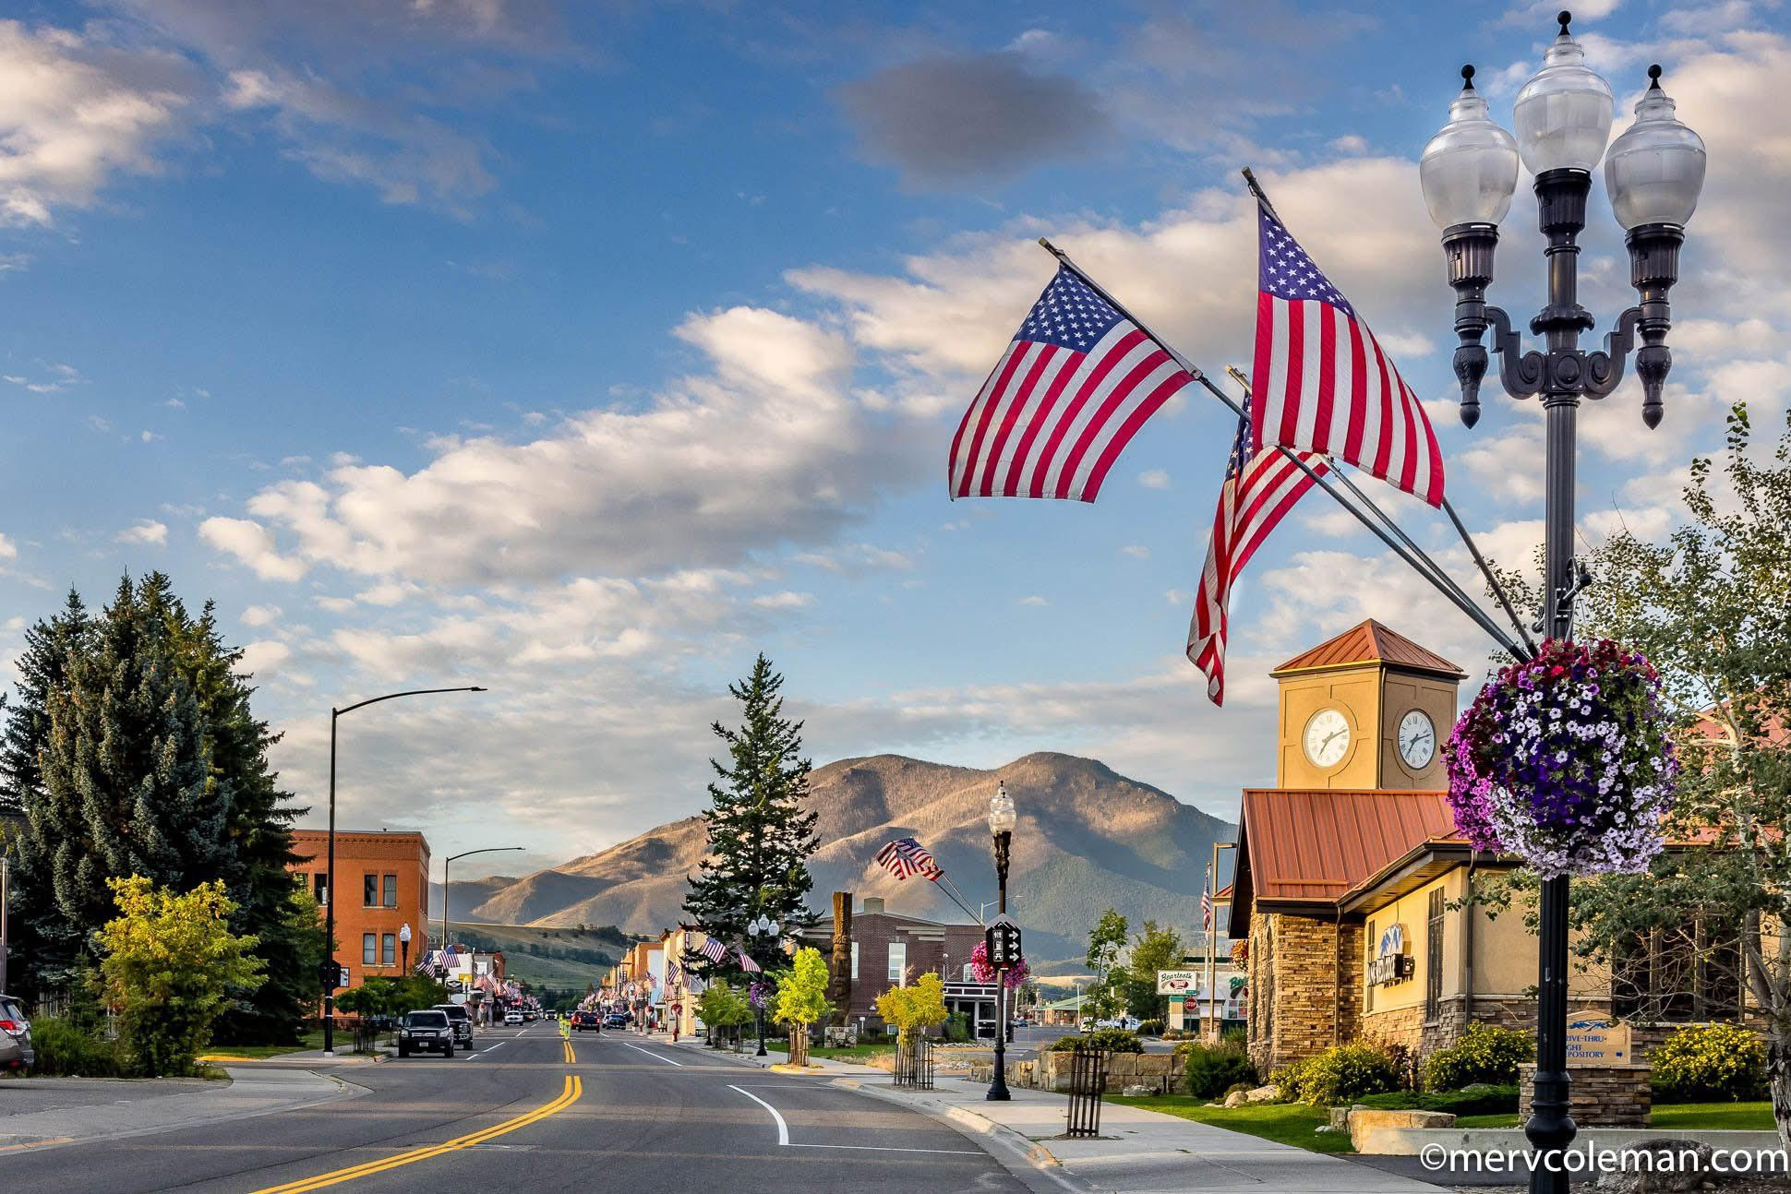
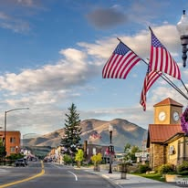
MAIN FOCUS FY27 STRATEGY

Slide 3
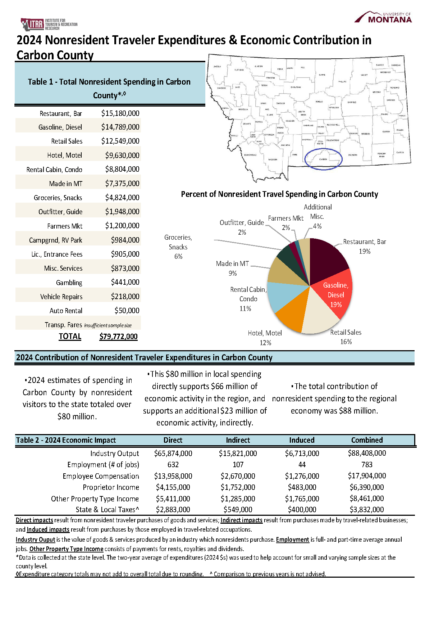
ITRR Research

Slide 4
FY27 Strategies to Achieve This Focus
To support these goals, we will implement several targeted strategies.

Slide 5
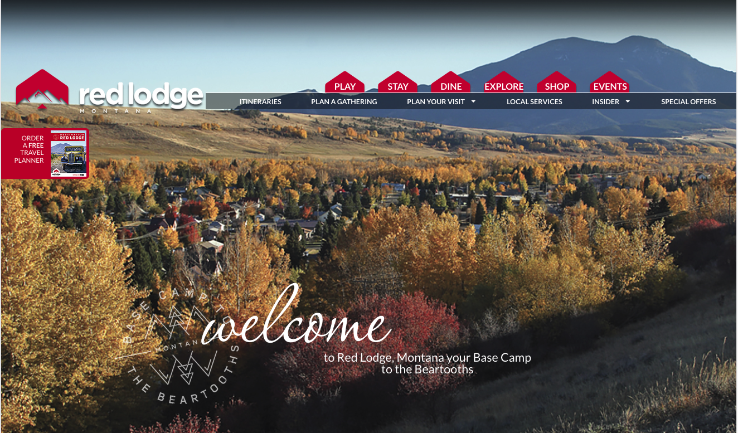
NEW WEBSITE

Slide 6


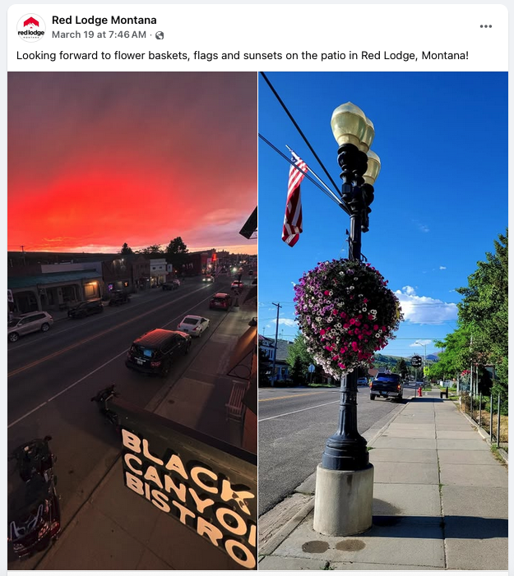
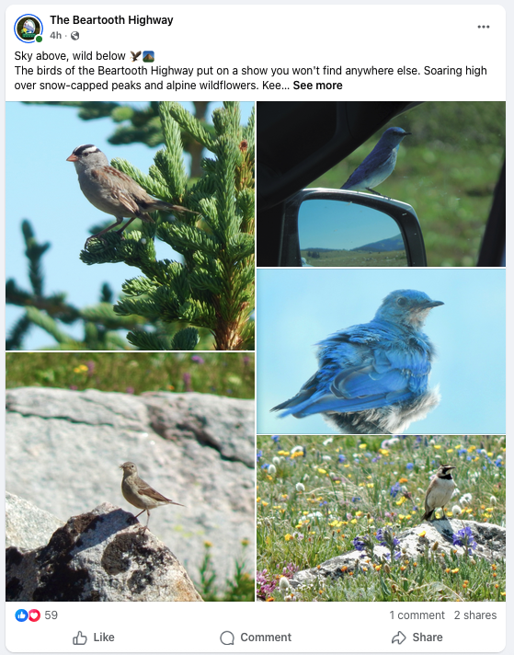
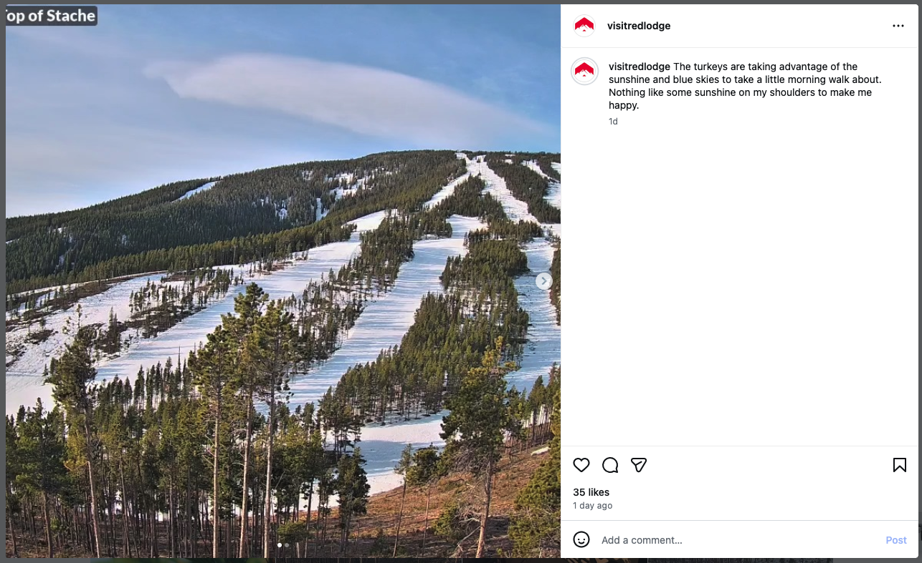
SOCIAL MEDIA
FACEBOOK
INSTAGRAM

Slide 7
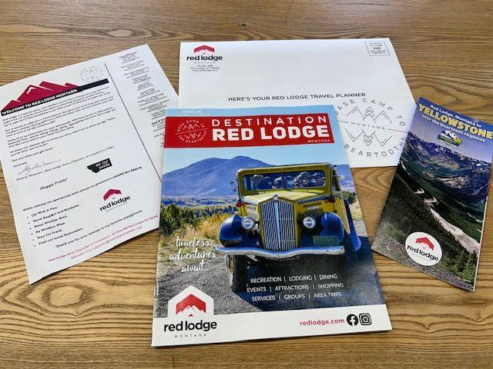

Slide 8
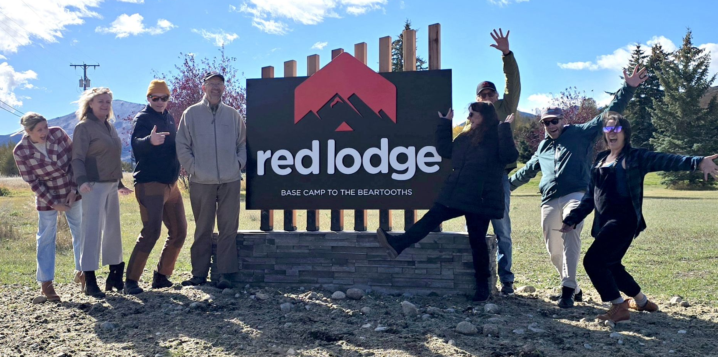
WAYFINDING

Slide 9
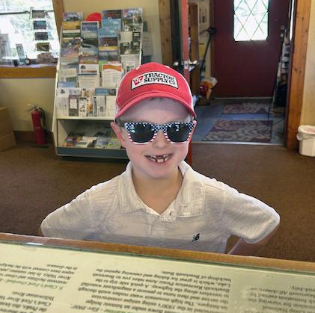
VISITORS CENTER
We assist
8,000+ visitors
plan everything from
lunch to full vacations.

Slide 10
Expanded FY27 Strategies
Cooperation - Work together
TBID - Red Lodge Area Community Foundation
City of Red Lodge - Red Lodge Business Alliance
Beartooth Trails - Red Lodge Proud and Beautiful.

Slide 11
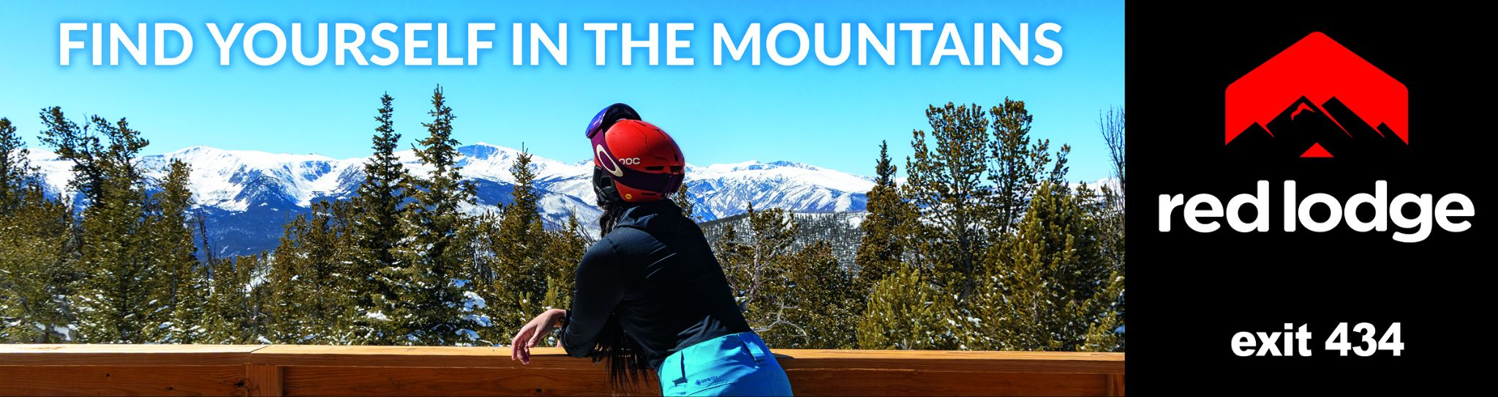

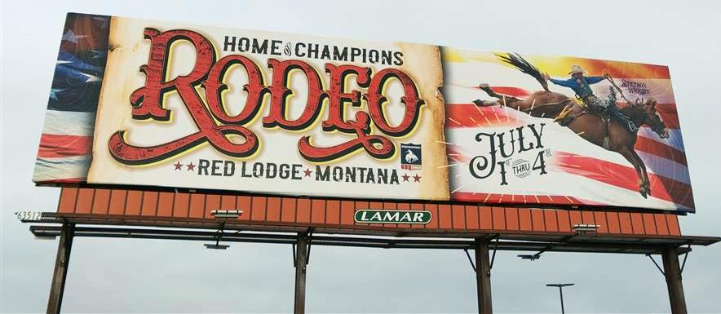
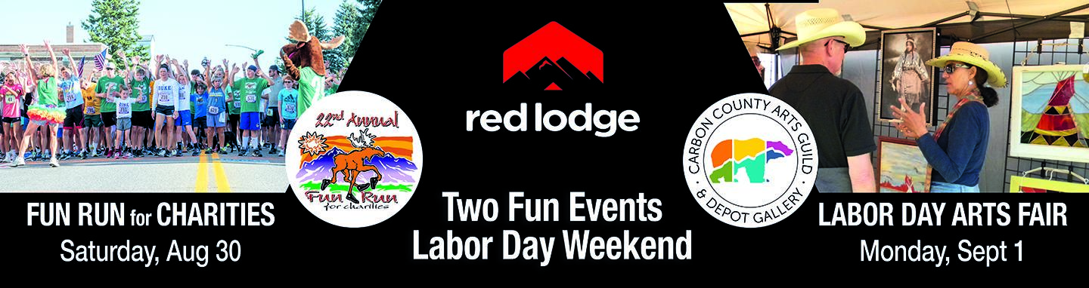
BILLBOARD

Slide 12


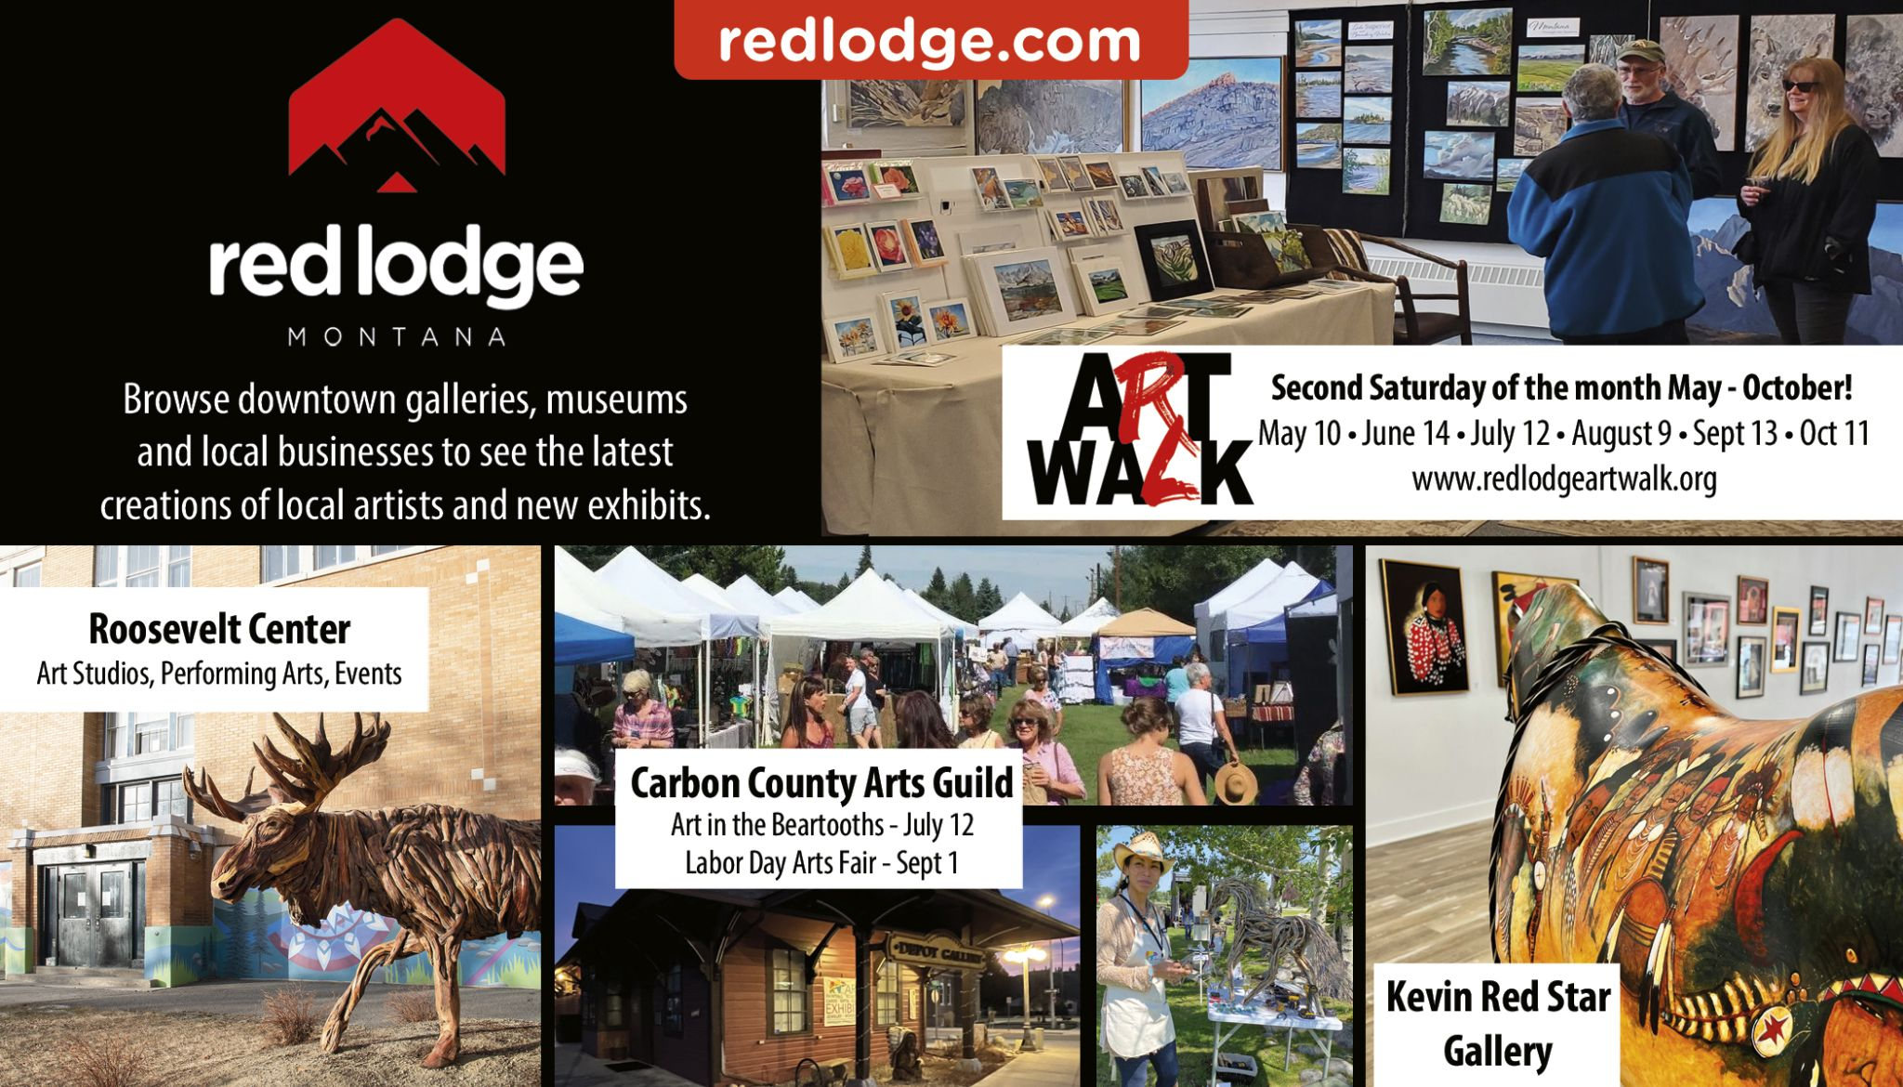
PRINT ADVERTISING

Slide 13
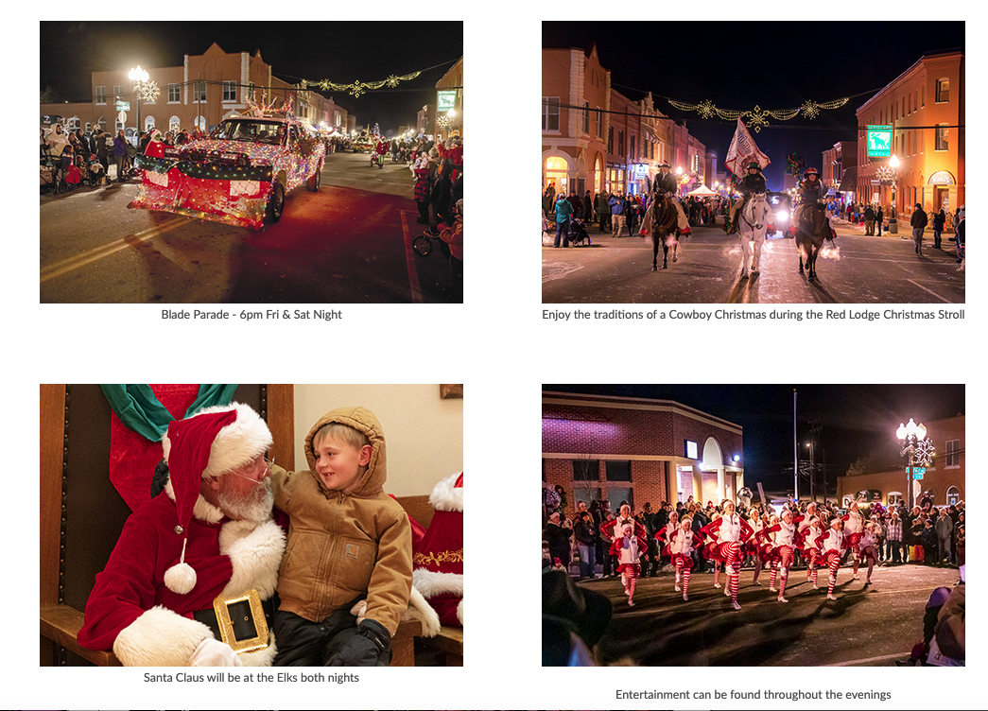
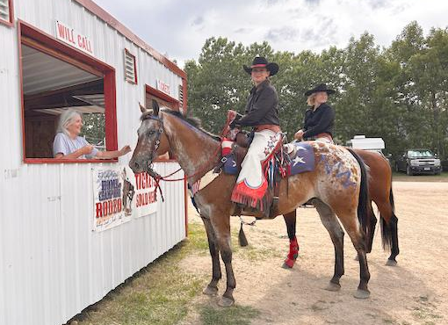
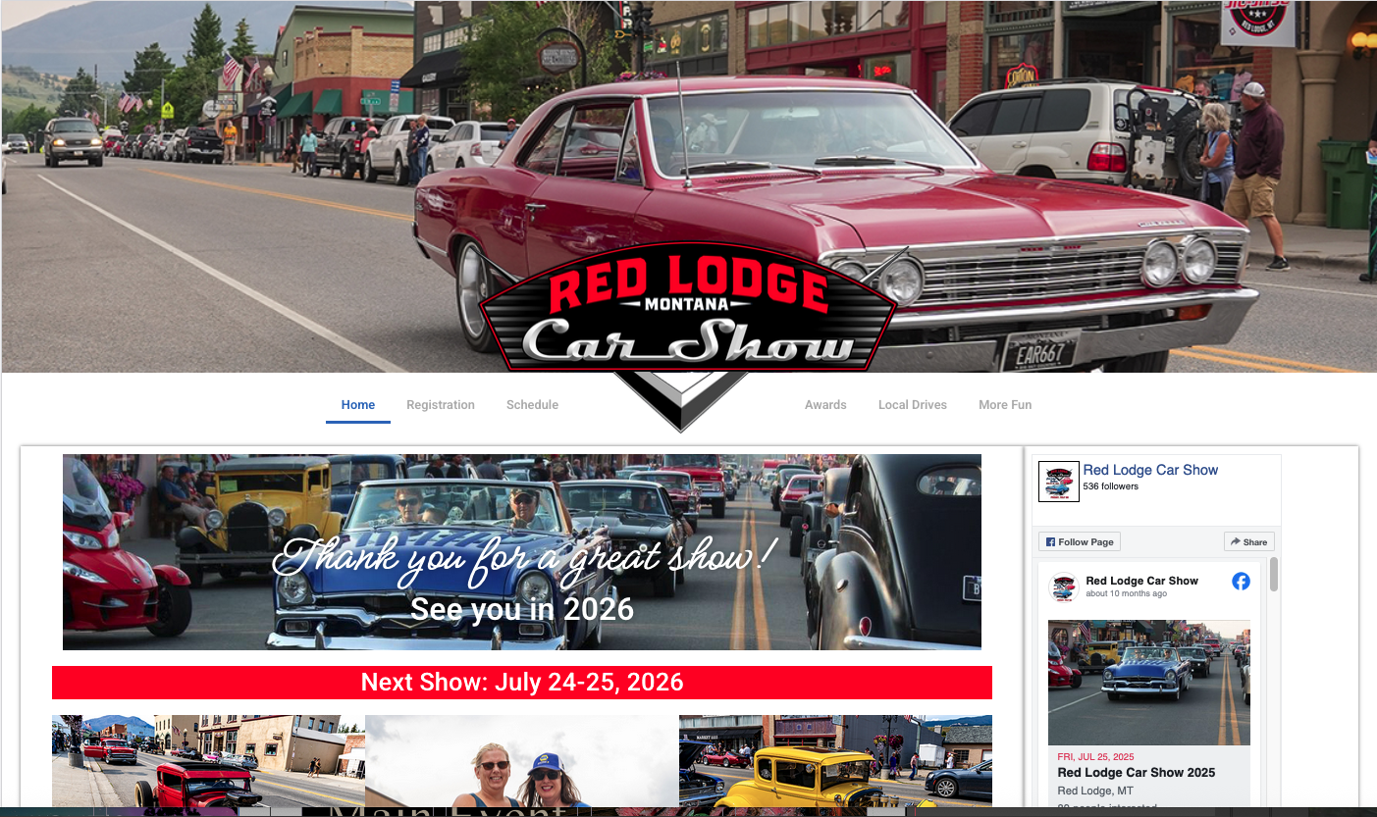
EVENTS
HOME OF CHAMPIONS
RODEO TICKETS
RED LODGE
CAR SHOW
CHRISTMAS STROLL

Slide 14
THANK YOU!

