Slide 1

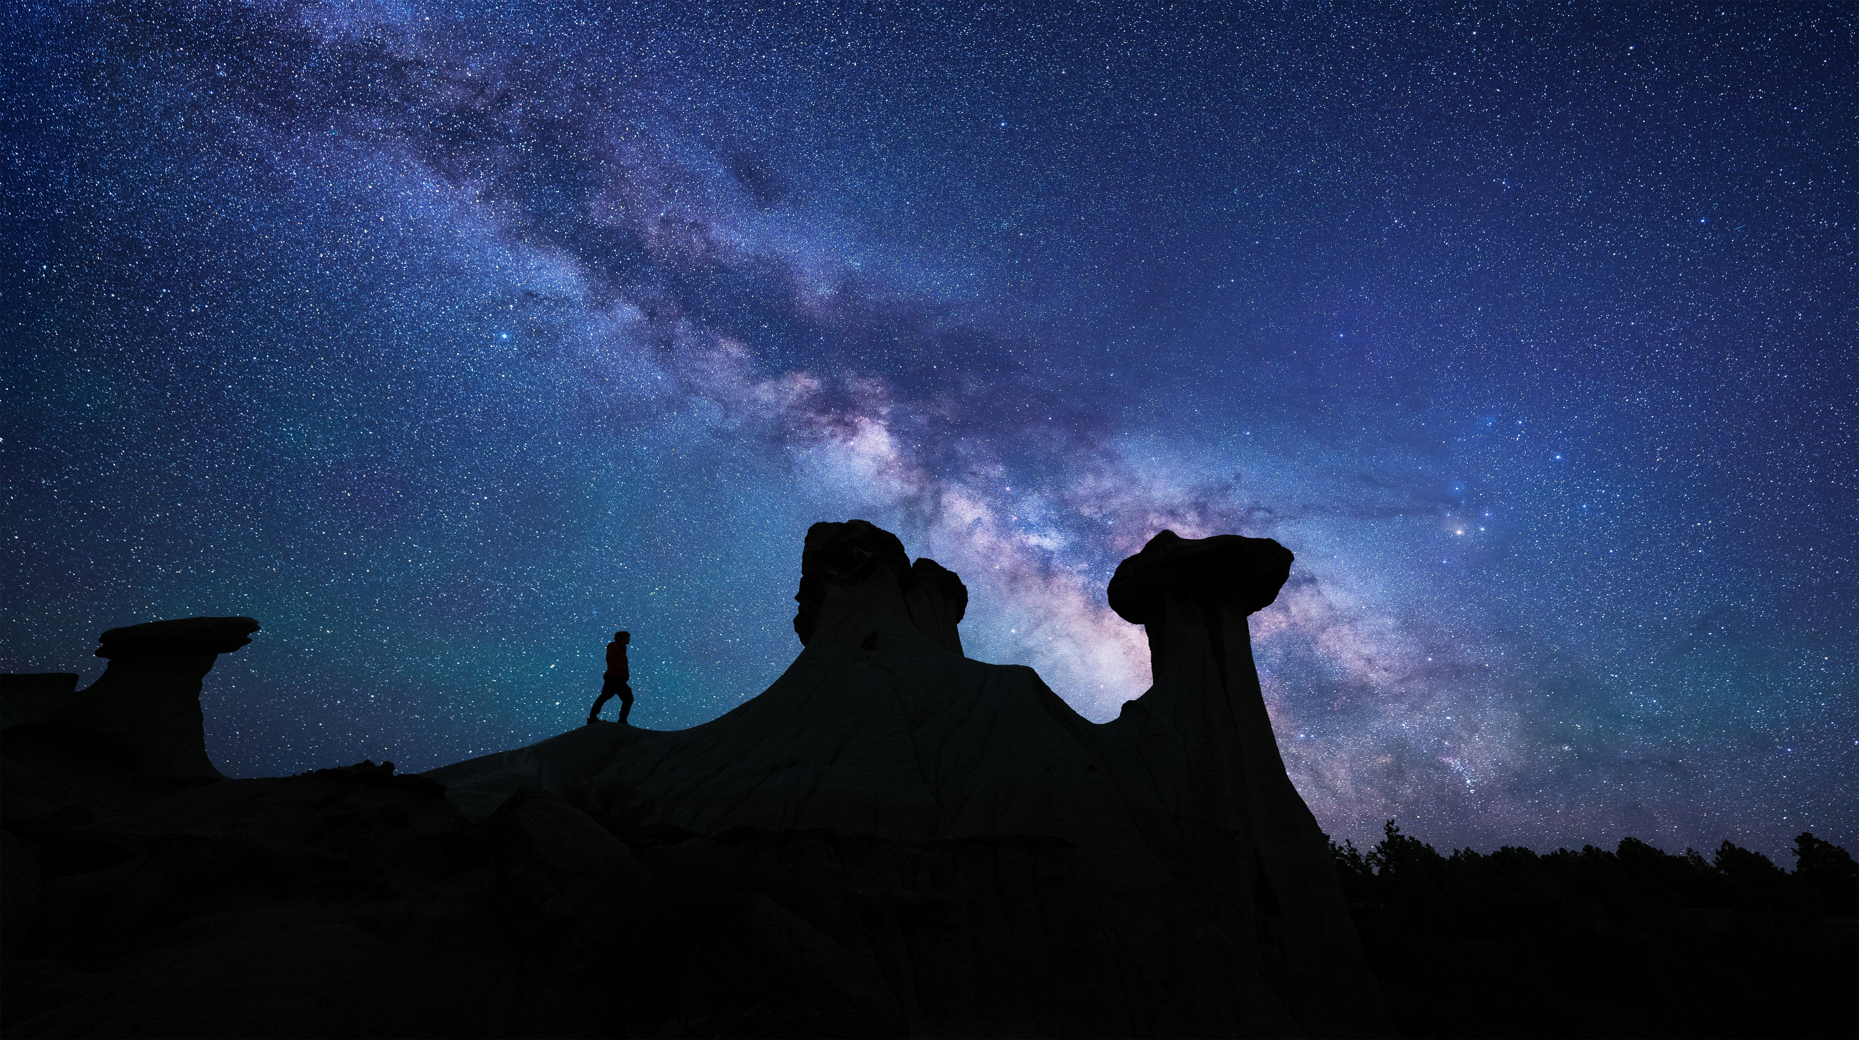
Tourism Advisory Council | June 9-10, 2026 | Helena, MT

Slide 2
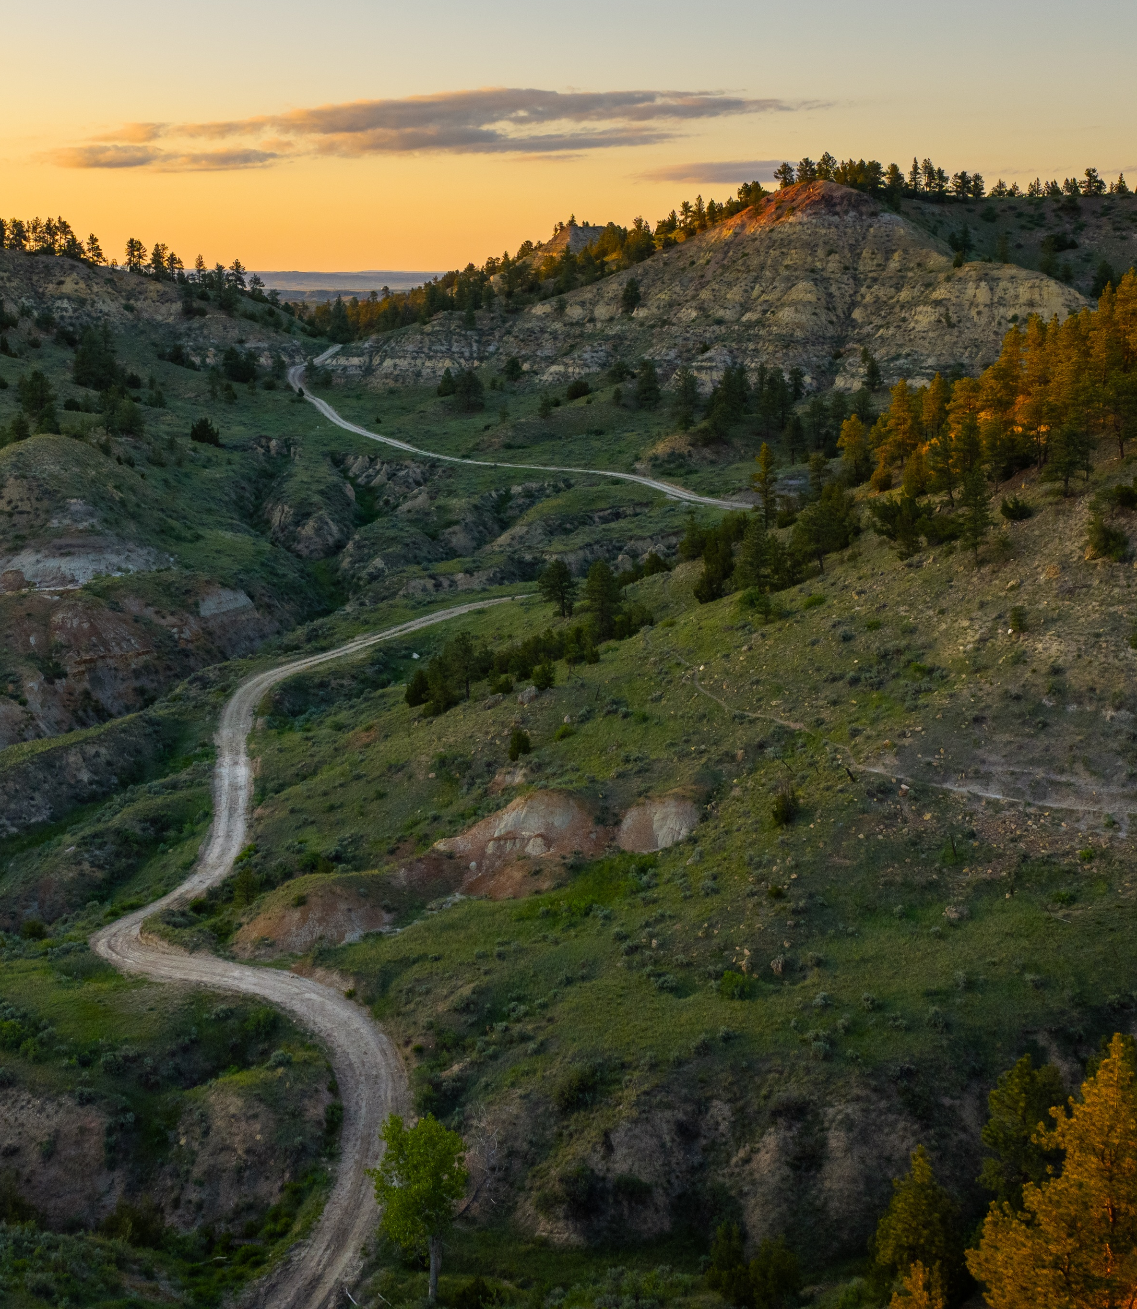
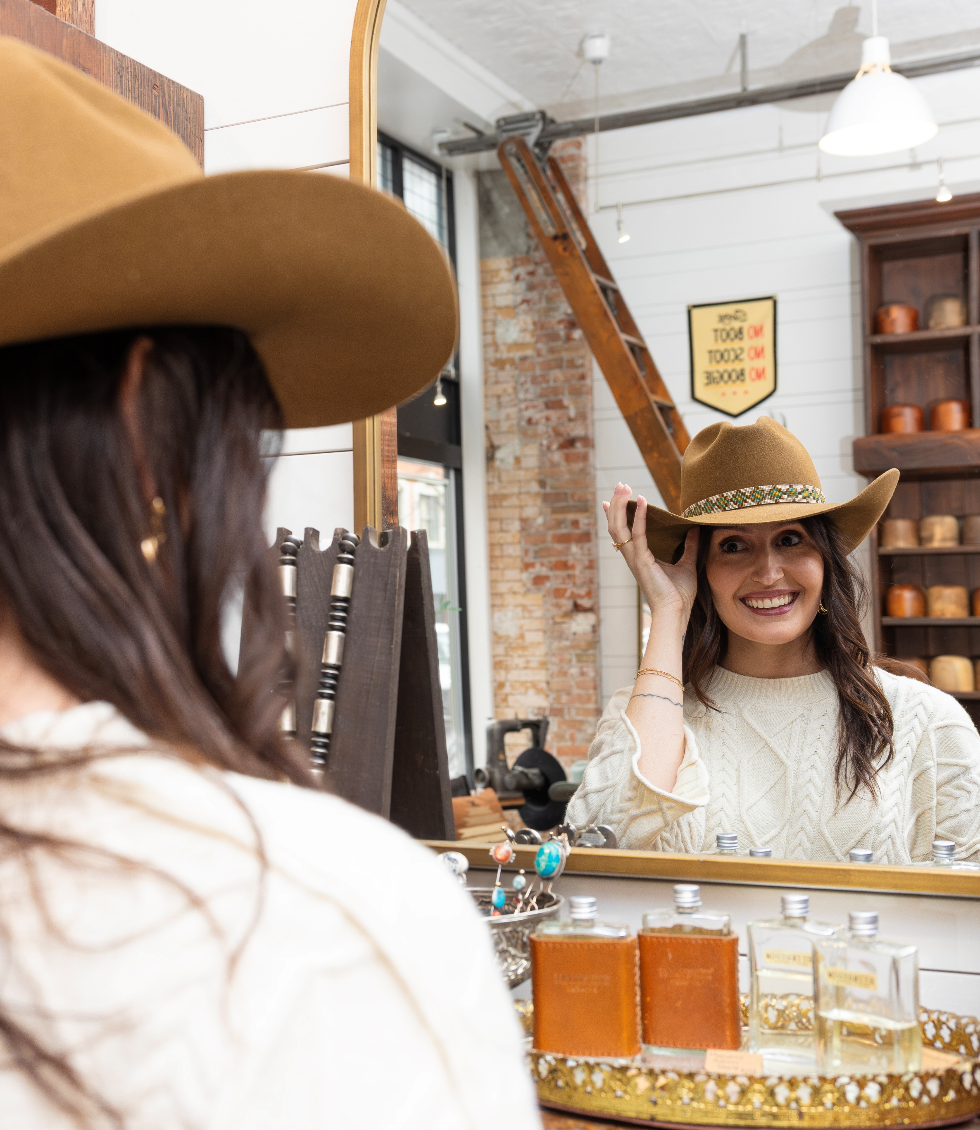

Familiarization is our North Star for FY27
Lead with Landscape. Convert with Experience.
Turn inspiration into understanding—and understanding into visits.
Strawberry Hill Recreation Area/Nate Luebbe
DJames Custom Hats, Billings/Amy Lynn Nelson

Slide 3

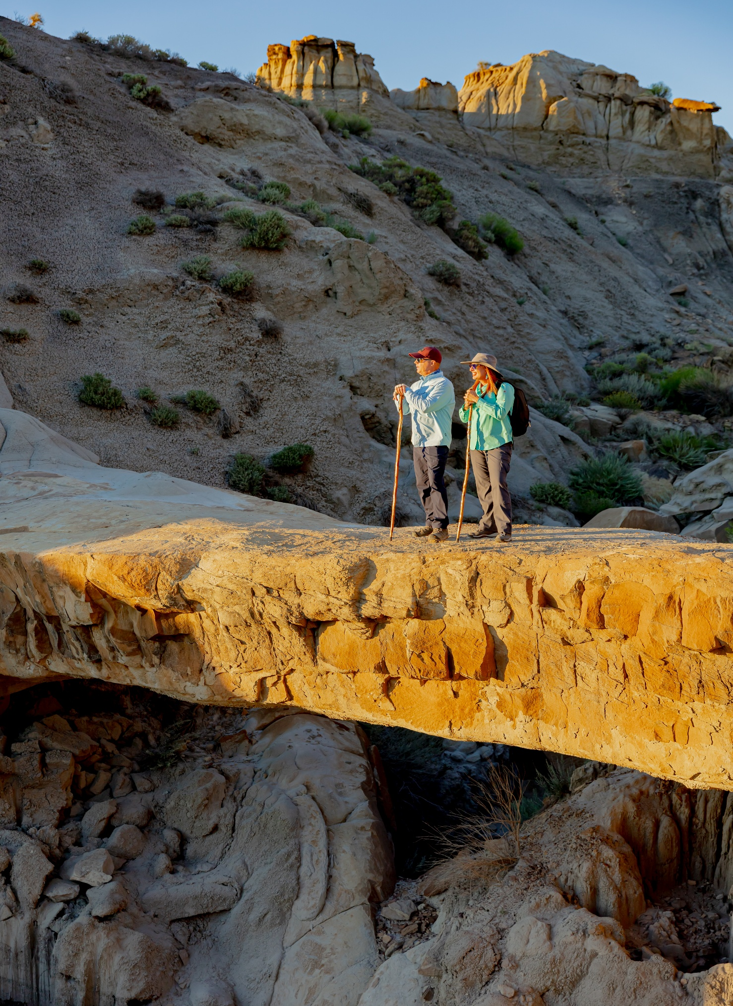

Perceptions in a Nutshell
PERCEPTIONS
Visitors See
Beautiful + Friendly + Historic + Memorable
Non-Visitors See
Montana (generic) + Remote + Maybe Industrial + Unsure
Makoshika State Park/RV There Yet TV
FY26 Southeast Montana visitor survey

Slide 4
WHY OUR GUESTS VISIT
Our visitors come for memorable experiences, to get off the beaten path and enjoy our welcoming communities. They enjoy scenic, peaceful and uncrowded areas, allowing them to make emotional connections.
FY26 Southeast Montana visitor survey
Notes:
See content engaged with on website through GA4 & Zartico platforms – blogs, event listings, attractions, things to do

Slide 5
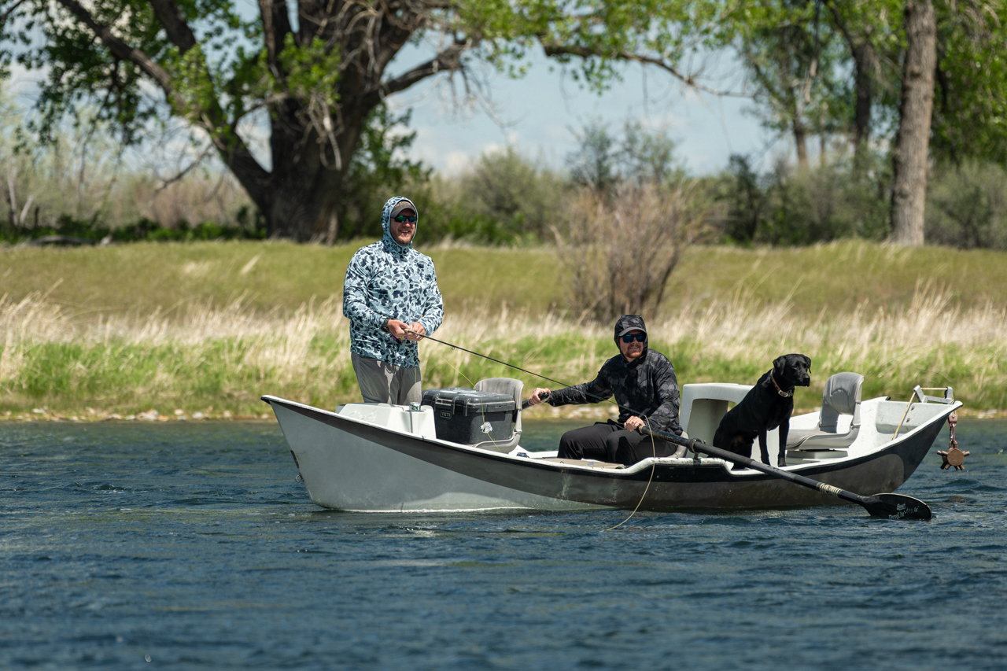
TOP 3 ACTIVITIES
SCENIC DRIVES
80% - drive traffic
Sited high satisfaction with wide open spaces and landscapes.
Sources: ITRR reports
OUTDOOR RECREATION
Combining all aspects listed including camping, hiking, hunting, fishing, state parks, etc.
HISTORY
Historic Sites and Museums ranked highly in surveys.
Most visited site in region – Little Big Horn Battlefield
Bighorn River/Drew Baker

Slide 6
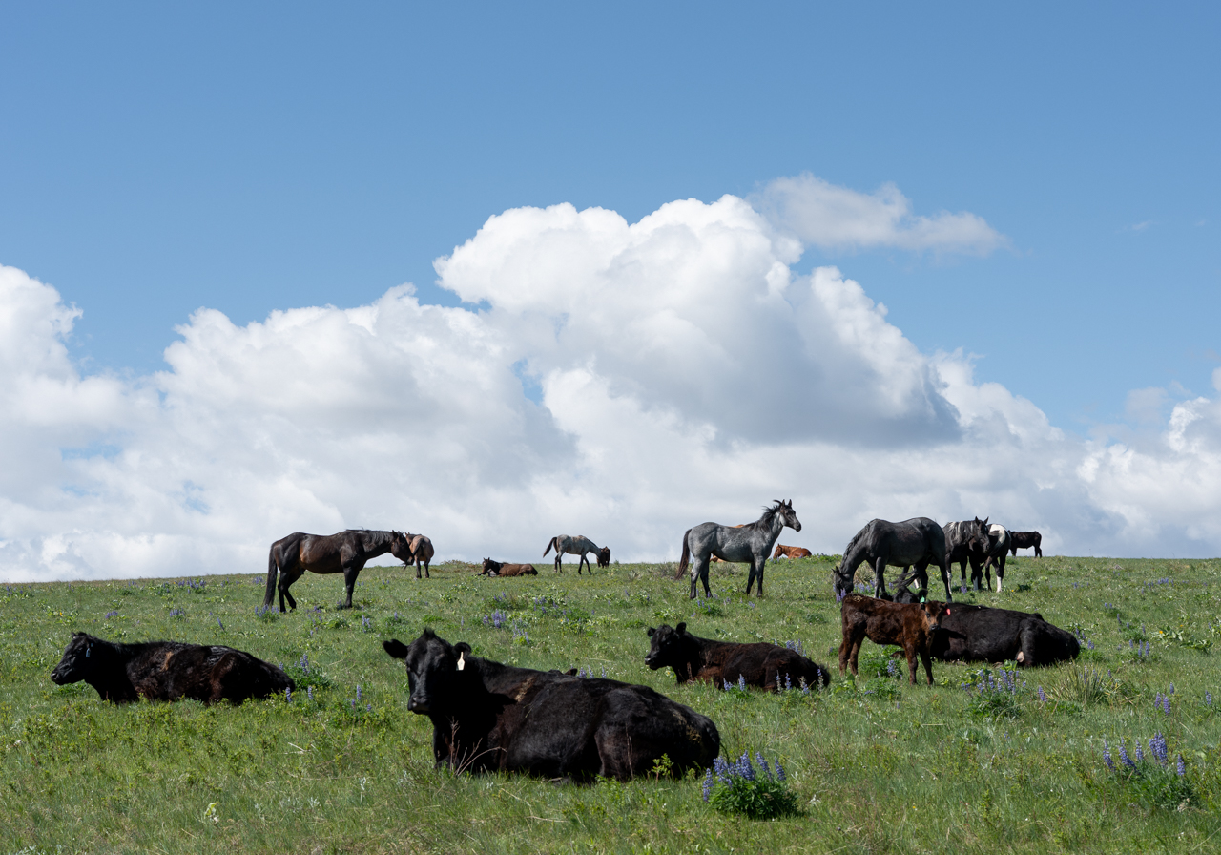
97%
83%
WOULD VISIT AGAIN
WOULD RECOMMEND
FY26 Southeast Montana visitor survey
Bighorn River/Drew Baker

Slide 7
AUDIENCE & MEDIA STRATEGY
TARGETING
CTA
Target: Relevant Geos + Behavioral/Interest
Retarget: Leads List from past 3 years (first-party data)
Explore / Learn More
AWARENESS
Retarget: Website + DD site visitors, prior social engagers, people who like and follow social, lookalikes
Plan Your Trip
CONSIDERATION
CONVERSION
Retarget: Website + DD site visitors, mid-funnel ad engagers
Exclude: Weekly leads list
Download a Free Travel Guide
Notes:
Full funnel, always-on, year-round – marketing a season ahead
Markets will be W. MT and non-resident in quality visit markets with potential for growth: Seattle, N. Wyoming, Dakotas, MN, Chicago (limited and targeted)

Slide 8
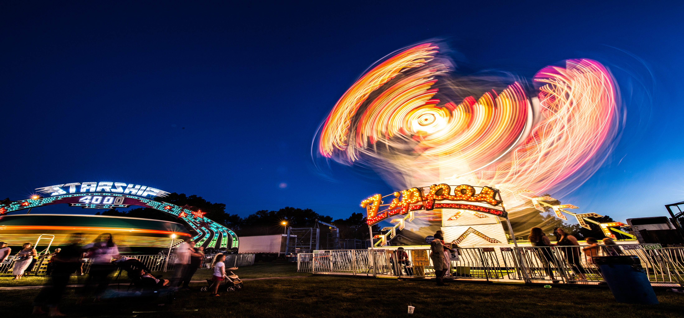
Rosebud County/Nathan Satran Photography
STRATEGIC PRIORITIES
Visit Southeast Montana

Slide 9
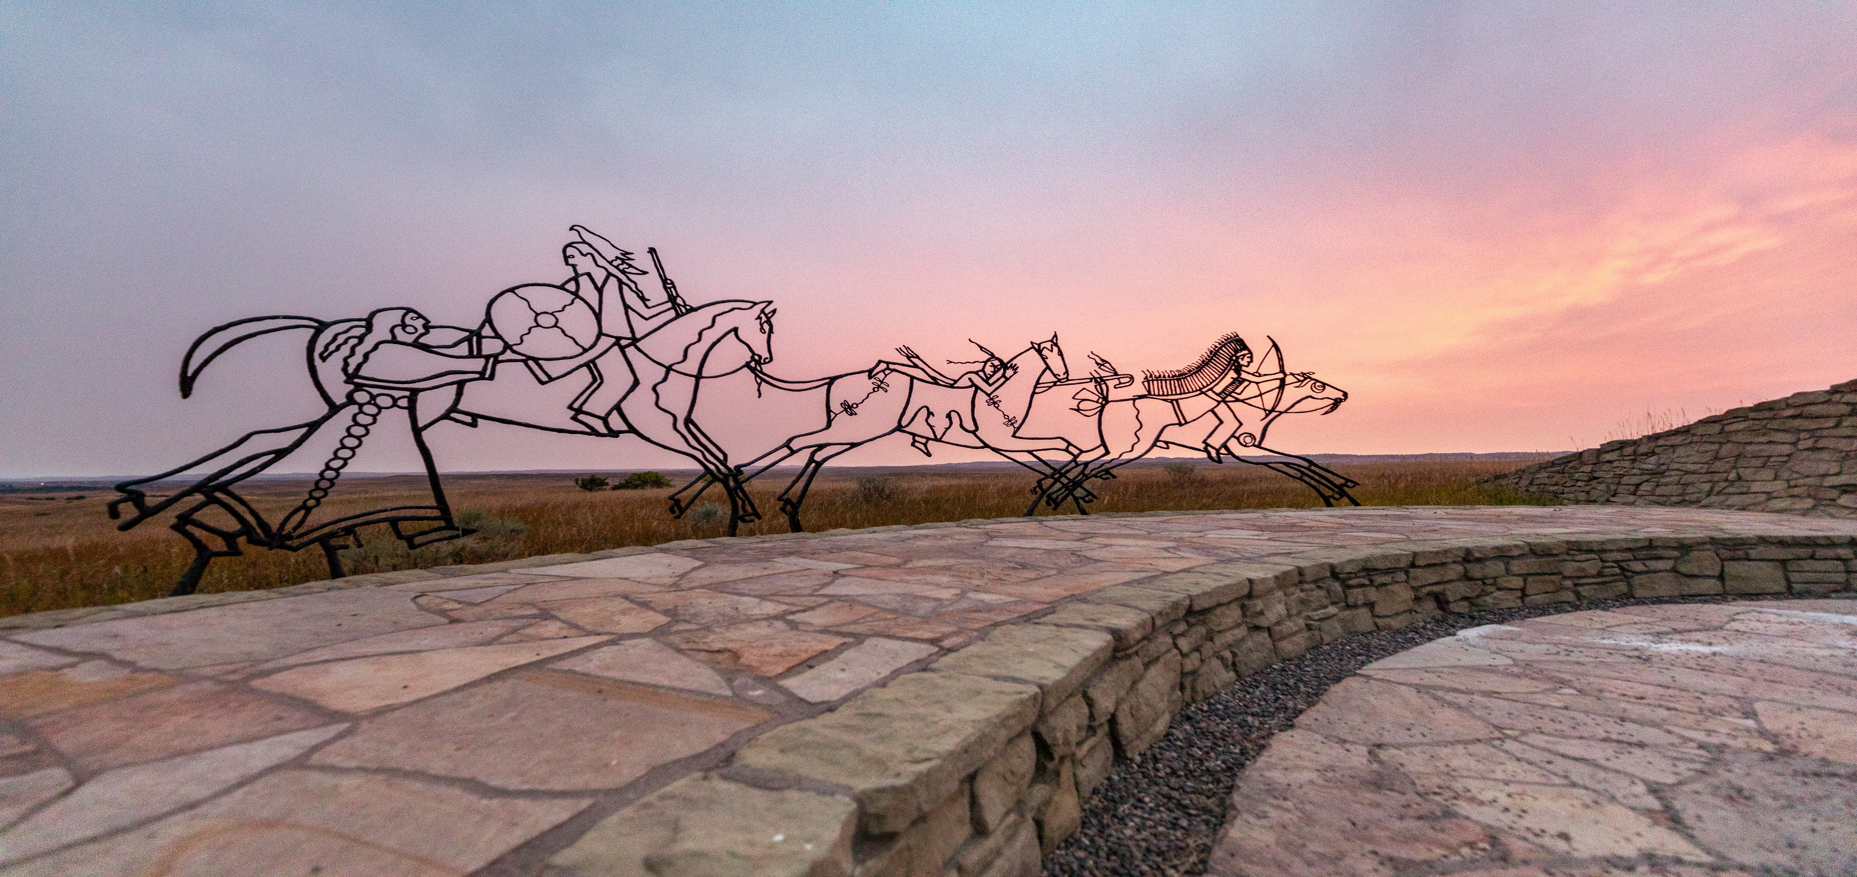
Little Big Horn Battlefield/Andy Austin
PILLARS
  Outdoor Recreation
  Historical Significance
  Western Authenticity
  Dinosaur Adventures
  Crow & Northern Cheyenne Culture

Slide 10
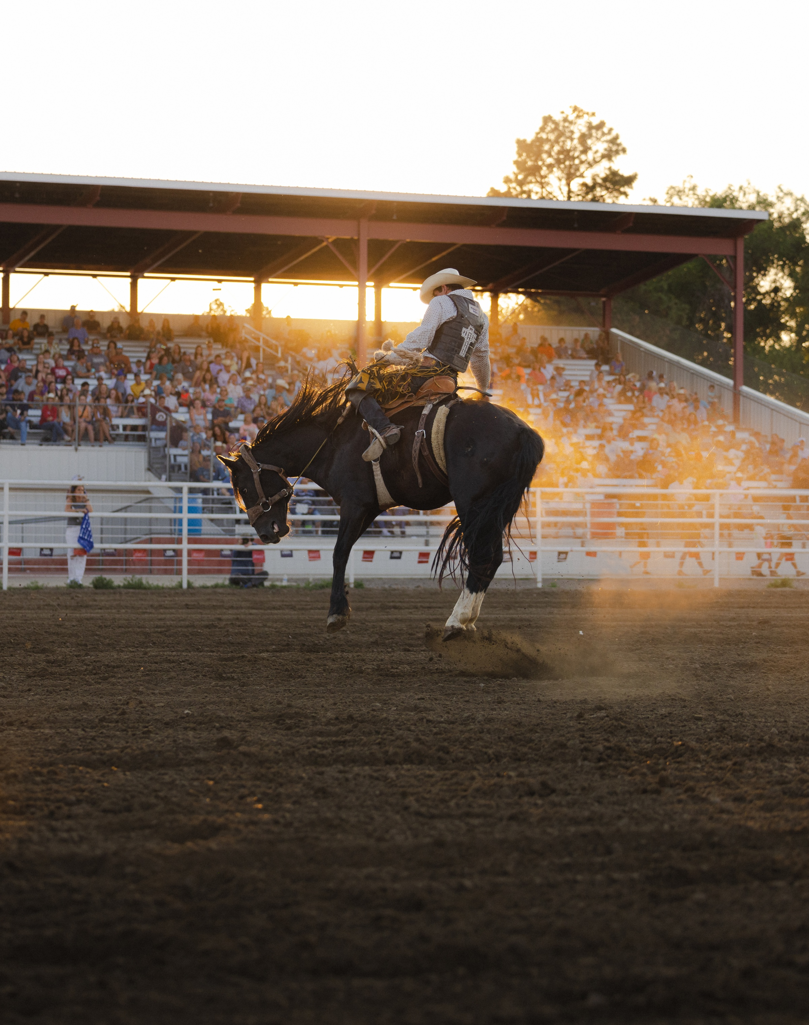
INCREASE CONVERSION
(key indicator of visits and spending)
Drive conversion across the full funnel — turning awareness into visits and visitor spend.
Always on campaigns
Experience-driven storytelling
Itineraries
Influencer partnerships
Dawson County Fair & Rodeo/Ashton Jones
Visit Southeast Montana

Slide 11
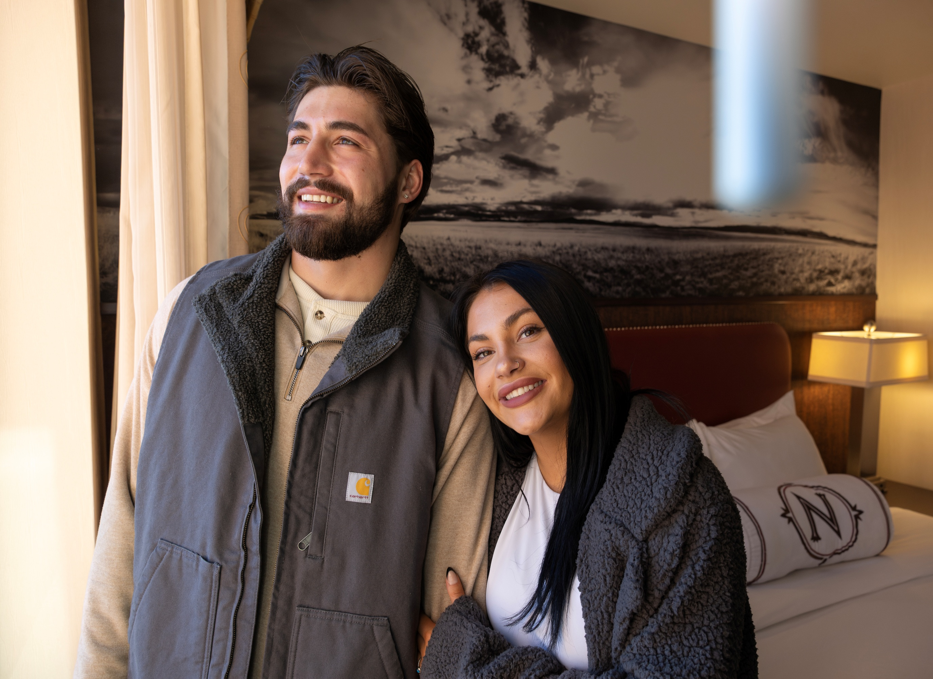
EXPAND MARKETING REACH & CONTENT
Broaden Southeast Montana's reach through partnerships, regional storytelling, and emerging-audience marketing.
Cross-state collaborations/partnerships
Authentic local narratives
Destination Development
Niche retargeting
Visit Southeast Montana
Northern Hotel,Billings/Amy Lynn Nelson

Slide 12
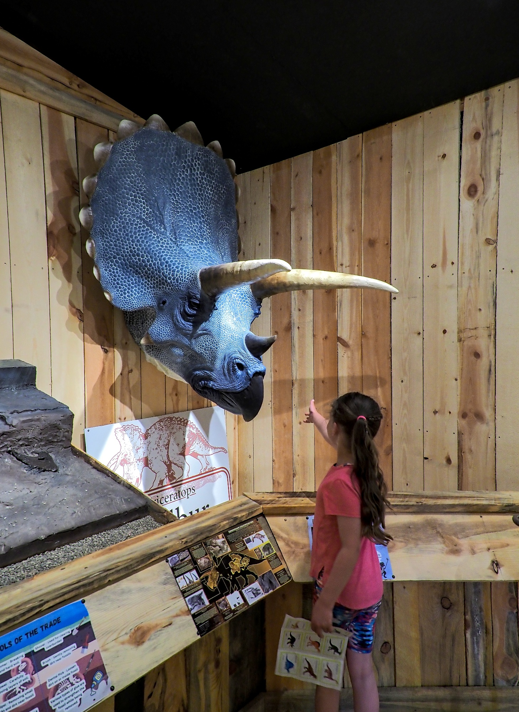
REGIONAL AMBASSADOR PROGRAM
Equip regional ambassadors with the training, content, and tools to share Southeast Montana with every visitor.
Recruitment
Resources
Online Education/Certification
Musselshell Valley Historical Museum/Cody Hildreth
Visit Southeast Montana

Slide 13
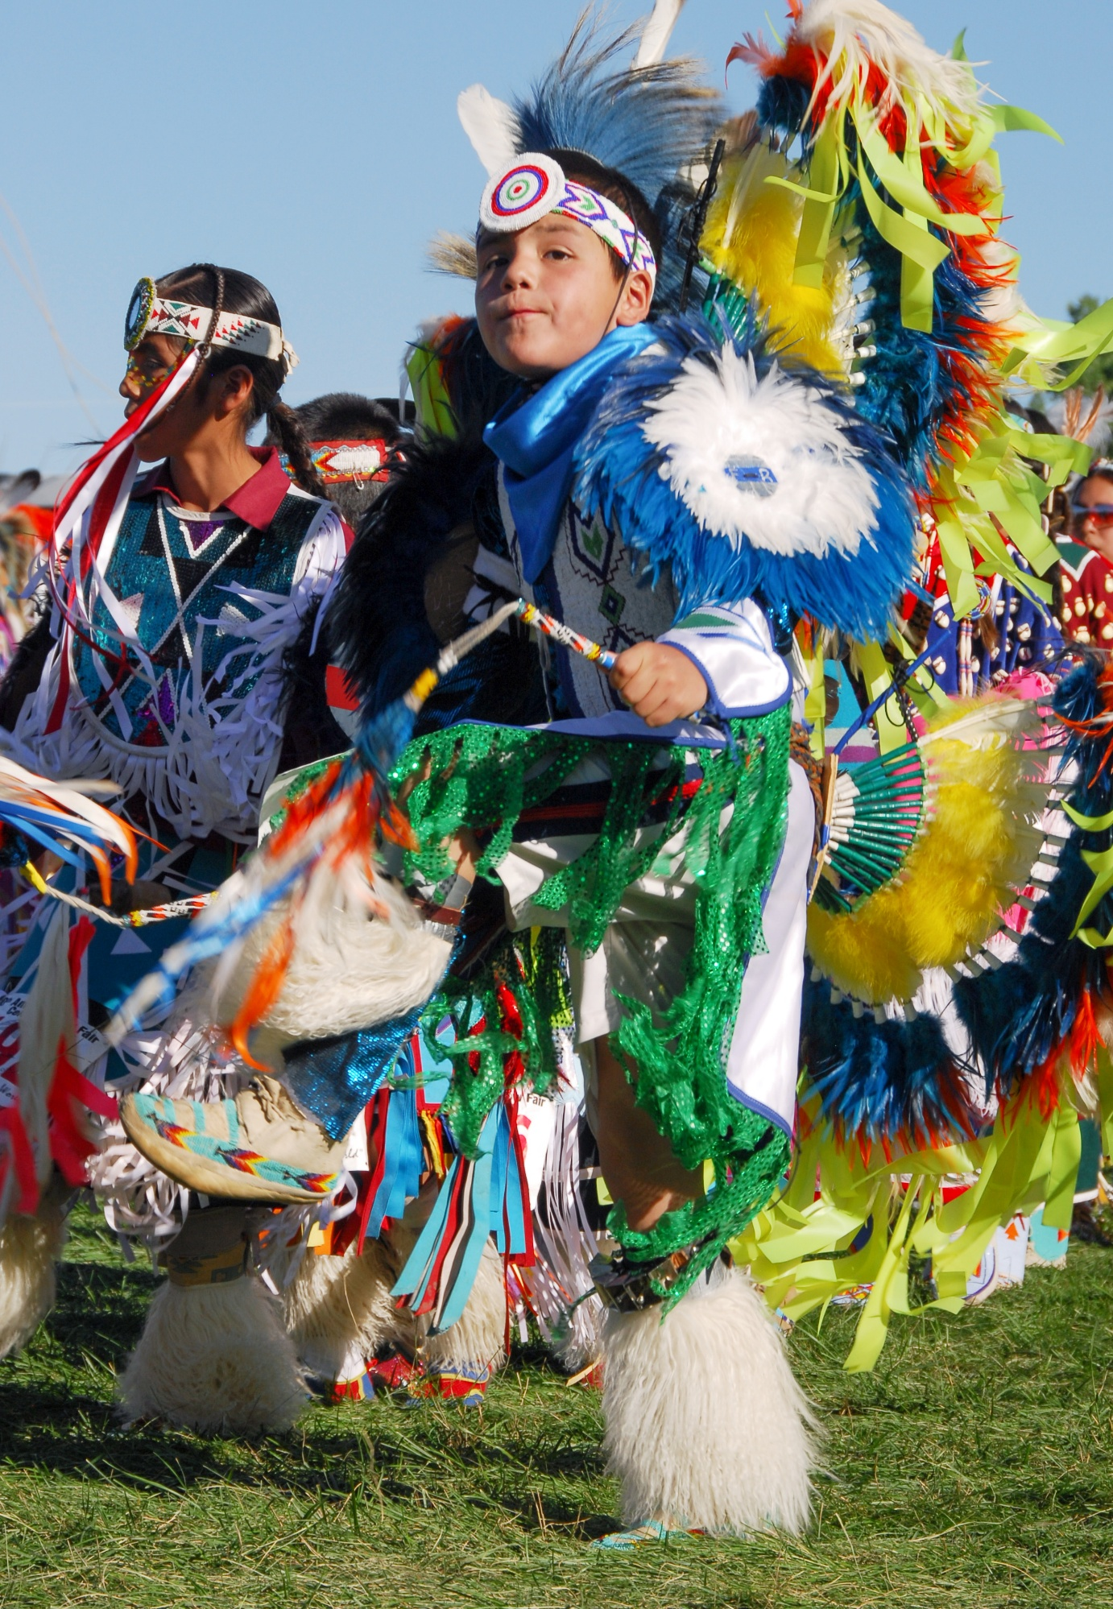
SUPPORTING PARTNERS IN GROWING TOURISM ECONOMY
Strengthen local businesses and partner organizations by sharing data, building capacity, and growing tourism region-wide.
Collaborations
Educating with data and research
Raising awareness of Visit SEMT & resources
Supporting capacity building
Visit Southeast Montana
Crow Fair/Brand MT

Slide 14
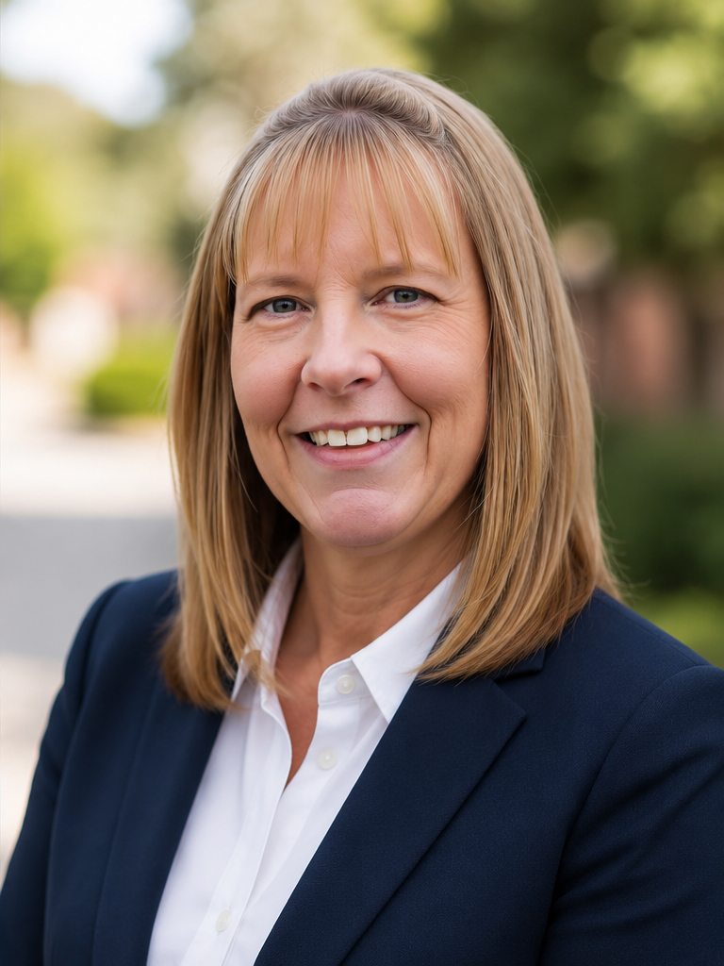


WENDY SWENSON
JESSICA
GRUBA
Executive Director
Content & Ambassador Program Manager

Slide 15
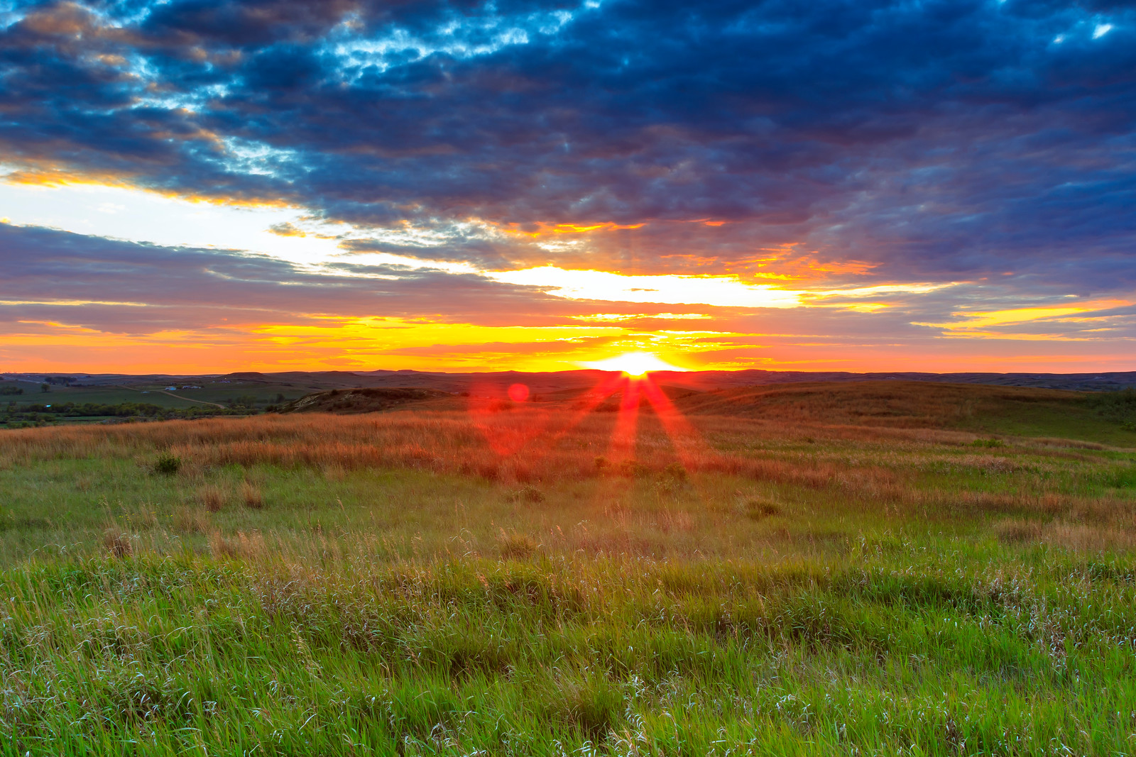
Wibaux County/Kelly Wicks
wendy@southeastmontana.com
(406)-570-2417
THANK YOU
815 S. 27th St. | Billings, MT 59101
southeastmontana.com

