Slide 1
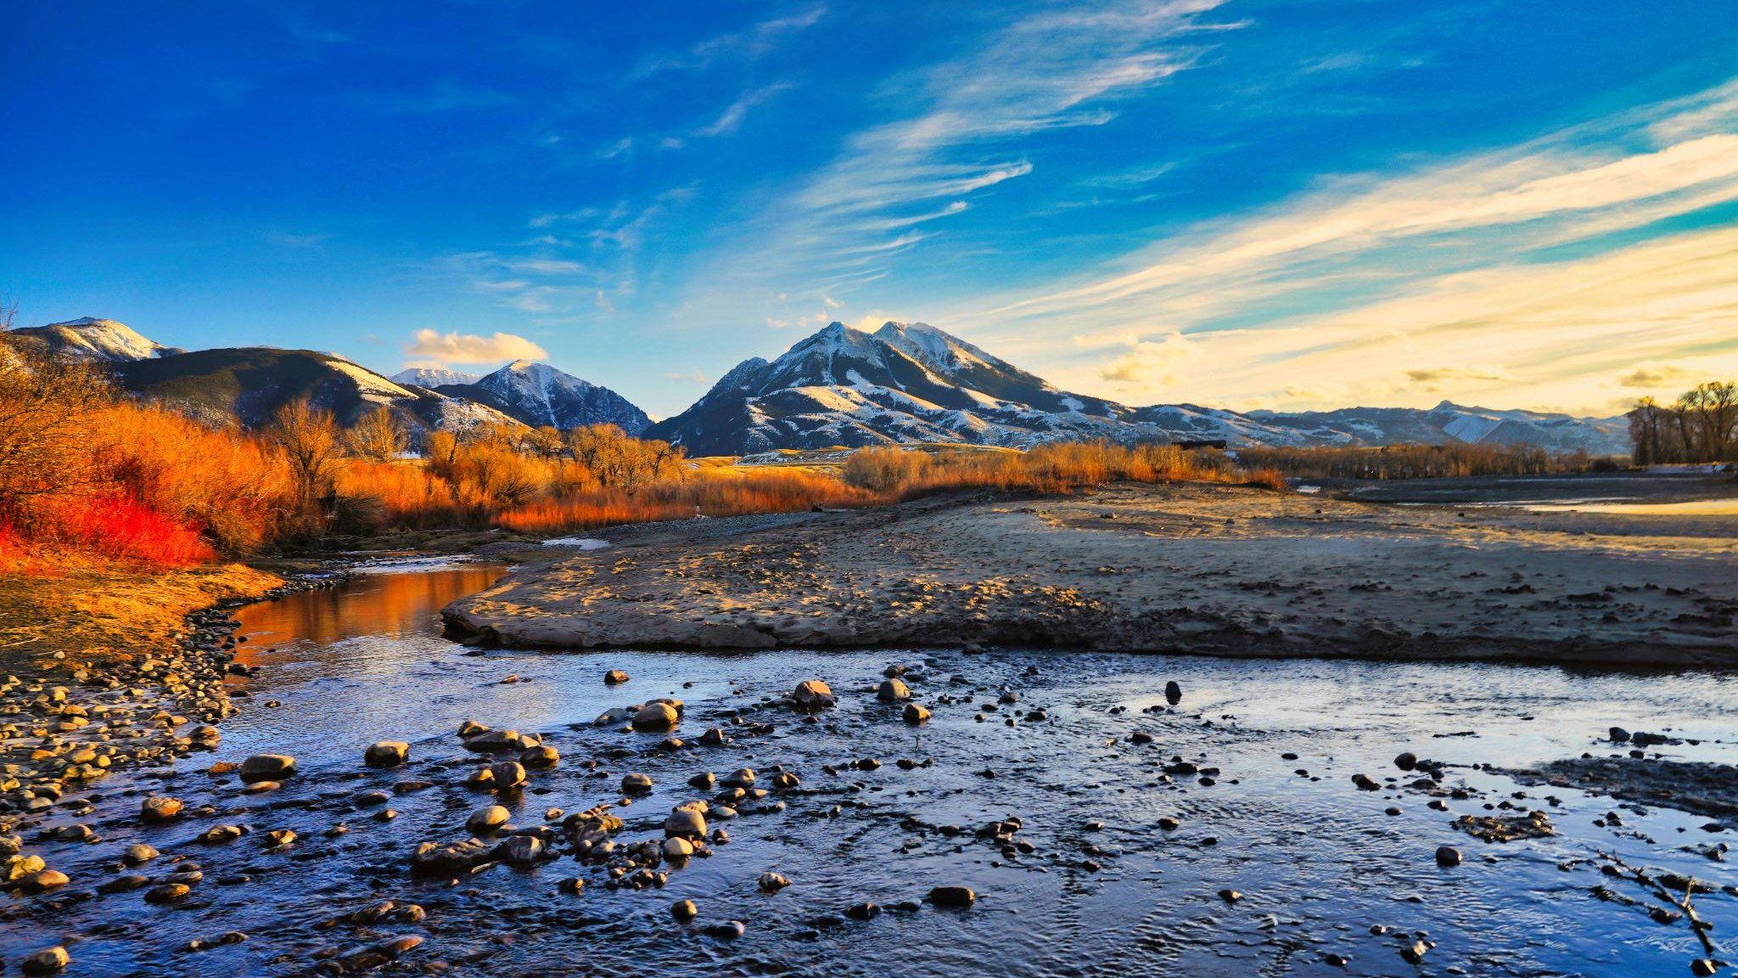

FY27 MARKETING PLAN
June 9, 2026
Presented by Kali Gillette, Assistant Director

Slide 2

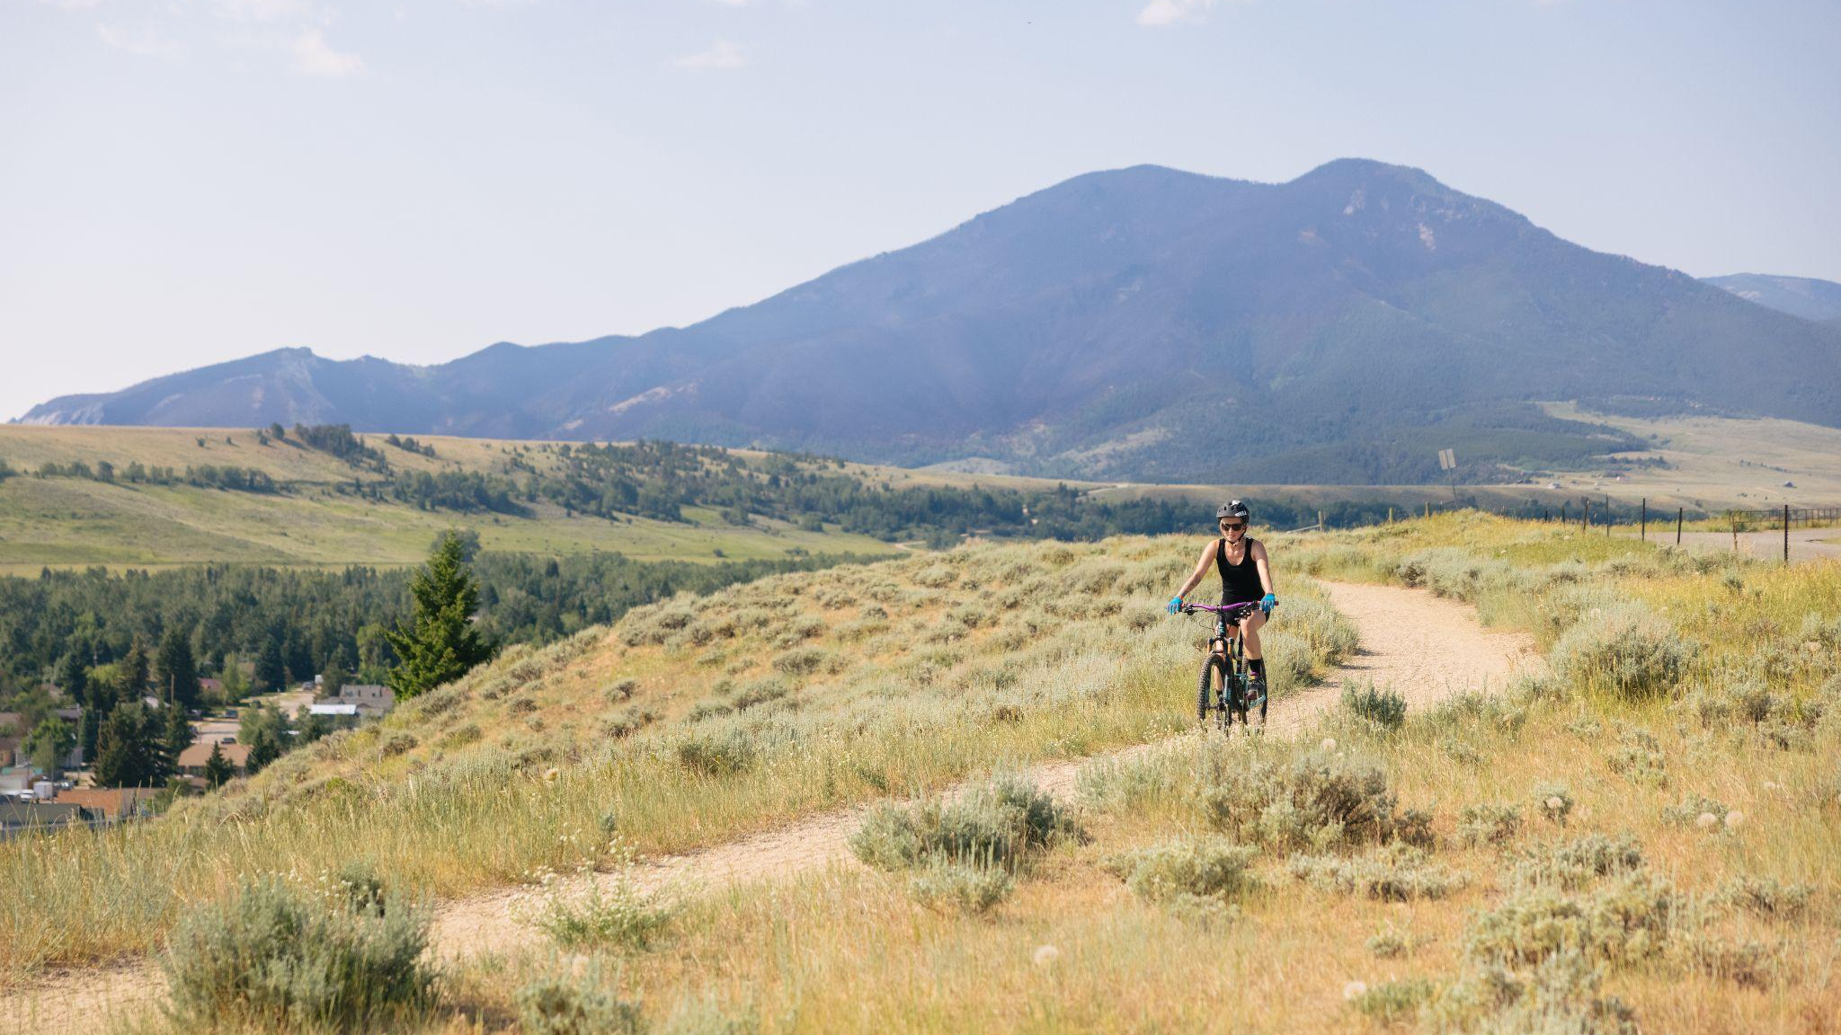

FY27 PRIORITIES

Slide 3

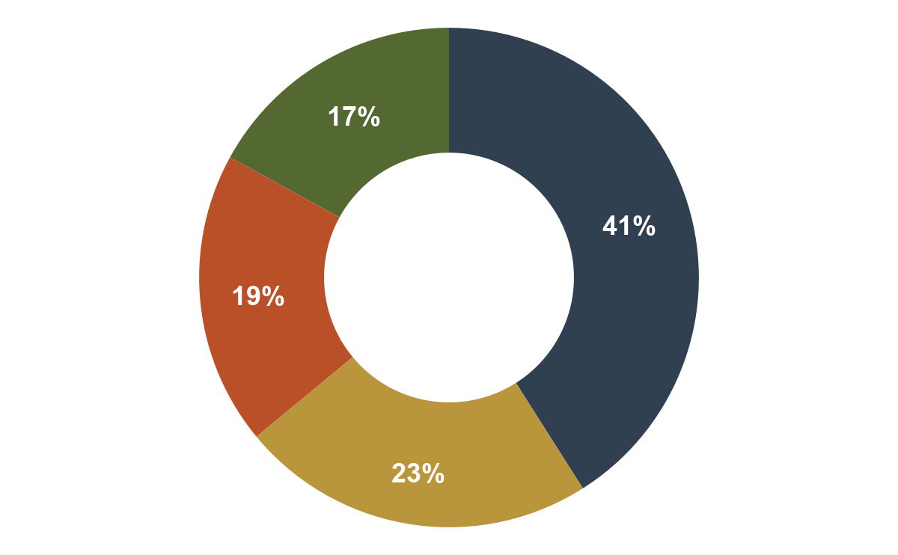
Top Priorities
Board-Determined Budget Allocations
Destination
Development
Increase visitation:
During shoulder and winter seasons
To rural communities
To areas with greater lodging capacity
Continue to advance initiatives from our 2023 Tourism Resiliency Plan
Destination
Marketing
Destination
Stewardship
Destination
Management
Notes:
While YC is still primarily focused on marketing our region, we are also developing priorities and strategies specific to destination management, stewardship and development.

Slide 4
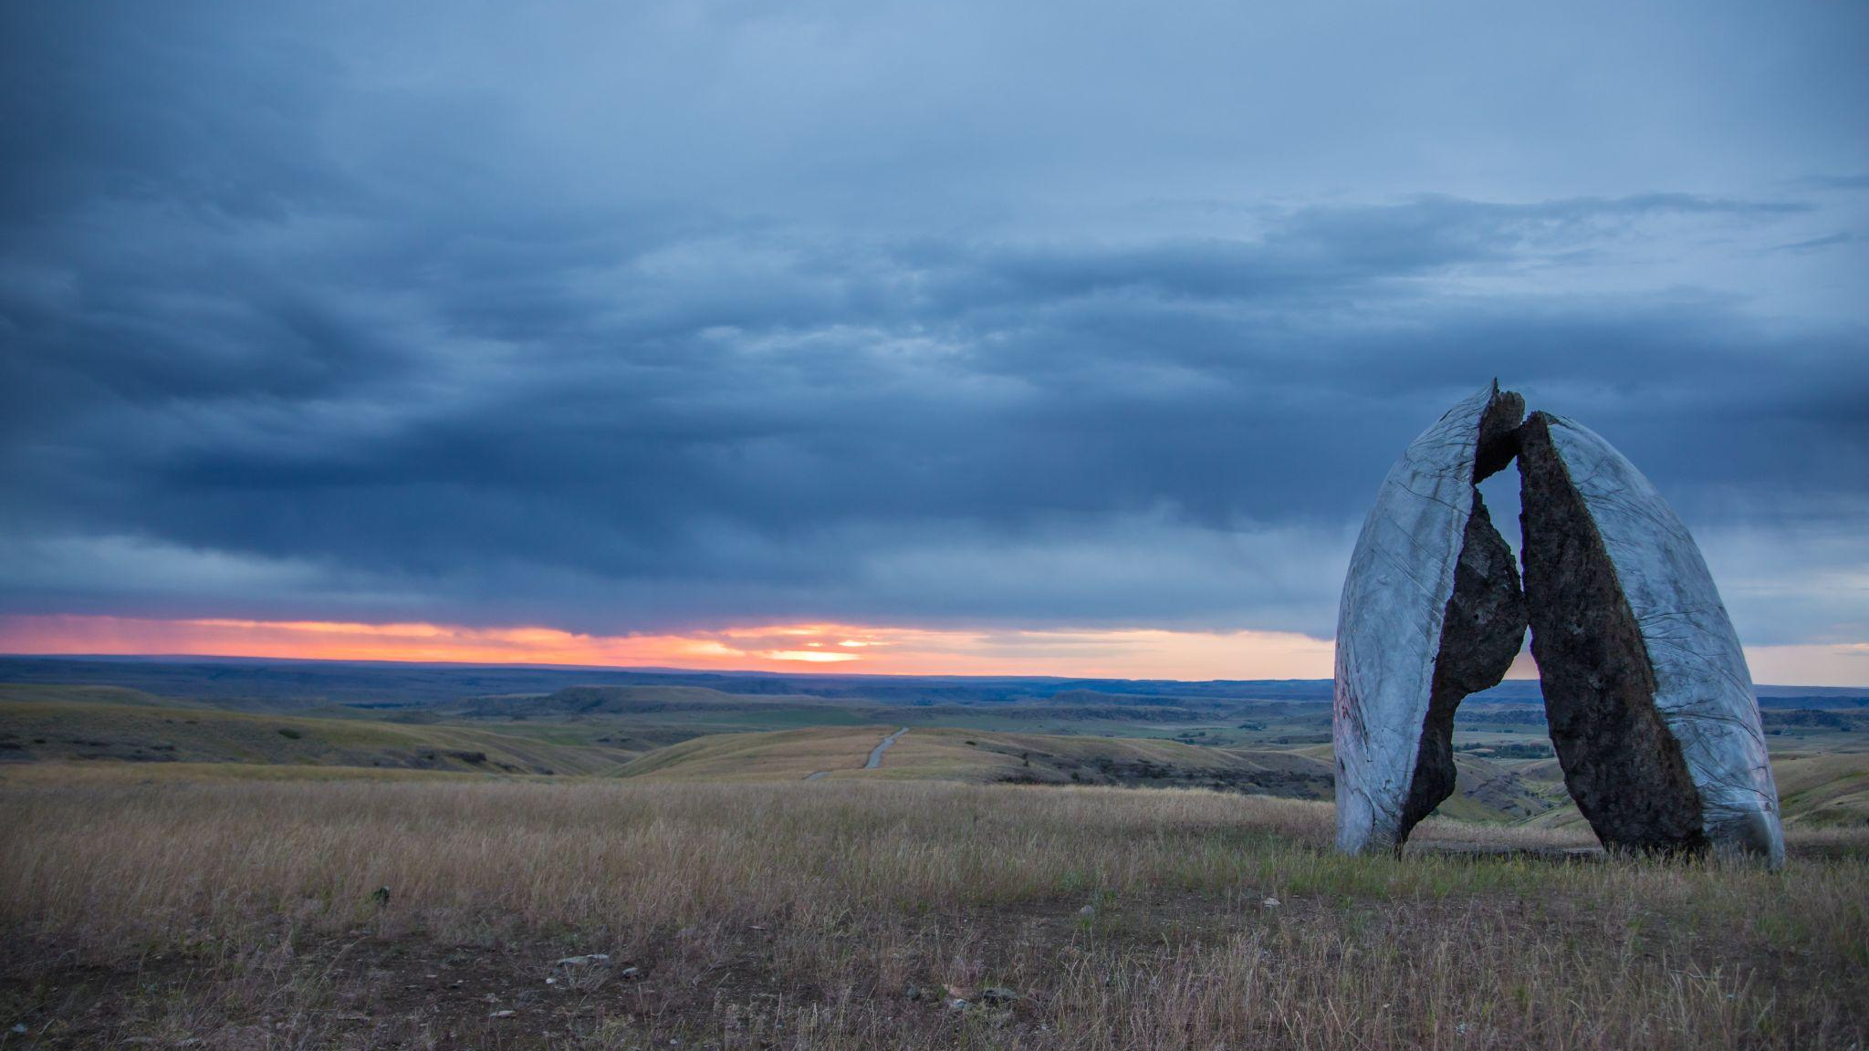
REGIONAL CONSIDERATIONS

Slide 5
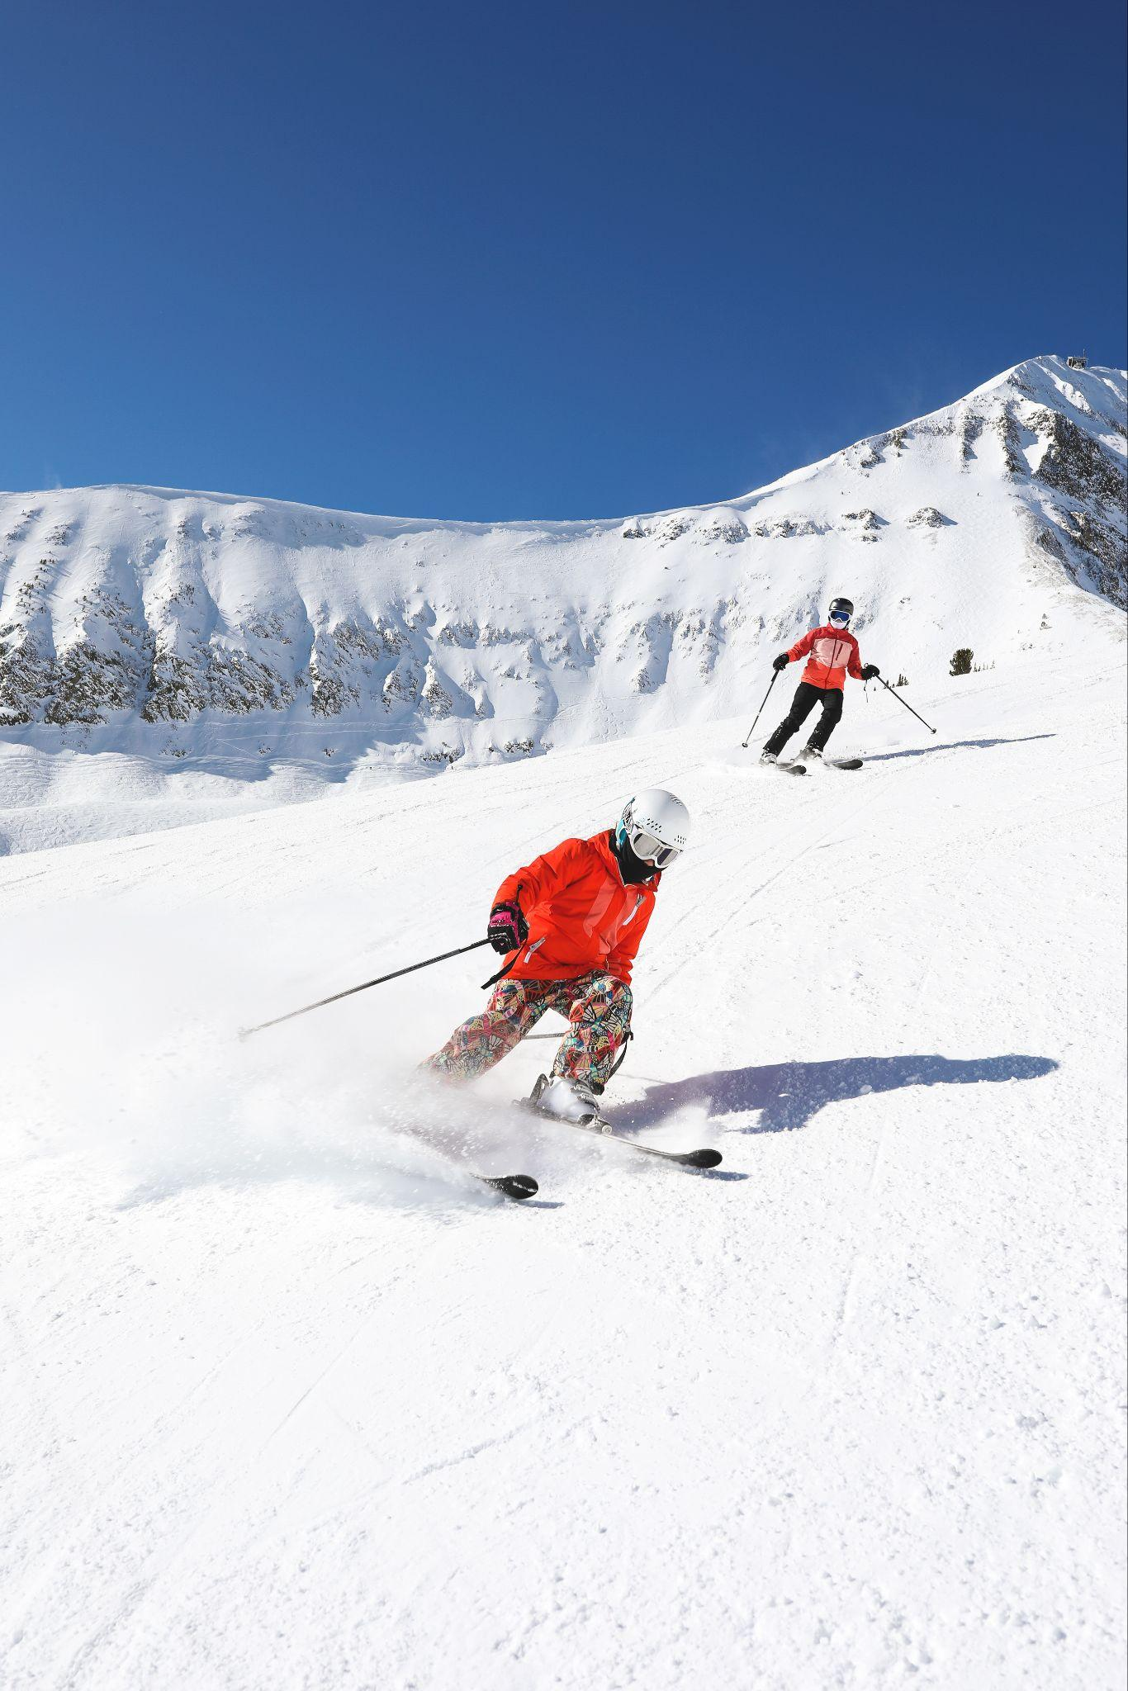

Yellowstone Country
at a Glance
Between Bozeman Yellowstone International Airport and Yellowstone National Park, the east and west sides of the region create a natural tourism ecosystem. However, each area has unique needs:
Four of the five counties in Yellowstone Country are mainly rural with most of the visitation occurring during peak summer months.
Bozeman and Belgrade also see peak visitation during summer but have significantly more hotel inventory, with more coming online.
Luxury hotels in Big Sky cater to a different demographic than most of the region, and while currently their peak season is winter, there is opportunity to increase both winter and summer visitation.
West Yellowstone is seeing high ADR, causing travelers to stay in other towns. Two more hotels are coming.

Slide 6
Bozeman and Belgrade Hotel Inventory
Year | Rooms | Rooms Under Construction | Buildings Under Construction
2016 | 2,528 | 0 | 0
2026 | 4,069 | 842 | 7
60% increase in number of rooms in Bozeman and Belgrade since 2016.
Number of rooms is expected to double in the next five years.
Big Sky and West Yellowstone are also seeing an increase.
Notes:
If you look at the hotel metrics in Bozeman and Belgrade, the overall picture looks positive, however, the numbers don’t tell the entire story because several downtown hotels have high occupancy and ADR, which offsets some of the newer and smaller hotels. The increased competition for rooms has affected these properties.

Slide 7
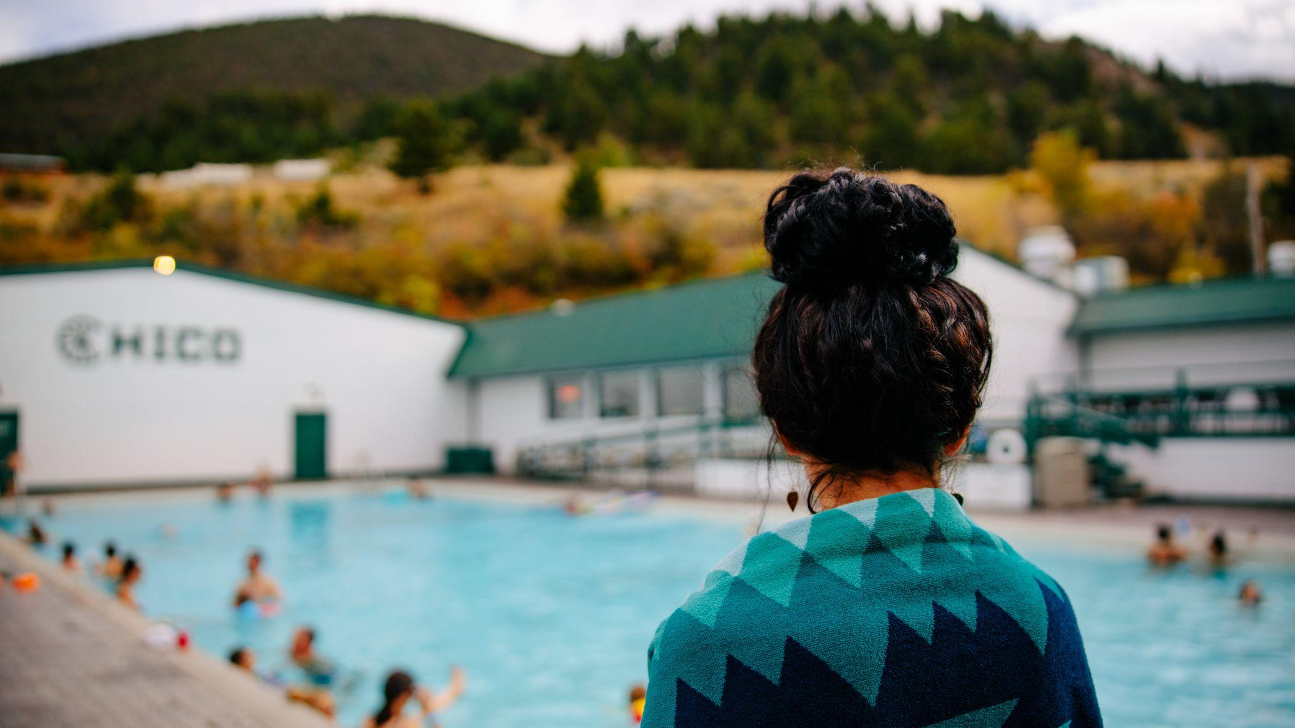
PRIORITY #1

Slide 8
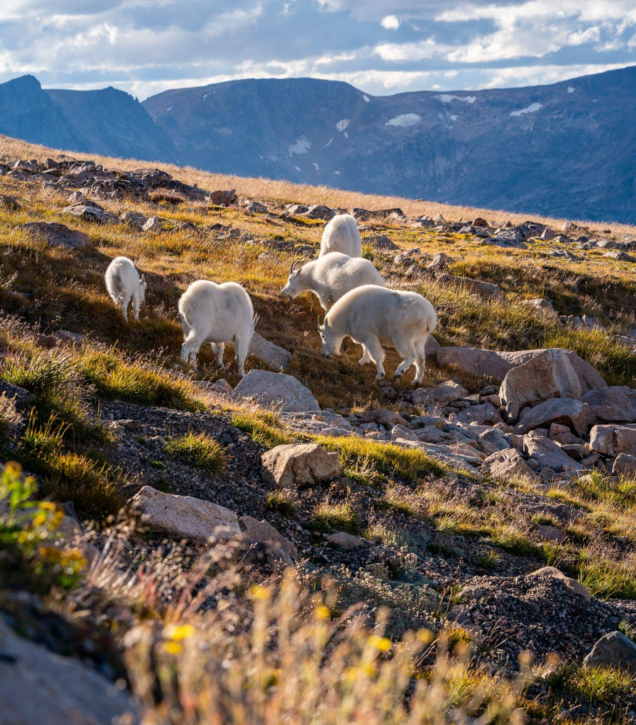

Increase Visitation
PRIORITY #1
Increase year-round visitation, specifically during winter and shoulder seasons, to rural communities, and to areas with greater lodging capacity.
Strategies include:
Develop a single unifying campaign that can speak to varying demographics, interests and geographic areas.
Increase awareness and visitation through paid, earned and social media, newsletter promotion and in-market activations across different interests and motivations.
Promote our new Arts and Culture audio trail product
Promote small-group travel including weddings, corporate retreats and “bleisure” travel to help fill year-round hotel inventory.
8
Notes:
Explain art and culture project.
While we do not yet have the capacity for large meetings and conventions, our region, is a prime locations for “bleisure” travel, the combination of business and leisure travel.

Slide 9
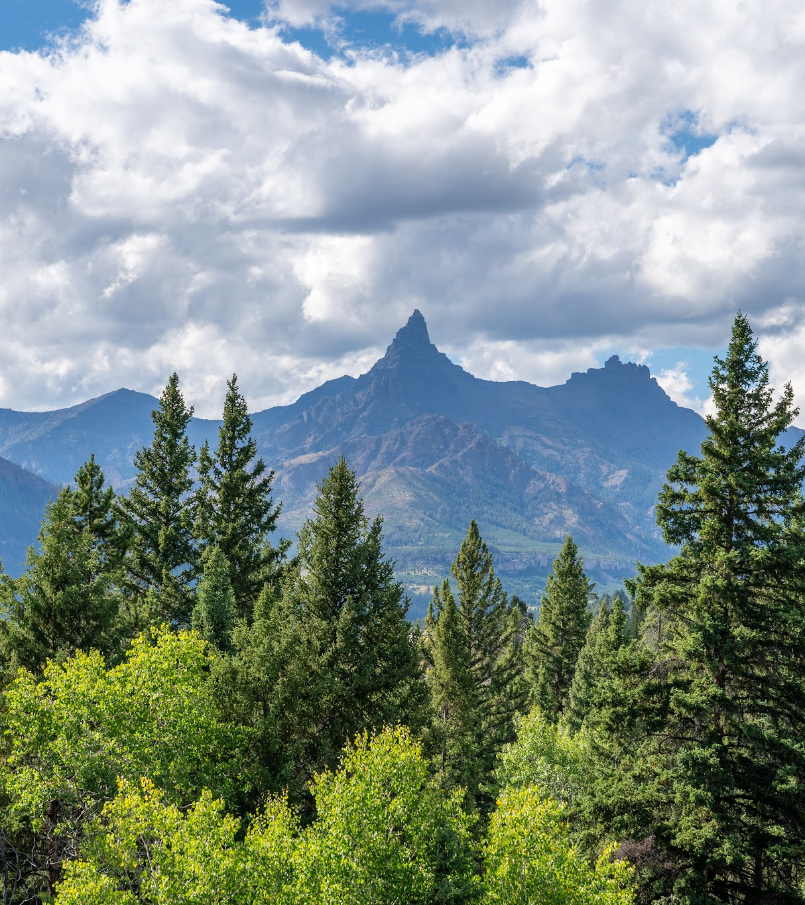
SUB SLIDE
Consumer Sentiment Research
Yellowstone Country engaged Future Partners to conduct consumer sentiment research to inform steps to implement Priority #1 strategies.
The study’s research objectives were:
To understand current and potential visitors in order to guide future strategy in the midst of shifts in visitation volume to Yellowstone Country.
To provide more targeted data for the region.
To examine the current Yellowstone Country brand among target consumers and identify strategic ways to increase visitation to the region.
Notes:
In 2025, we partnered with Future Partners to conduct a Consumer Sentiment Survey.

Slide 10
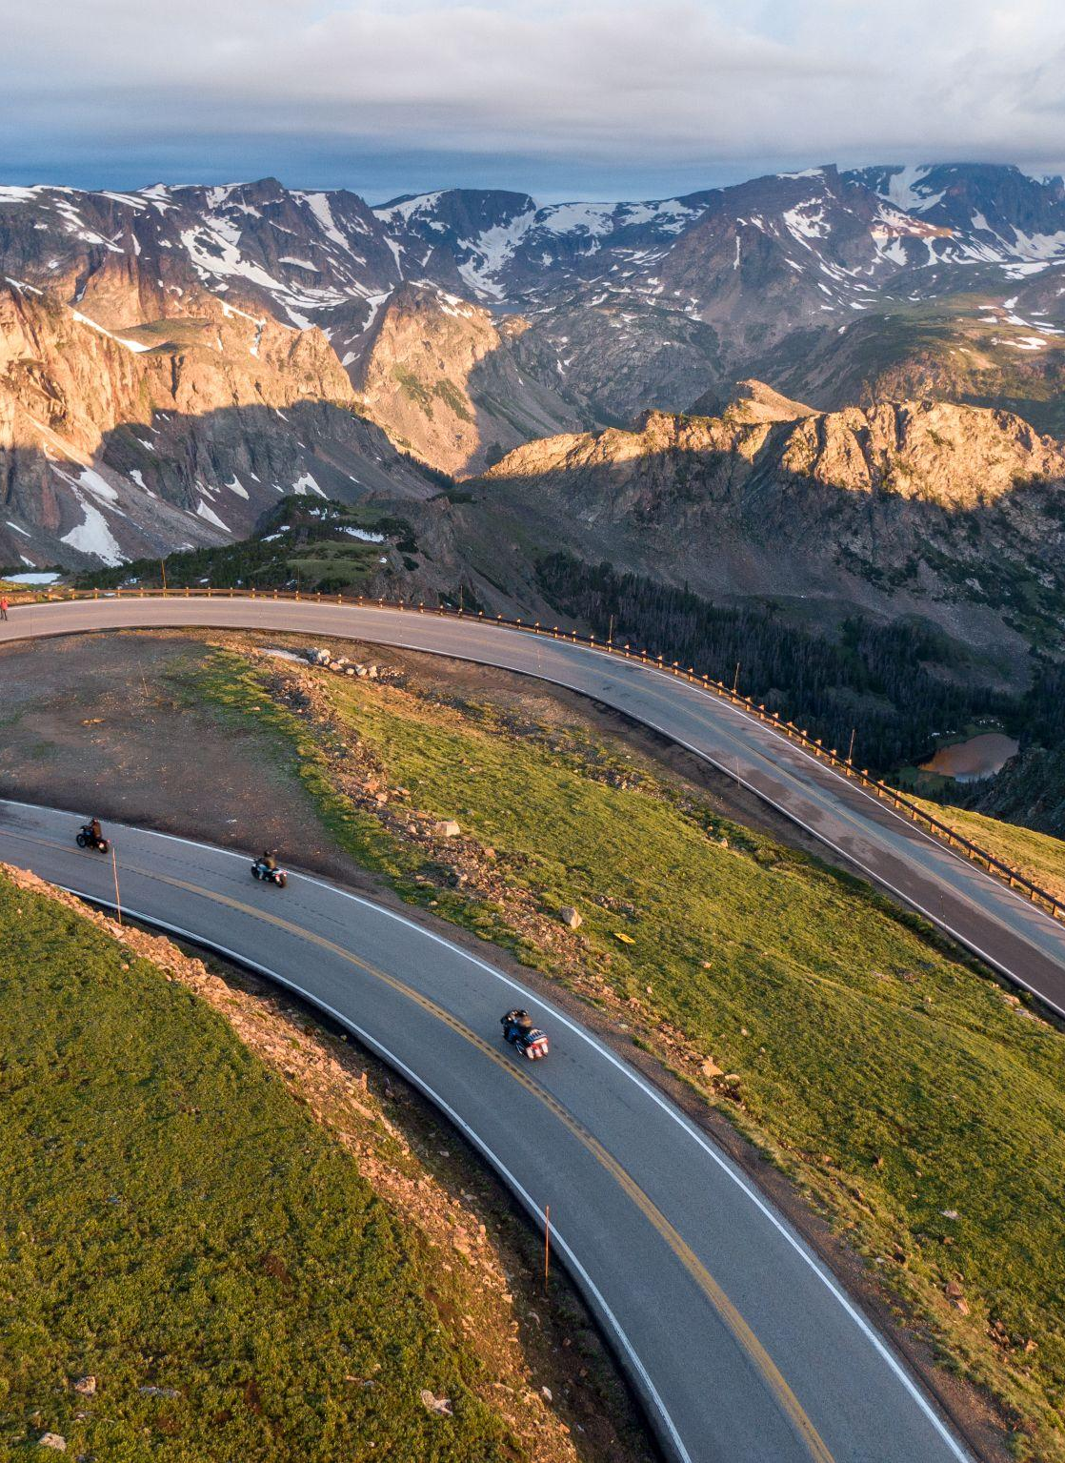
Key Takeaways
Travelers seek the allure of nature but prioritize affordability and good weather.
Yellowstone Country is seen as an appealing outdoor destination for adventure and peaceful recharging.
There's still a limited awareness of attractions and experiences outside Yellowstone National Park.
The biggest deterrents to visitation are distance/accessibility, perceived high costs (airfare, accommodation, in-market), and concerns about crowding/tourist saturation.
Top competitors include high-profile, upscale mountain destinations and other national park-adjacent destinations.
Warmer months dominate, but shoulder seasons are highly appealing; winter trip consideration remains low except among a small cold-weather traveler segment.
Firsthand referrals are the main inspiration for visitation, strongly supported by digital channels like online search and social media.

Slide 11
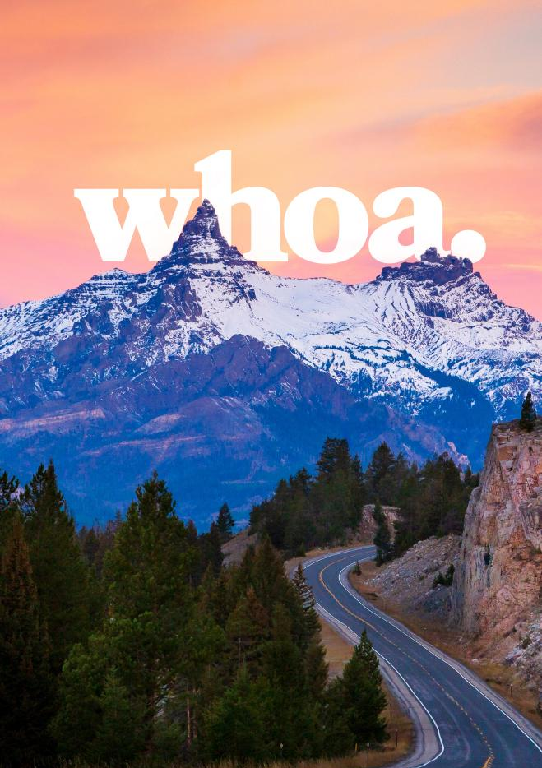
Campaign Development
At the start of 2026, Yellowstone Country green-lit the development of a single, unifying campaign that would take the study’s insights into consideration. The new Yellowstone Country campaign will:
Resonate with all audiences and promote all seasons.
Create a brand persona that supports executions customized for audience, season, demographic or interest/activity.
Distinguish the region from Yellowstone National Park and promote dispersion across the region.
Communicate the region’s dynamic of opposites — adventurous yet peaceful, rugged yet approachable — which is an ownable brand truth.

Slide 12
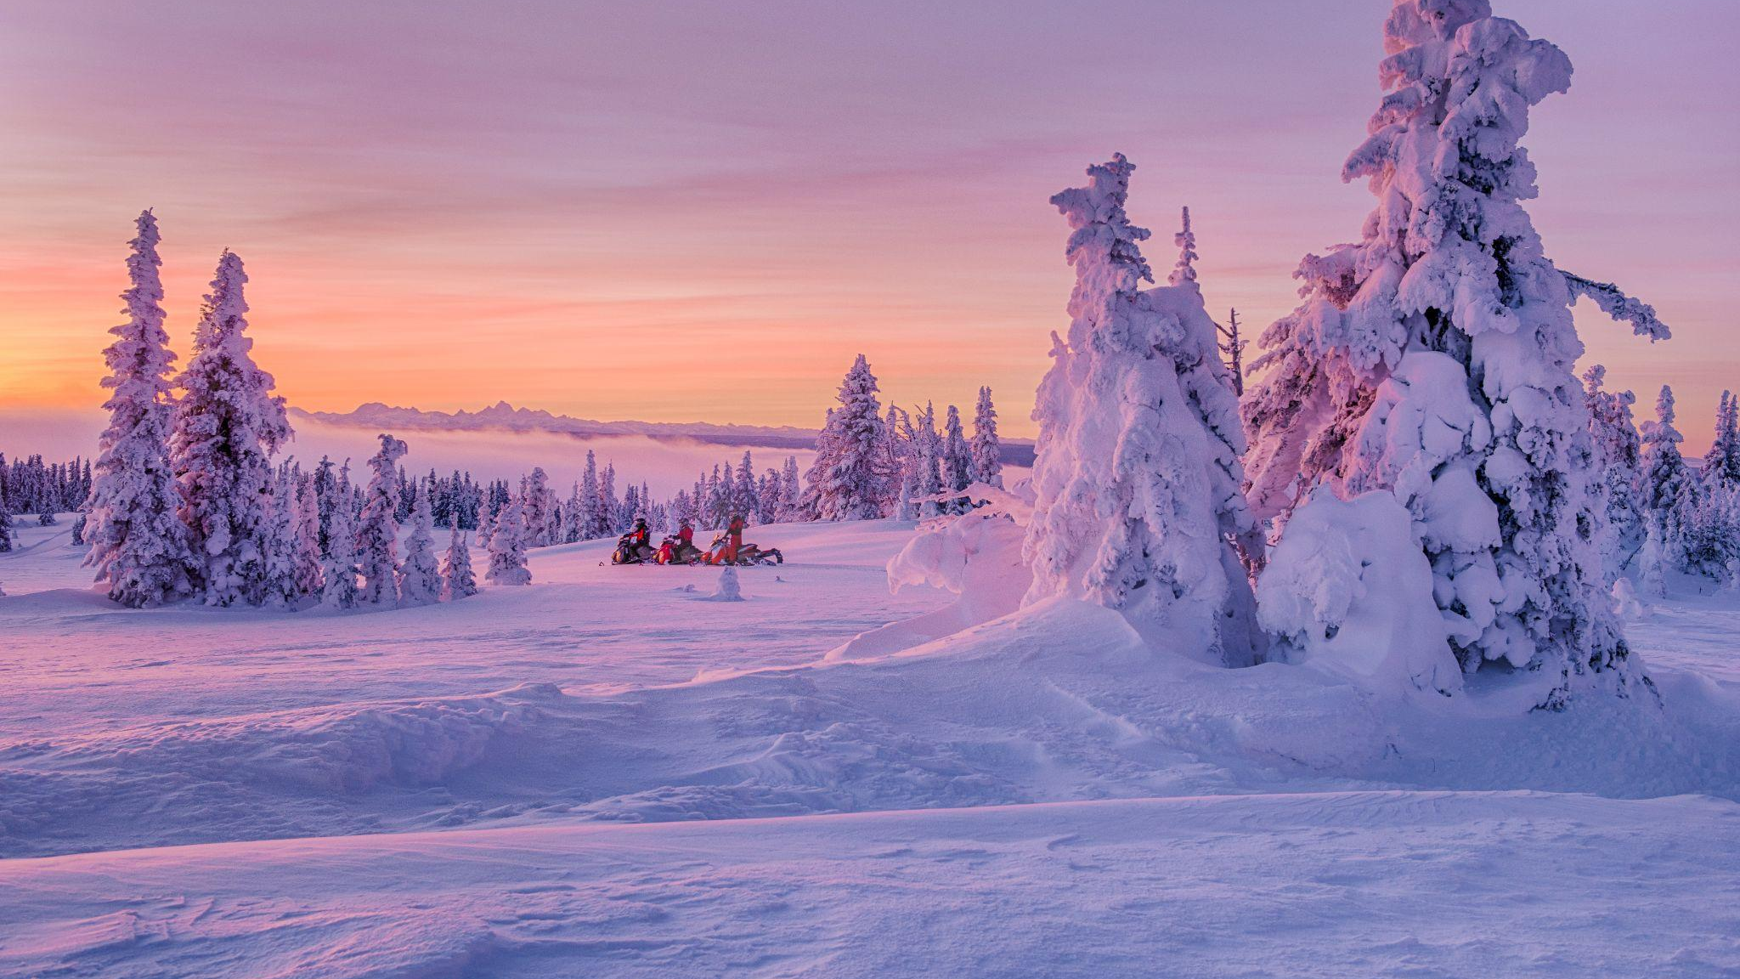
PRIORITY #2

Slide 13
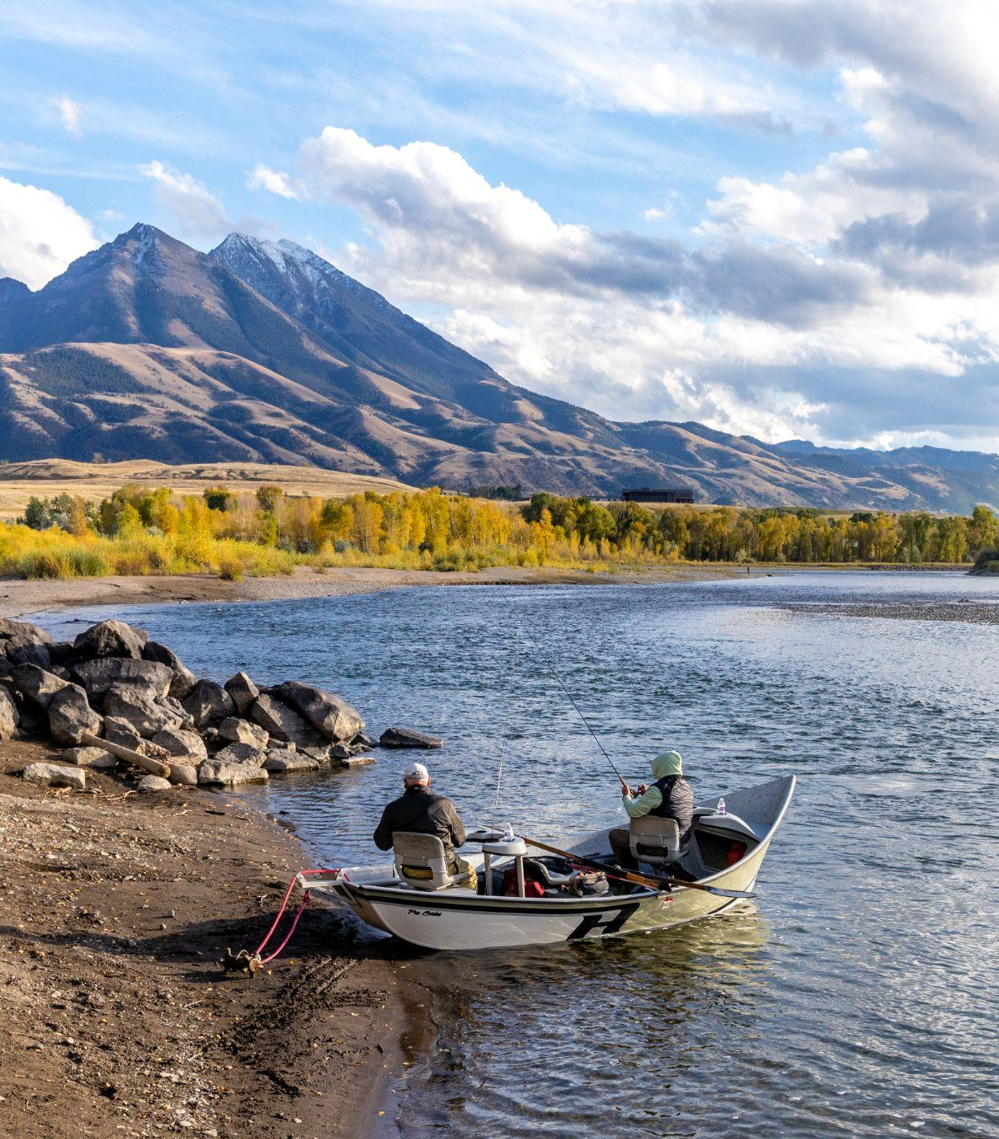
Advance Resiliency
Initiatives
PRIORITY #2
Continue to advance the initiatives in our 2023 Regional Tourism Resiliency Plan.
Strategies include:
Expanding our Resident Handbook to other platforms
Utilizing these products to collaborate on ongoing education and outreach goals.
(Strategic Resiliency Plan, 2022-2023, Imperative 2,
Strategy 4: Prioritize responsible destination promotion practices.)

Slide 14
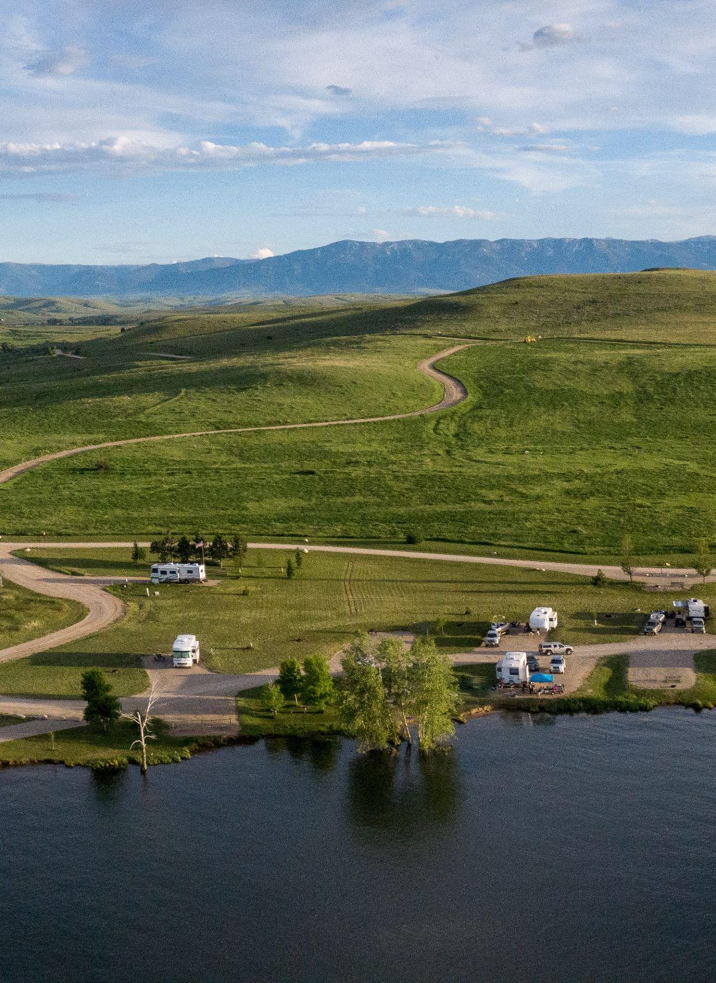
Resiliency Initiative Strategies (continued)
Develop a multifaceted frontline hospitality training program to help facilitate knowledge of and travel around the region.
Broaden our information and education resources to help build awareness around tourism and travel jobs that are available at local and regional levels.
(Strategic Resiliency Plan, 2022-2023, Imperative 3,
Strategy 6: Build programs and partnerships that sustain Yellowstone Country’s current and future workforce needs.)

Slide 15
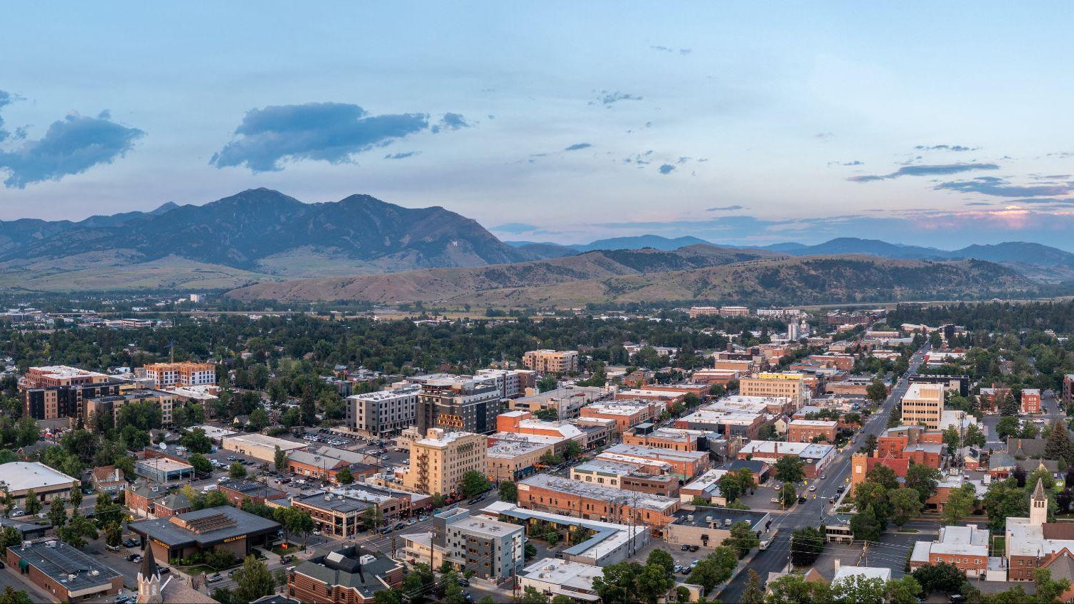
THANK YOU!
JANUARY 30, 2024

